Slide 1
Exoplanet Exploration
Hard science for stellar science fiction

Slide 2
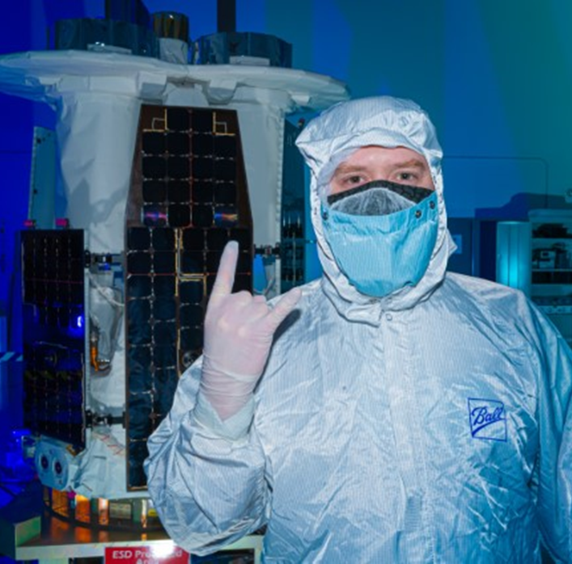
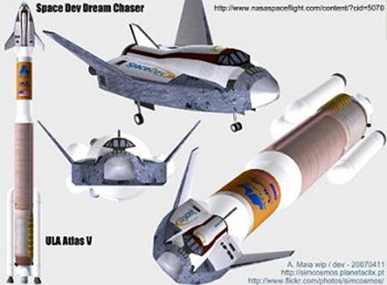
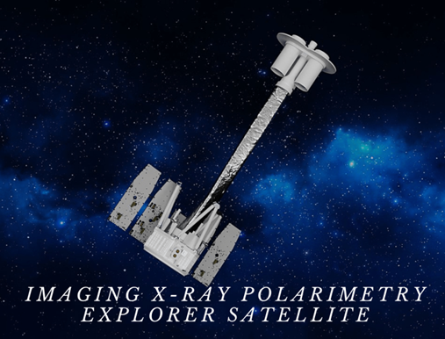
Hi! I’m Calvin

Slide 3
Table of contents
Find a world
Preliminary Steps – unmanned probes
Getting there – propulsion
The Human Equation – keeping us alive
Settlements Once There
Ethics

Slide 4
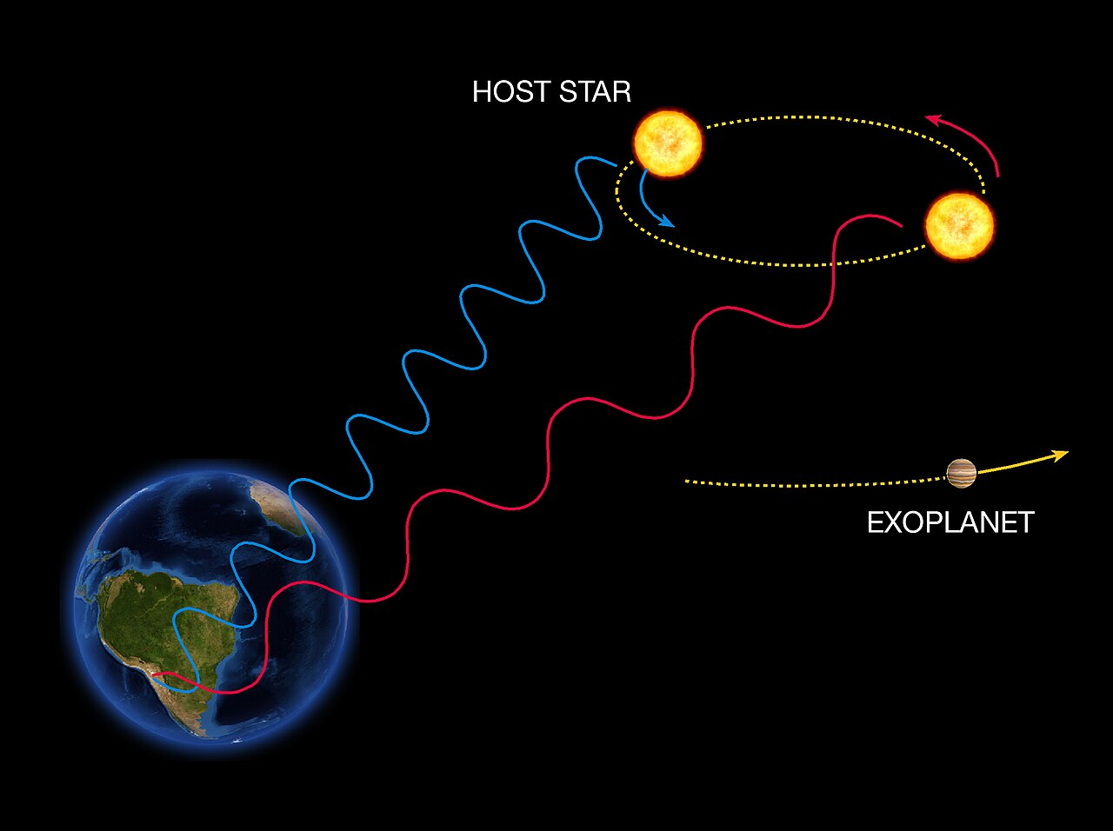
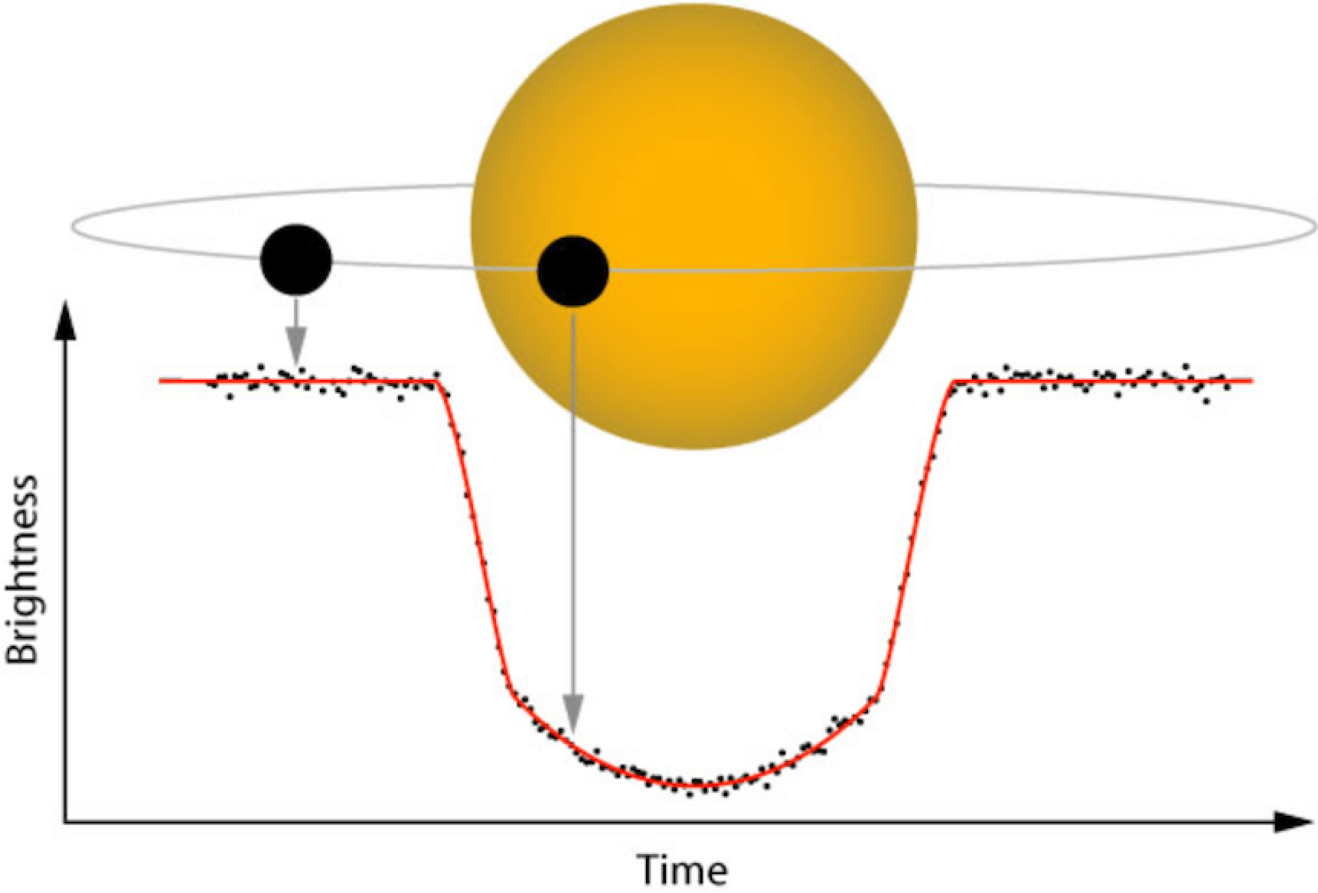
Step one: Find a World
Exoplanet targets are going to be scoped out from Earth* first using telescopes
Doppler Spectroscopy
Most often finds large planets close to stars
Previous best method to find planets
Transit Photometry – can determine atmosphere
Atmospheric Spectroscopy – determining atmospheres by the sunlight travelling through it

Slide 5
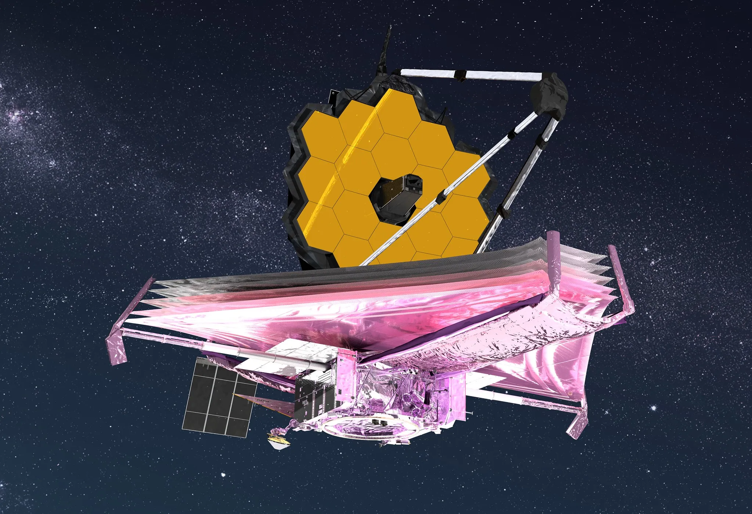
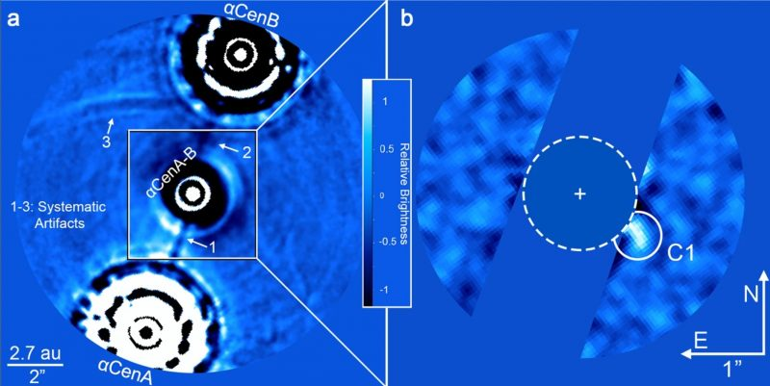
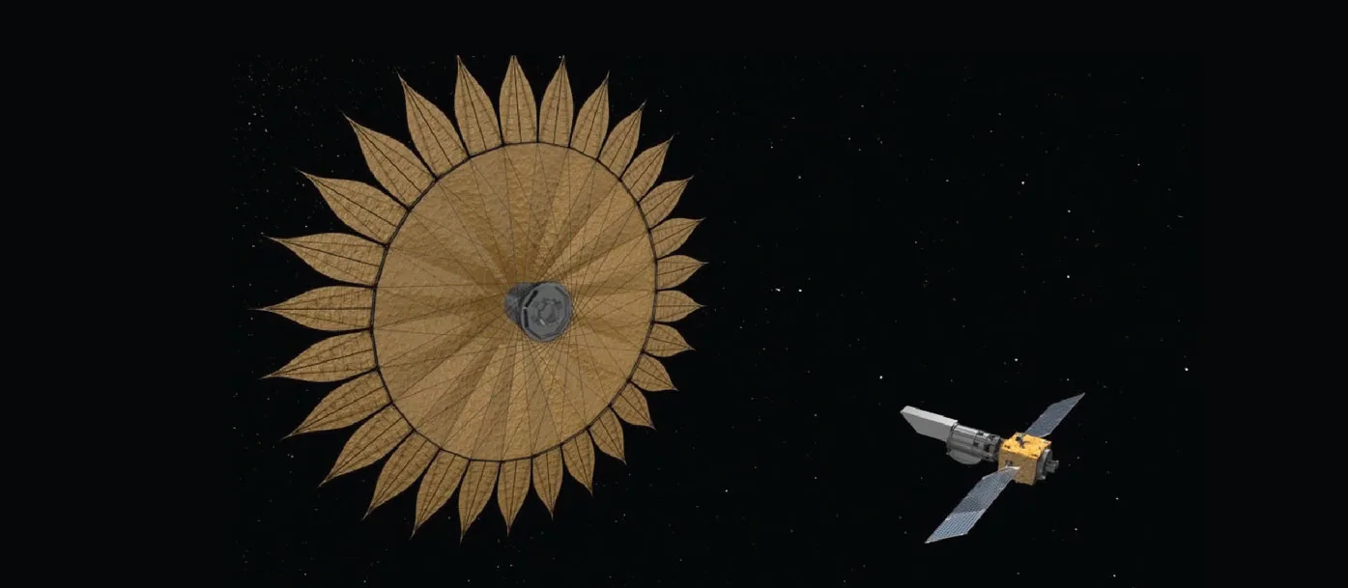
Finding a World
Direct imaging
Already directly imaged dozens of exoplanets!
More possible with better technology
Larger land-based and orbital telescopes planned
Solar-system-sized “binocular” telescopes in sun orbit
Block exoplanet’s star’s light with star-shaped occulter, or “Starshade”

Slide 6
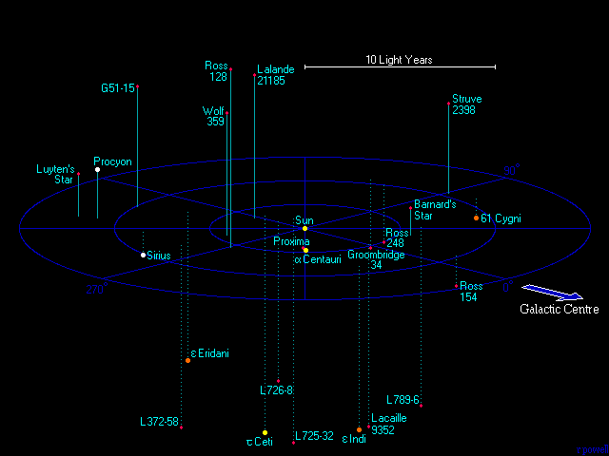
Targets
59 star systems within 40 light-years of Earth with 81 visible stars
Proxima Centauri – 4.24 LY
Nearest Star has a planet!
Barnard’s Star – 6 LY
No confirmed planets
Epsilon Eridani – 10.5 LY
1 large world, 2 asteroid belts
Tau Ceti – 11.8 LY
Possibly 4 planets, 2 in habitable zone
Trappist-1 – 40.7 LY
SEVEN planets, THREE in habitable zone

Slide 7
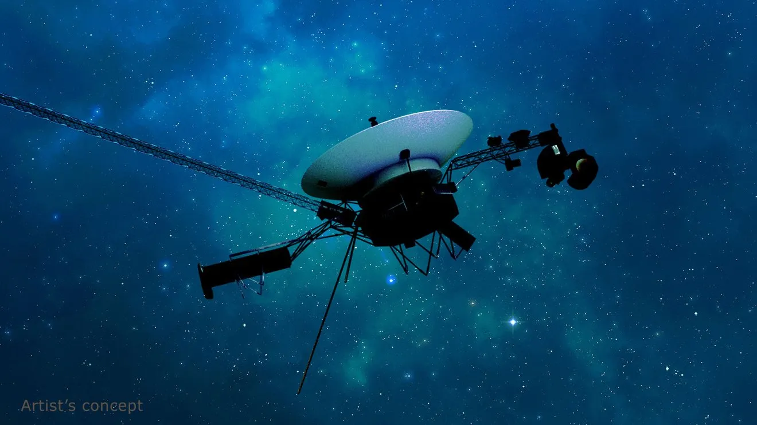
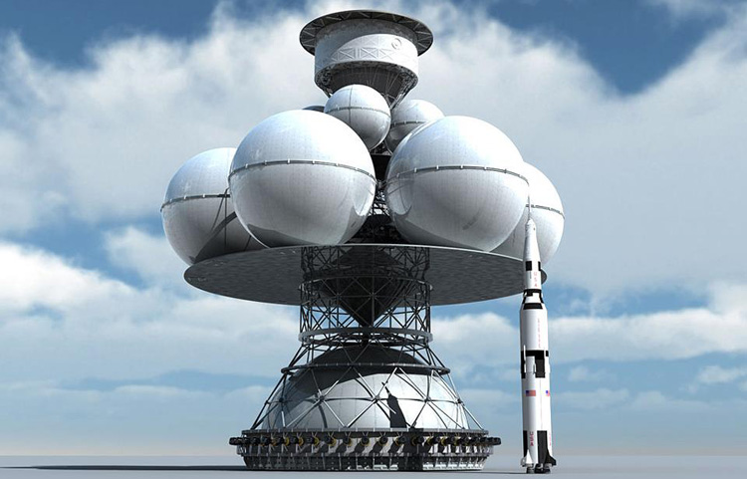
Step Two: Unmanned Probes
Slow
5 Already launched (Voyager 1 & 2, Pioneer 10 & 11, New Horizons)
Not targeting stars
Would take 40,000+ years to reach a star
Fast Flyby
Don’t need fuel to slow
Much cheaper and more technically feasible
One-way landing
Will require method of slowing down, multiply energy/fuel requirements
Return
Near impossible, requires in-situ resource development
Largely safe. Few threats to human life…

Slide 8
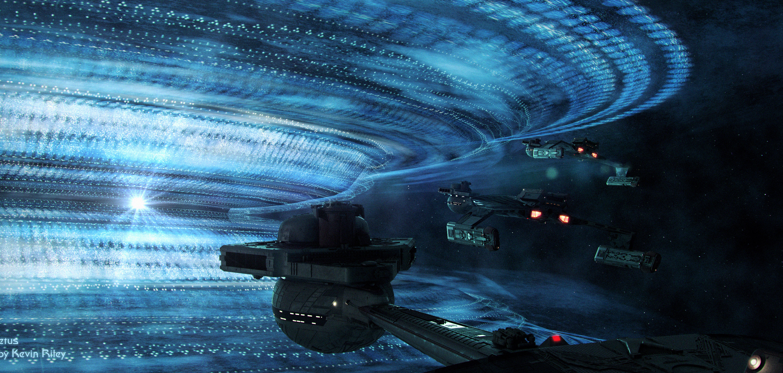
…But not none

Slide 9
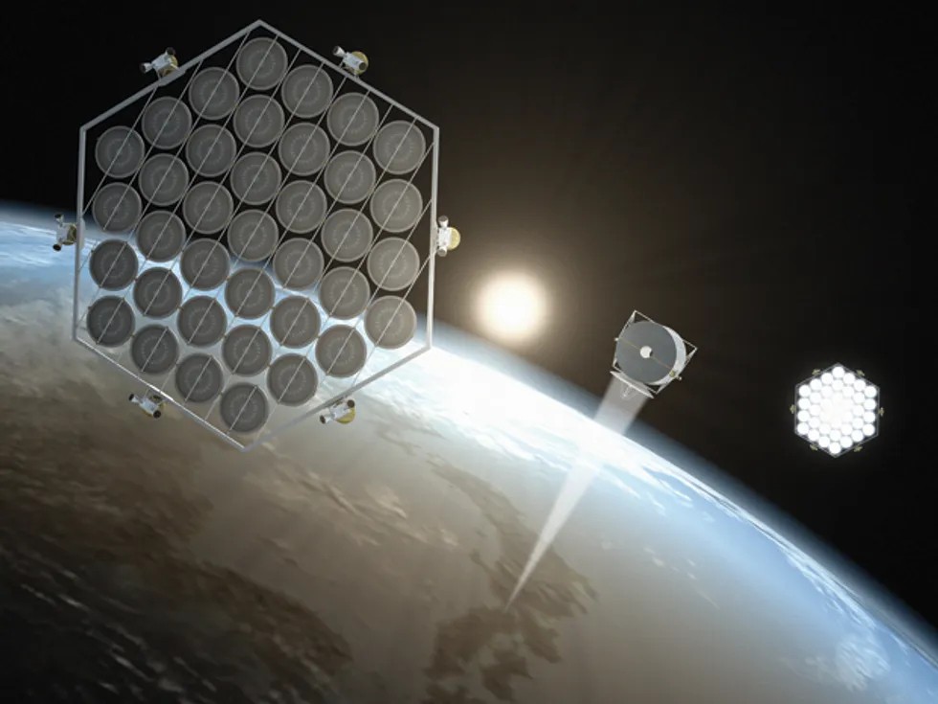
Problems Getting there – Insufficient Power
Energy development needs to increase
Interstellar missions require significant power
Accelerating 1 metric ton to 0.1c requires 125 terawatt-hours
2022 – Earth power consumption was 24,398 terawatt-hours, so ~2 days of world power required per ton
Minimum spacecraft mass is on the order of 100 tons to keep 6 people alive, not including consumables, so ~200 days of world power required
1980 – Earth power consumption was 8,132 terawatt-hours
1900 – Earth power generation was 66.4 terawatt-hours (66,400 gigawatt-hours)
Apollo 16 – 41.9 TJ = 41,900,000,000,000J = 11.639 gigawatt-hours, or 1.5 hours of 1900 power consumption
Space-based solar power could resolve Earthly power requirements and provide power to extrasolar missions
Continuous green energy with only 16 minutes blackout per orbiter
Realistically requires space-based industry to accomplish (or 100 launches per solar orbiter)

Slide 10
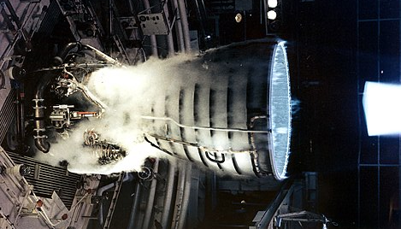
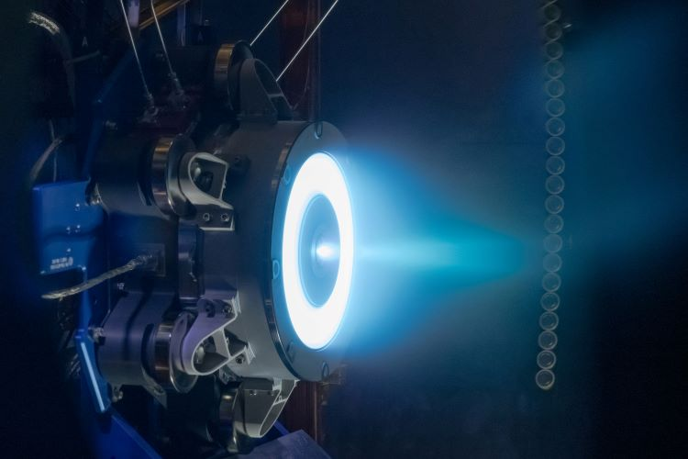
Problems Getting There - Inadequate Propulsion
Current Propulsion methods inadequate
Rocket Equation – Δv = v_{e}*ln(m_{o}/m_{f}) = I_{sp}*g_{o}*ln(m_{o}/m_{f})
Thrust vs Specific Impulse
Rocket Engines – high thrust (8MN best) but low specific impulse (465 s best achieved so far)
Requires huge fuel loads and heat dissipation
Electric Engines – high specific impulse (2,000-5,000 s) but miniscule thrust (25-250 mN)
Would take a century to accelerate to significant c-fractional speed

Slide 11
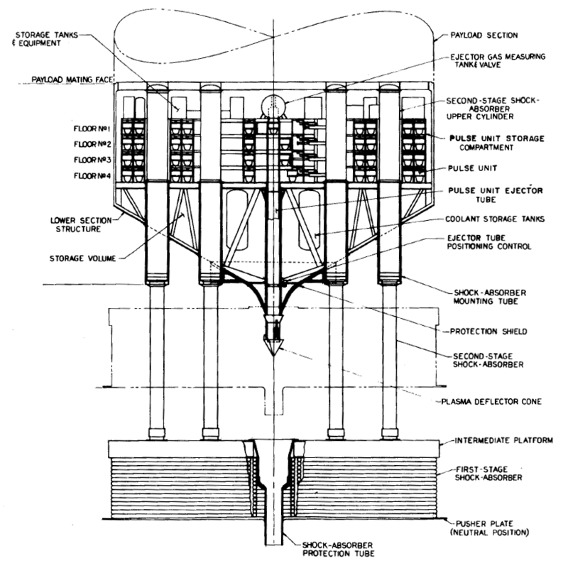
Step Three: Getting There – Nuclear Propulsion
Nuclear Thermal Rocket
Uses nuclear power to heat reaction mass
High thrust and high Isp
Isp up to 7,000s (nuclear lightbulb)
Fission-Fragment Rocket
Uses fission products directly for thrust
Spinning Disk, Dusty Plasma
Isp 100,000-1,000,000s
Nuclear Pulse Propulsion
A.K.A. BLOWING UP ATOM BOMBS
Huge thrust and high Isp (potentially 100ks)
Capable of .12c speeds

Slide 12
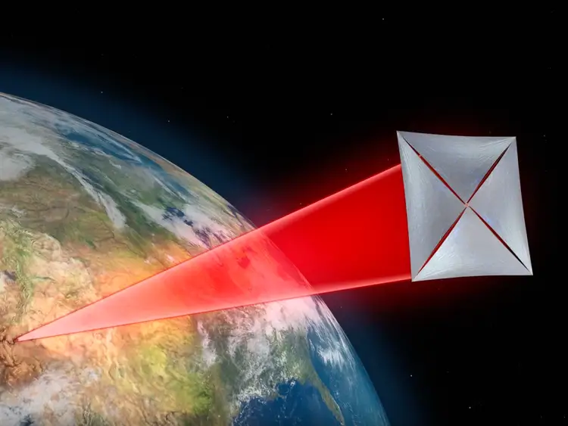
Step Three: Getting there – Beam Propulsion
Laser Rockets
External beam energizes reaction mass, reducing onboard mass by eliminating energy source
Limited by rocket equations
Difficult deceleration at target
Laser Sails
Propels solar-sail type craft with laser array from solar system
Can slow at destination via multiple detachable reflective sails
High mass and high volume sail required

Slide 13
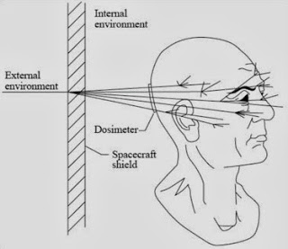
Step Four: Keeping Us Alive - problems
Time
All feasible propulsion methods reach .08-.25c
Travel to nears stars still takes decades
Interstellar medium
Microscopic dust/gas impacts corrode spacecraft
Macroscopic impacts cause nuclear-level detonations
Radiation
Cataracts
Cancer
Nerve System Damage
Weightlessness
Loss of bone and muscle mass
Slowing of cardiovascular system
Increased virus virulence

Slide 14
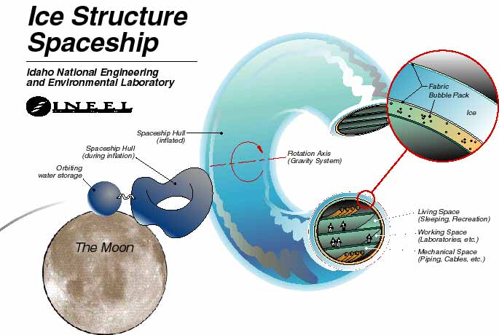
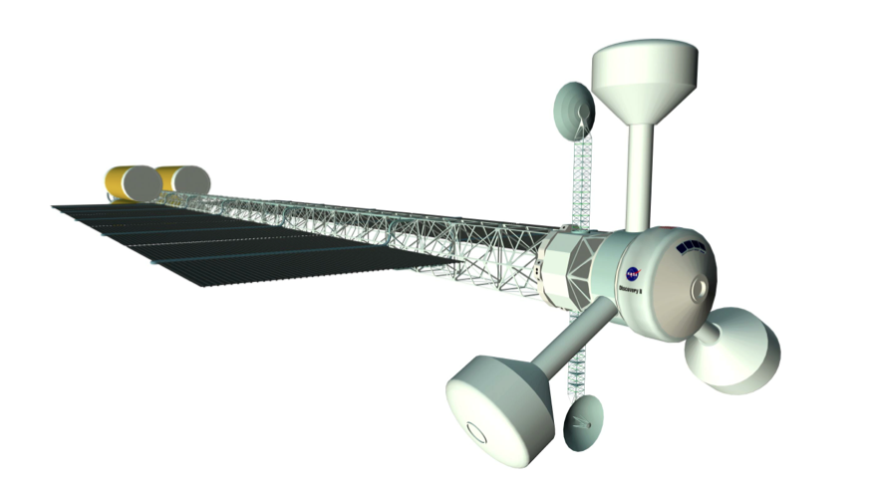
Step Four: Keeping Us ALive
Time
Entertainment, provisions, and a large spacecraft
Selection of crews who will work well together
Interstellar Medium
Particle Shield – cloud of particles precedes ship
Does not accelerate with ship
Will keep going until it hits something
Ablative Shield – accelerates with ship, but heavy
Radiation
Solid shielding – familiar, ineffective against cosmic radiation
Electromagnetic shield – Earth uses it, but power-intensive and tech isn’t there yet
Water jacket – effective against all radiation, but heavy
Weightlessness
Artificial gravity through centrifugal force
Continual thrust only lasts 1-2 years before max velocity is reached

Slide 15
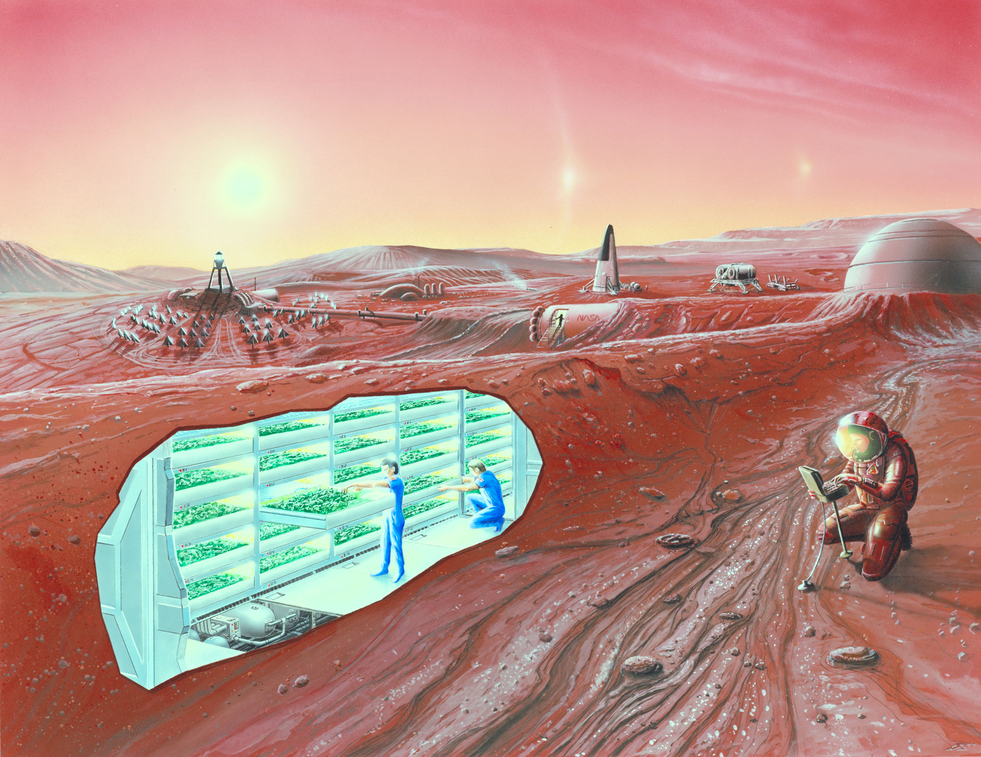
Step Five: Settling the Planet
Settlement much like spaceflight
Confined, likely pressurized environments
Suits needed for exterior exploration
No communication home (multi-year messages)
No return home
Benefits on-planet
Local building materials available
Room to expand living quarters
Local gravity
In-situ resource development available
Solar power
Minable materials
Plant growth in greenhouses

Slide 16
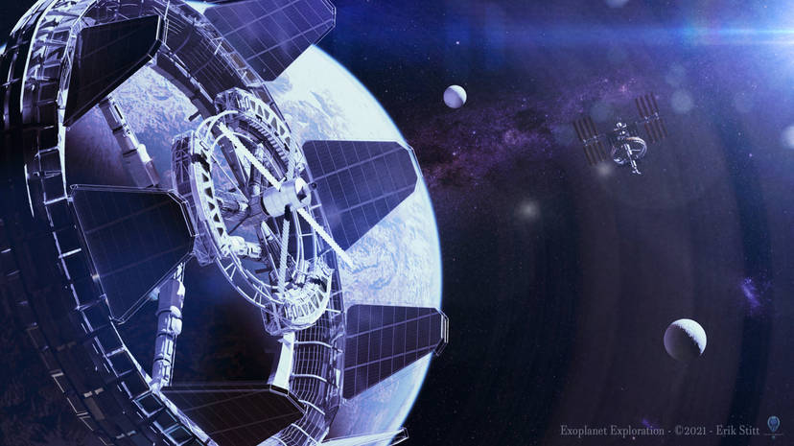
Benefits to extrasolar settlement
Cons
Huge resource expenditure
No material benefit to those who remain behind
Survival of the Human Species
Unifying purpose
Scientific advancement
Exploration could advance scientific knowledge
As modern space program provided benefits to all, so would developing extrasolar infrastructure
Satisfy human drive to explore

Slide 17
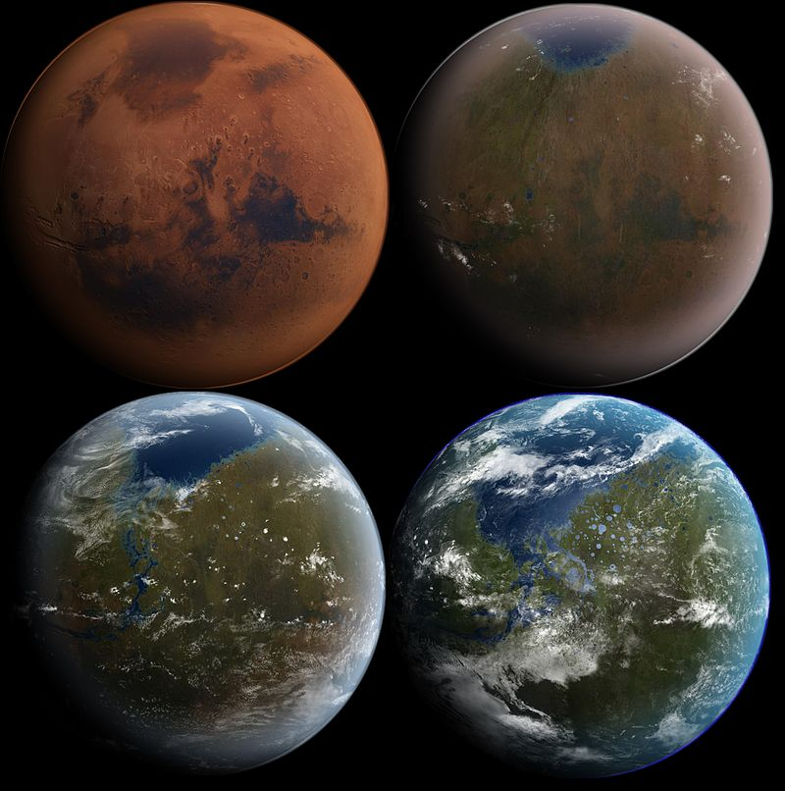
Interplanetary Ethics
What worlds should we colonize?
Lifeless Worlds
Least ethical problems
Least likely to be habitable
Worlds with Non-Sapient Lifeforms
Molecular oxygen most often a by-product of life
Potentially exploitable life (plants we can eat)
Worth destroying ecosystems?
Worlds with Sapient Life
Prime Directive

Slide 18
Questions?

