Slide 1
Serial Fiction
ZJ Czupor
Rocky Mountain fiction Writers’
gold conference
Sept. 29, 2024

Slide 2
Serial Fiction
Definitions
Timeline & History of Serial Fiction
  Print
  Radio
  Television
Present Day
  Print
  Social media platforms
  Streaming
Secrets to Writing Serial Fiction
Q&A

Slide 3
Serial Fiction
A serial is a work of entertainment,
something published or produced in installments
at regular intervals as a novel, or radio or television drama
that contains a narrative thread or overarching theme, as in a series.

Slide 4
Serial Fiction
Serialized fiction is a method of writing to keep readers engaged
Authors can publish with a low-cost barrier to entry
Serialized fiction is episodic storytelling popular for nearly 200 years
Popular not only in America, but around the world

Slide 5
Serial Fiction
Etymology
1610s: Proto-Indo-European; Latin serie, series,
      Meaning: row, chain, sequence, bind, link.
1711: Set of printed works published consecutively
1949: Set of radio or TV programs with same characters and themes
1971: Mini-series – a TV series of short duration on a single theme

Slide 6
Serial Fiction
Timeline of Serial Fiction
8th or 7th c. BC – Homer’s Odyssey
18th c. The Tales of 1001 Arabian Nights
1712 – The Stamp Act in England
1800s – Printing decreased costs and literacy increased
1836 – Charles Dickens, The Posthumous Papers of the Pickwick Club

Slide 7
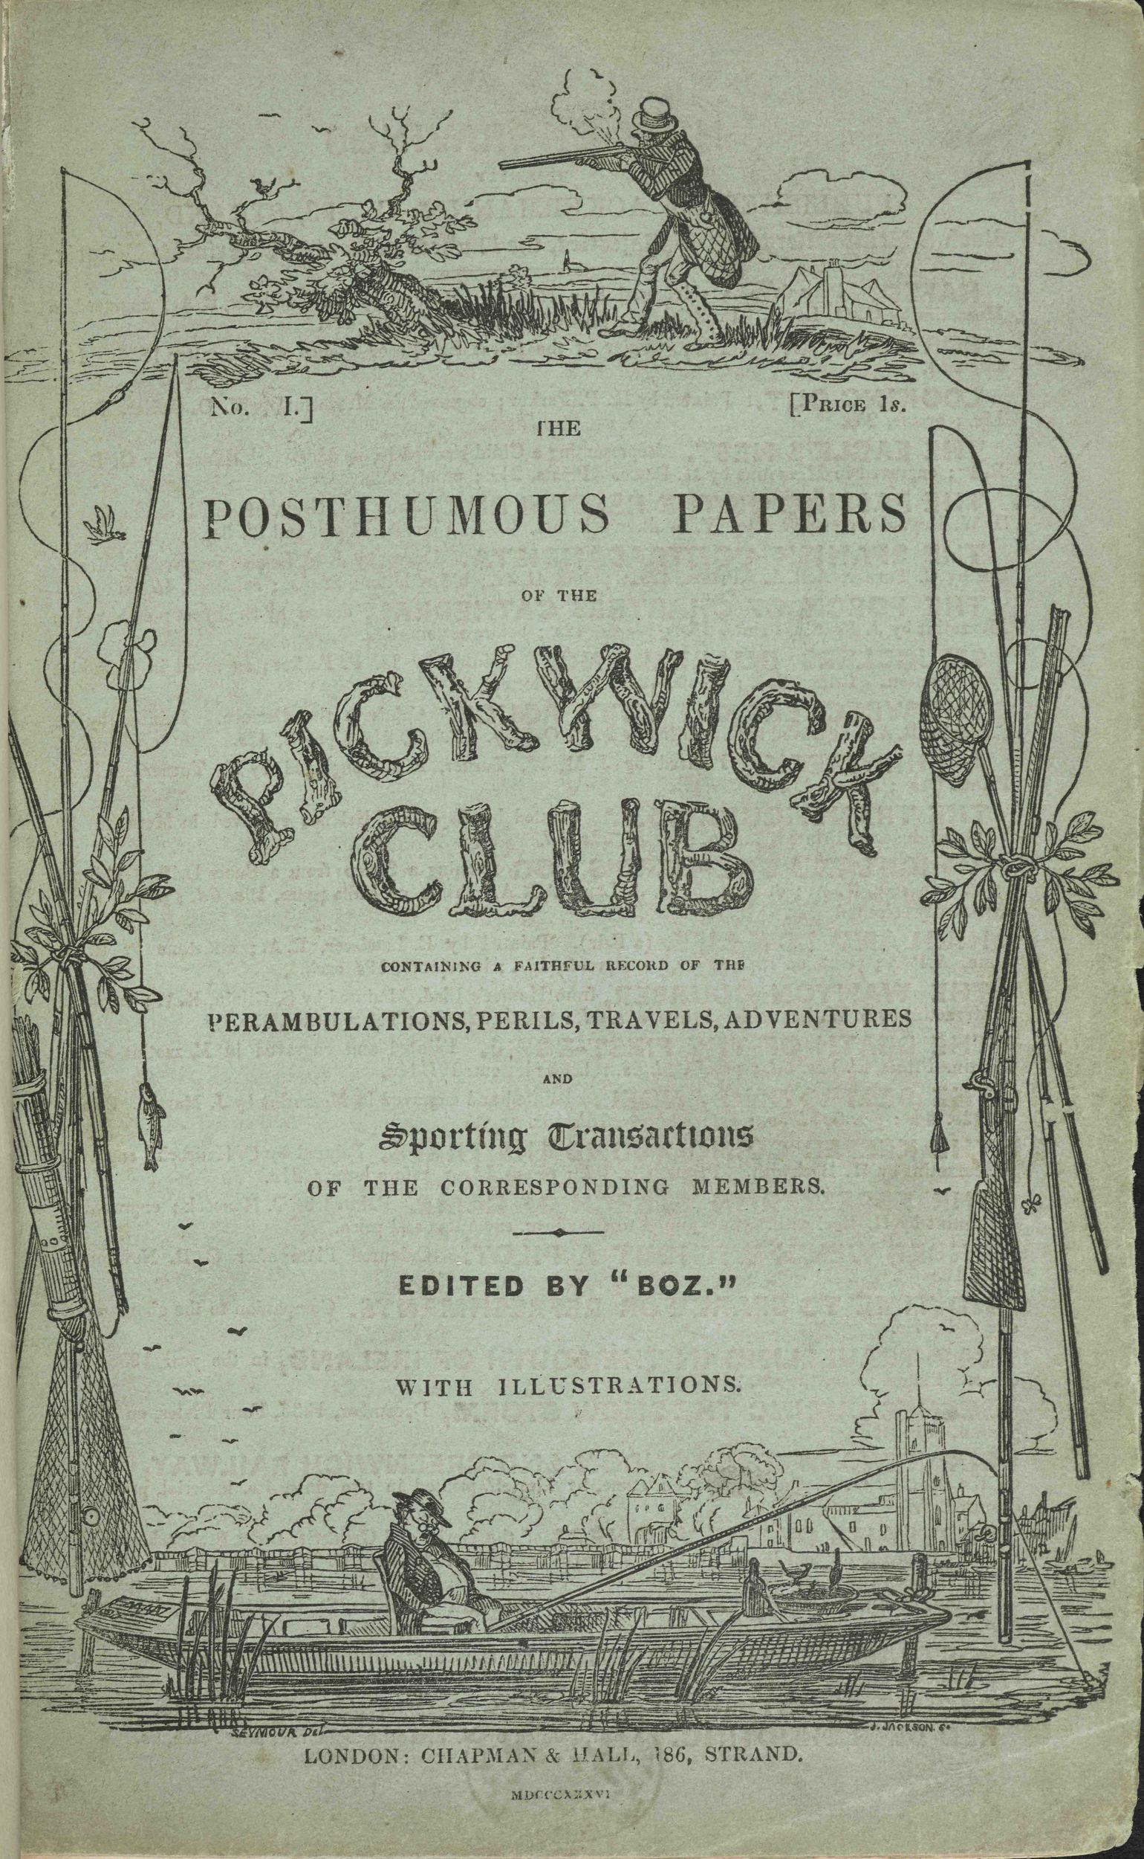
Serial Fiction
1836 – Charles Dickens, The Posthumous Papers of the Pickwick Club
19 installments in book format by Chapman & Hall
400 copies/month
40,000 copies per month at the end of the run
Also serialized: Nicholas Nickleby (1838-1839),
Great Expectations (1860-61), David Copperfield (1949-50) and others.

Slide 8
Serial Fiction
1872 – A Pair of Blue Eyes by Thomas Hardy
Reputedly the origin of the term “cliffhanger”
1878 – Scribner’s Monthly, “Now it is the second or third-rate novelist who cannot get publication in a magazine and is obliged to publish it in a volume, and it is in the magazine that the best novelist always appears first.”

Slide 9
Serial Fiction
ENGLAND –
Sir Arthur Conon Doyle, Sherlock Holmes (1891)
Joseph Conrad, Heart of Darkness (1899)
FRANCE –
Alexandre Dumas, The Count of Monte Cristo (1844-46), The Three Musketeers (1844)
Gustave Flaubert, Madame Bovary (1856)

Slide 10
Serial Fiction
RUSSIA--
Leo Tolstoy, Anna Karenina (1873-1877)
Fyodor Dostoevsky, Crime & Punishment (1866)
ITALY—
Carlo Collodi, The Adventures of Pinocchio (1881)
FRANCE, CHINA, JAPAN, POLAND

Slide 11
Serial Fiction
UNITED STATES –
Harriet Beecher Stowe, Uncle Tom’s Cabin (1851)
Mark Twain, Pudd’nhead Wilson (1893)
Upton Sinclair, The Jungle (1905)

Slide 12
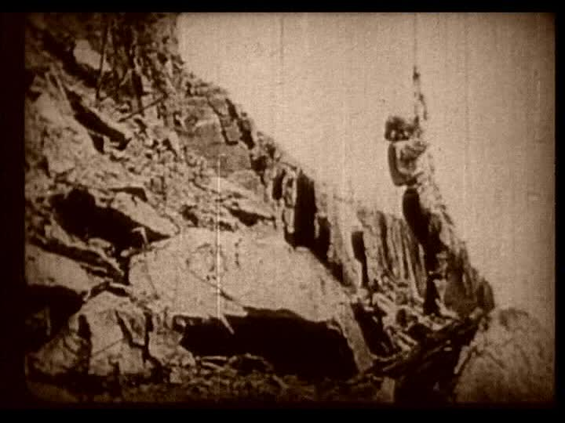
Serial Fiction
Film industry discovered popularity of serials
1912 What Happened to Mary
1914 The Perils of Pauline

Slide 13
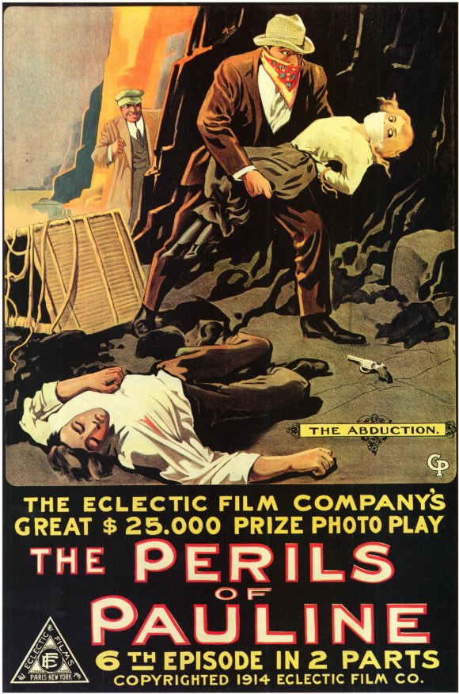
Serial Fiction
The Perils of Pauline by Charles W. Goddard and George B. Setz
Produced by William Randolph Hearst
Eclectic Film Company
20 chapters in bi-weekly installments
The Exploits of Elaine
The Hazards of Helen
The Active Life of Dolly of the Dailies

Slide 14
Serial Fiction
1920s
Magazine sales soared and serial fiction blossomed
Harper’s and The Atlantic
1930s – The Golden Age of Serials in film
Little Orphan Annie, The Lone Ranger, Adventures of Superman, Perry Mason
1937 – term “cliffhanger” applied to serial movies

Slide 15
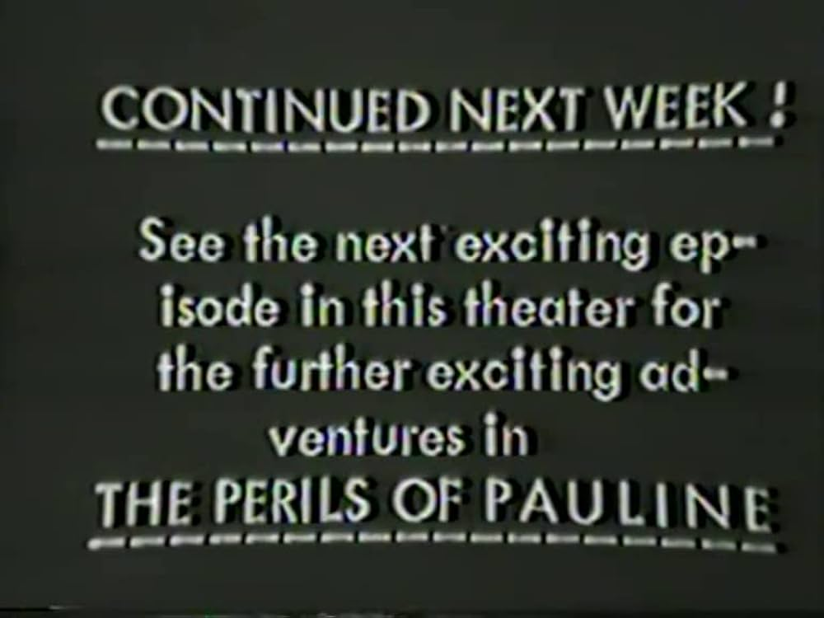
Serial Fiction

Slide 16
Serial Fiction
1940s
BBC produced more than 400 serial plays for radio
The Shadow, The Green Hornet, Flash Gordon, The Spider, Adventures of Captain Marvel, Batman, The Phantom, etc.
1950s
Advent of TV, radio dramas began losing audience and began the emergence of daytime “soap operas”

Slide 17
Serial Fiction
“I think people like stories that continue so they can relate to these people. They become like a family, and the viewer becomes emotionally involved. There seem to be two attitudes by viewers. One, that the stories are similar to what happened to them in real life, or two, thank goodness that isn't me.”
— H. Wesley Kenney, 1988, executive producer, General Hospital,

Slide 18
Serial Fiction
The Archers, 1950 – BBC Radio, world’s longest running radio soap opera
These Are My Children, 1949 – US first daytime soap opera
The Guiding Light, 1937 on radio; 1952 -2009 on TV –longest running soap opera of any kind.
  Began as 15-min. daily installments. Expanded to 30 min., then to hour-long segments.
Also popular in Australia, Britain, Canada, Egypt, Europe, Greece, India, Latin America, Turkey, and Russia

Slide 19
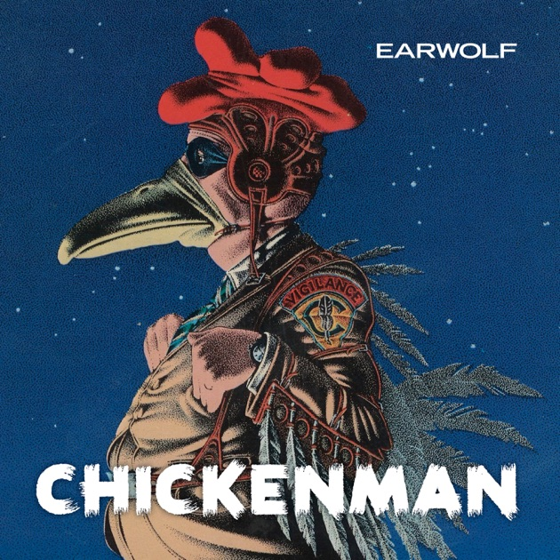
Serial Fiction
1966

Slide 20
Serial Fiction
1980s
Societal changes impacted popularity of soap operas
Primetime serials
  Peyton Place, Dallas, Knots Landing, Dynasty, Falcon Crest, Hill Street Blues, Cagney & Lacy, St. Elsewhere, etc.
1990s
Beverly Hills 90210, Melrose Place, The O.C., Dawson’s Creek, Desperate Housewives, Grey’s Anatomy, Nashville, etc.
2001
“24”

Slide 21
Serial Fiction
Contemporary authors who first serialized fiction
Ernest Hemingway, A Farewell to Arms, 1929
Truman Capote, Breakfast at Tiffany’s, 1965
Charles Portis, True Grit, 1968
Hunter S. Thompson, Fear and Loathing in Las Vegas, 1971
Tom Wolfe, The Bonfire of the Vanities, 1984
Stephen King, The Green Mile, 1996

Slide 22
Serial Fiction
More Recent Authors Who Began Careers with Serial Fiction
Andy Weir, The Martian
Hugh Howey, Wool
John C. “Wildbow” McCrae, Worm

Slide 23
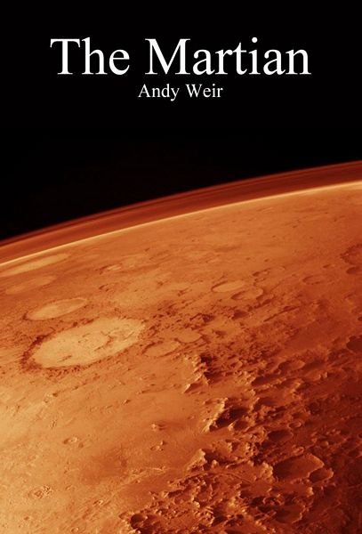
Serial Fiction

Slide 24
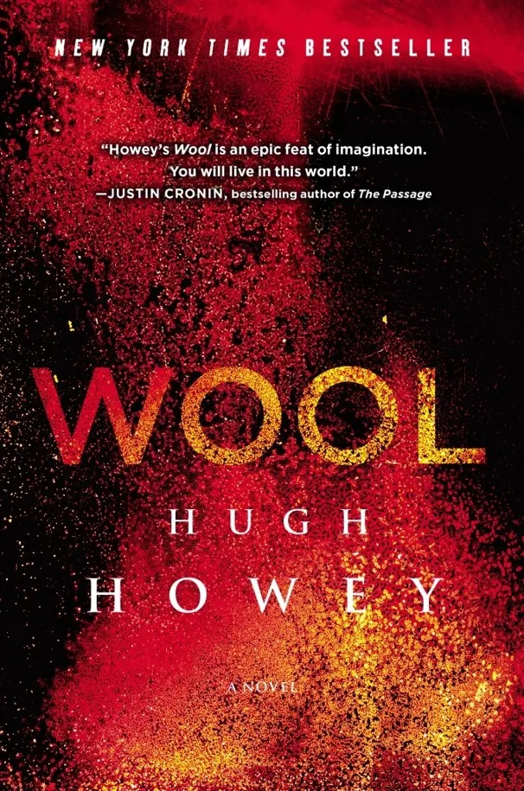
Serial Fiction

Slide 25
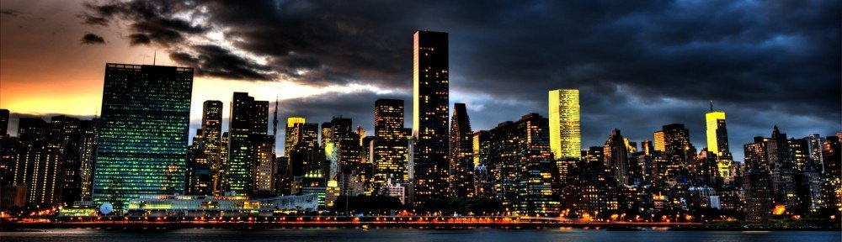
Serial Fiction
Worm by John C. McCrae

Slide 26
Serial Fiction
Fast forward to modern times
New technology offers new options for serial fiction
Social media platforms
Television streaming

Slide 27
Serial Fiction
Social Media Platforms
Substack
Wattpad
Inkitt
Kindle Vella
Realm
Radish
Tapas

Slide 28
Serial Fiction
Streaming Platforms that Feature Serial Fiction
Amazon Prime Video, 2006
Netflix, 2007
Hulu, 2007 (NBC+Fox), in 2019 Disney became a major owner
TV.com, 2009 (CBS)
Paramount+, 2014 (Paramount Global Media Co.)
Apple TV+, 2019
Disney+, 2019
Peacock, 2020 (subsidiary, NBC Universal)
HBO Max, 2021 (Warner Media)
Discovery+, 2021 (Warner Bros. Discovery)
Source: Nielsen

Slide 29
Serial Fiction
Top 10 Streaming Serial Programs 2024
The Perfect Couple, limited series
The Penguin, limited series
KAOS, season 1
The Lord of the Rings: The Rings of Power, season 2
The Old Man, season 2
Slow Horses, season 4
Kevin Can F**K Himself, season 1
Dark Winds, season 2
English Teacher, season 1
Bad Monkey, season 1
Source: Rotten Tomatoes

Slide 30
Serial Fiction
Secrets to Writing Serial Fiction
The plan
Character profiles
Plot diagram
Keep the reader engaged
Writing cliffhangers

Slide 31
Serial Fiction
THE PLAN – Two approaches
Finish your novel first
Write it on the fly

Slide 32
Serial Fiction
CHARACTER PROFILES
Desire
Goals
Motivation
Flaws

Slide 33
Serial Fiction
CHARACTER | DESIRE | GOALS | MOTIVATION | FLAWS
Samantha “Sam” Eggers
Grace Eggers - Mom
Otto Eggers - Dad
Aunt George
Mabrey “Mabs”
Dr. Tom Cavendish
Sheriff Chad Fuller
Alexander Federov

Slide 34
Serial Fiction
ACT ONE | ACT TWO | ACT THREE
Opening Image | Break into two | Break into three
Theme Stated | B-story | Finale
Set-up | Fun & Games | Finale image
Catalyst | Midpoint
Debate | Bad guys close in
 | All is lost
 | Dark night of the soul

Slide 35

Serial Fiction
KEEP THE READER ENGAGED

Slide 36
Serial Fiction
“At the end, something has to propel you into the next chapter.”
--James Patterson

Slide 37
Serial Fiction
WRITING CLIFFHANGERS
Suspenseful situation
Shocking revelation or unanswered question
Change of location
Change POV
Break up chapter lengths
Delay the climax
Offer new information or plot twist
End on high emotion or low note
Promise of events to come
Mysterious line of dialogue
Ominous metaphor

Slide 38
Serial Fiction
Final thoughts
Serial Fiction – long and rich history
Compelling stories
Technology the constant
We live in exciting times with more opportunities.

Slide 39
Serial Fiction
“Our instinct as human beings is to provide answers, to ease tension. As writers our job is the opposite, to create tension and not dispel it immediately.”
– Sol Stein

Slide 40
Serial Fiction
“People have forgotten how to tell a story. Stories don’t have a middle or an end anymore. They usually have a beginning that never stops beginning.”
- Steven Spielberg.

Slide 41

zoltanjames.com
Zjames.substack.com

