Slide 1
Let's Get Down to Business: How to Start a Business For Your Writing/Editing
Speaker: Mel Koons
Helper: Rebecca Rowley

Slide 2
Starting a Business: Roadmap
How to make sure you don’t pick a name that someone has already registered
Which type of business to file for (sole proprietor or LLC)
Where to file (SOS)
Tax information and numbers (EIN registration)
Beware of scammers!
What licenses you need to sell your work or services (sales tax vs special event licenses, etc.)
Basic bookkeeping for maintaining a good standing with the IRS (expenses, sales, income, etc.)
Websites and why they’re important for more than just marketing
Including your business in your annual tax return

Slide 3
Starting a Business in Colorado
Secretary of State < Register your business
EIN < Get a employer tax ID
Department of Revenue < Get a sales tax license
Revenue Online < Pay taxes
Small Business Resources from IRS

Slide 4
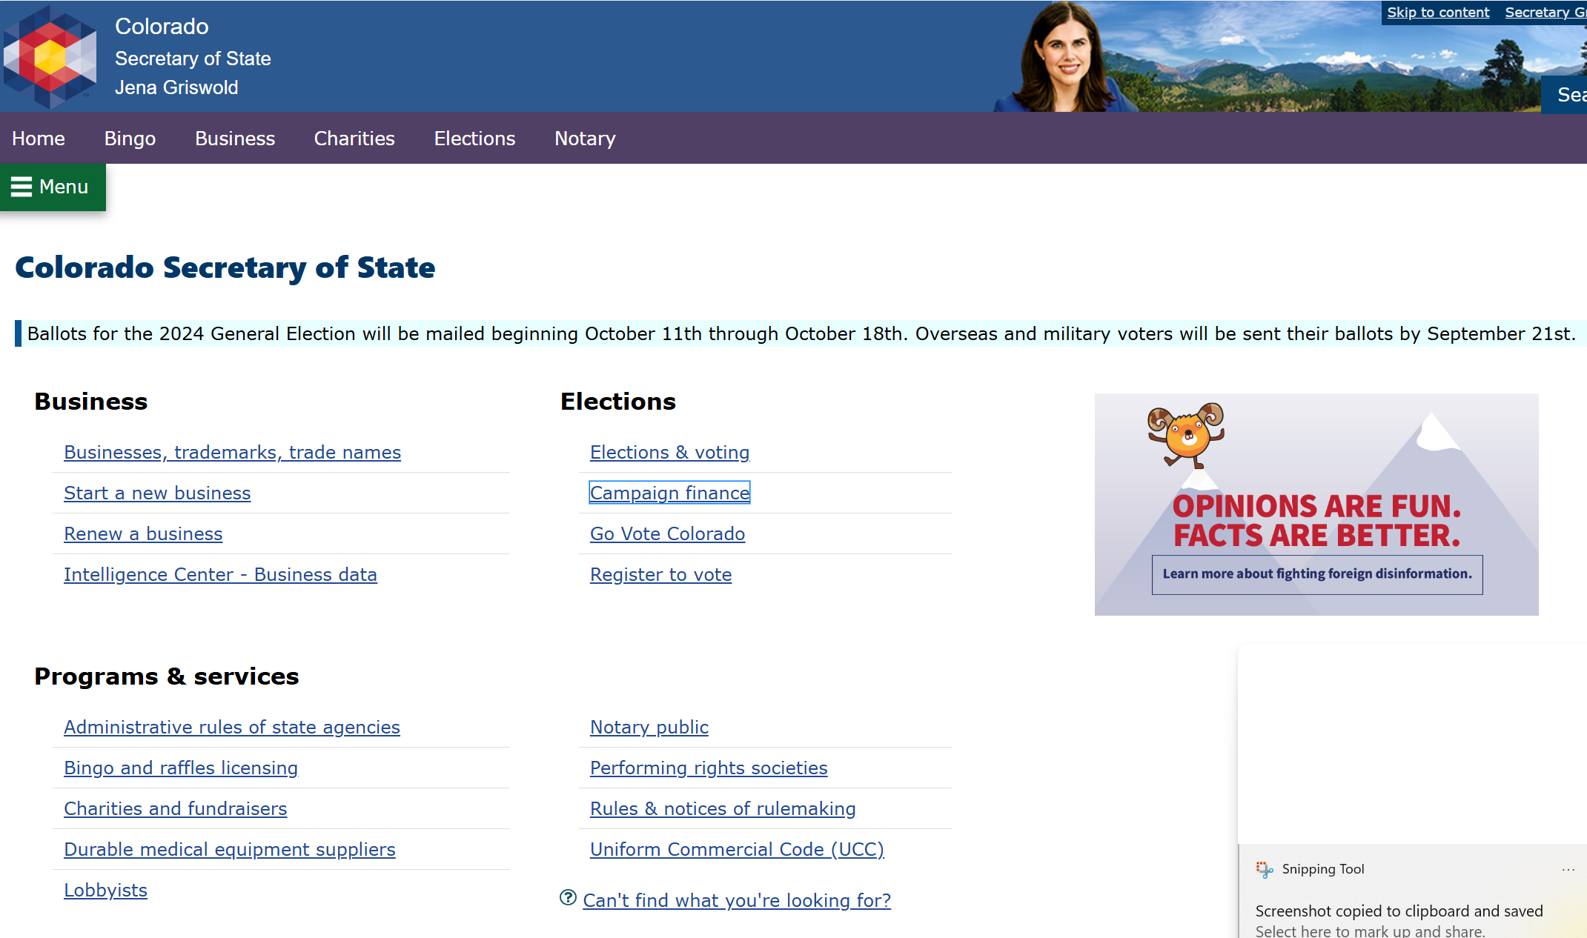
Colorado Secretary of State

Slide 5
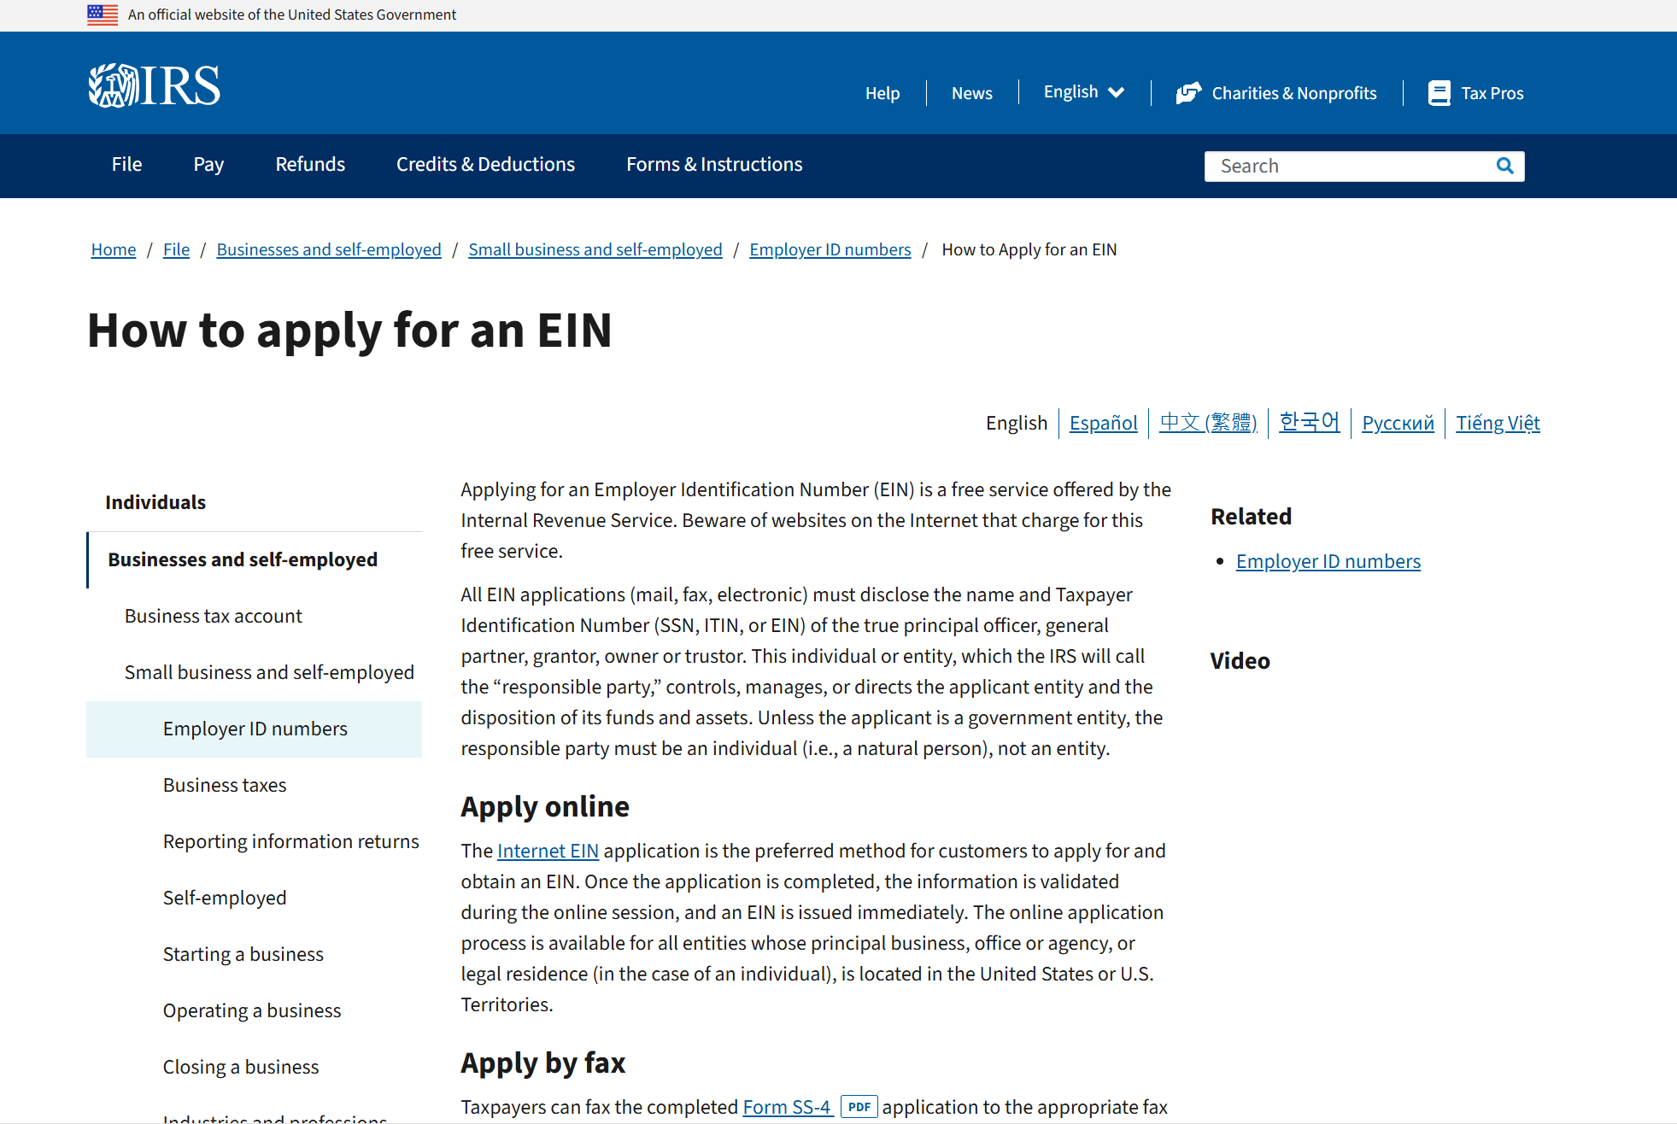
IRS.Gov

Slide 6
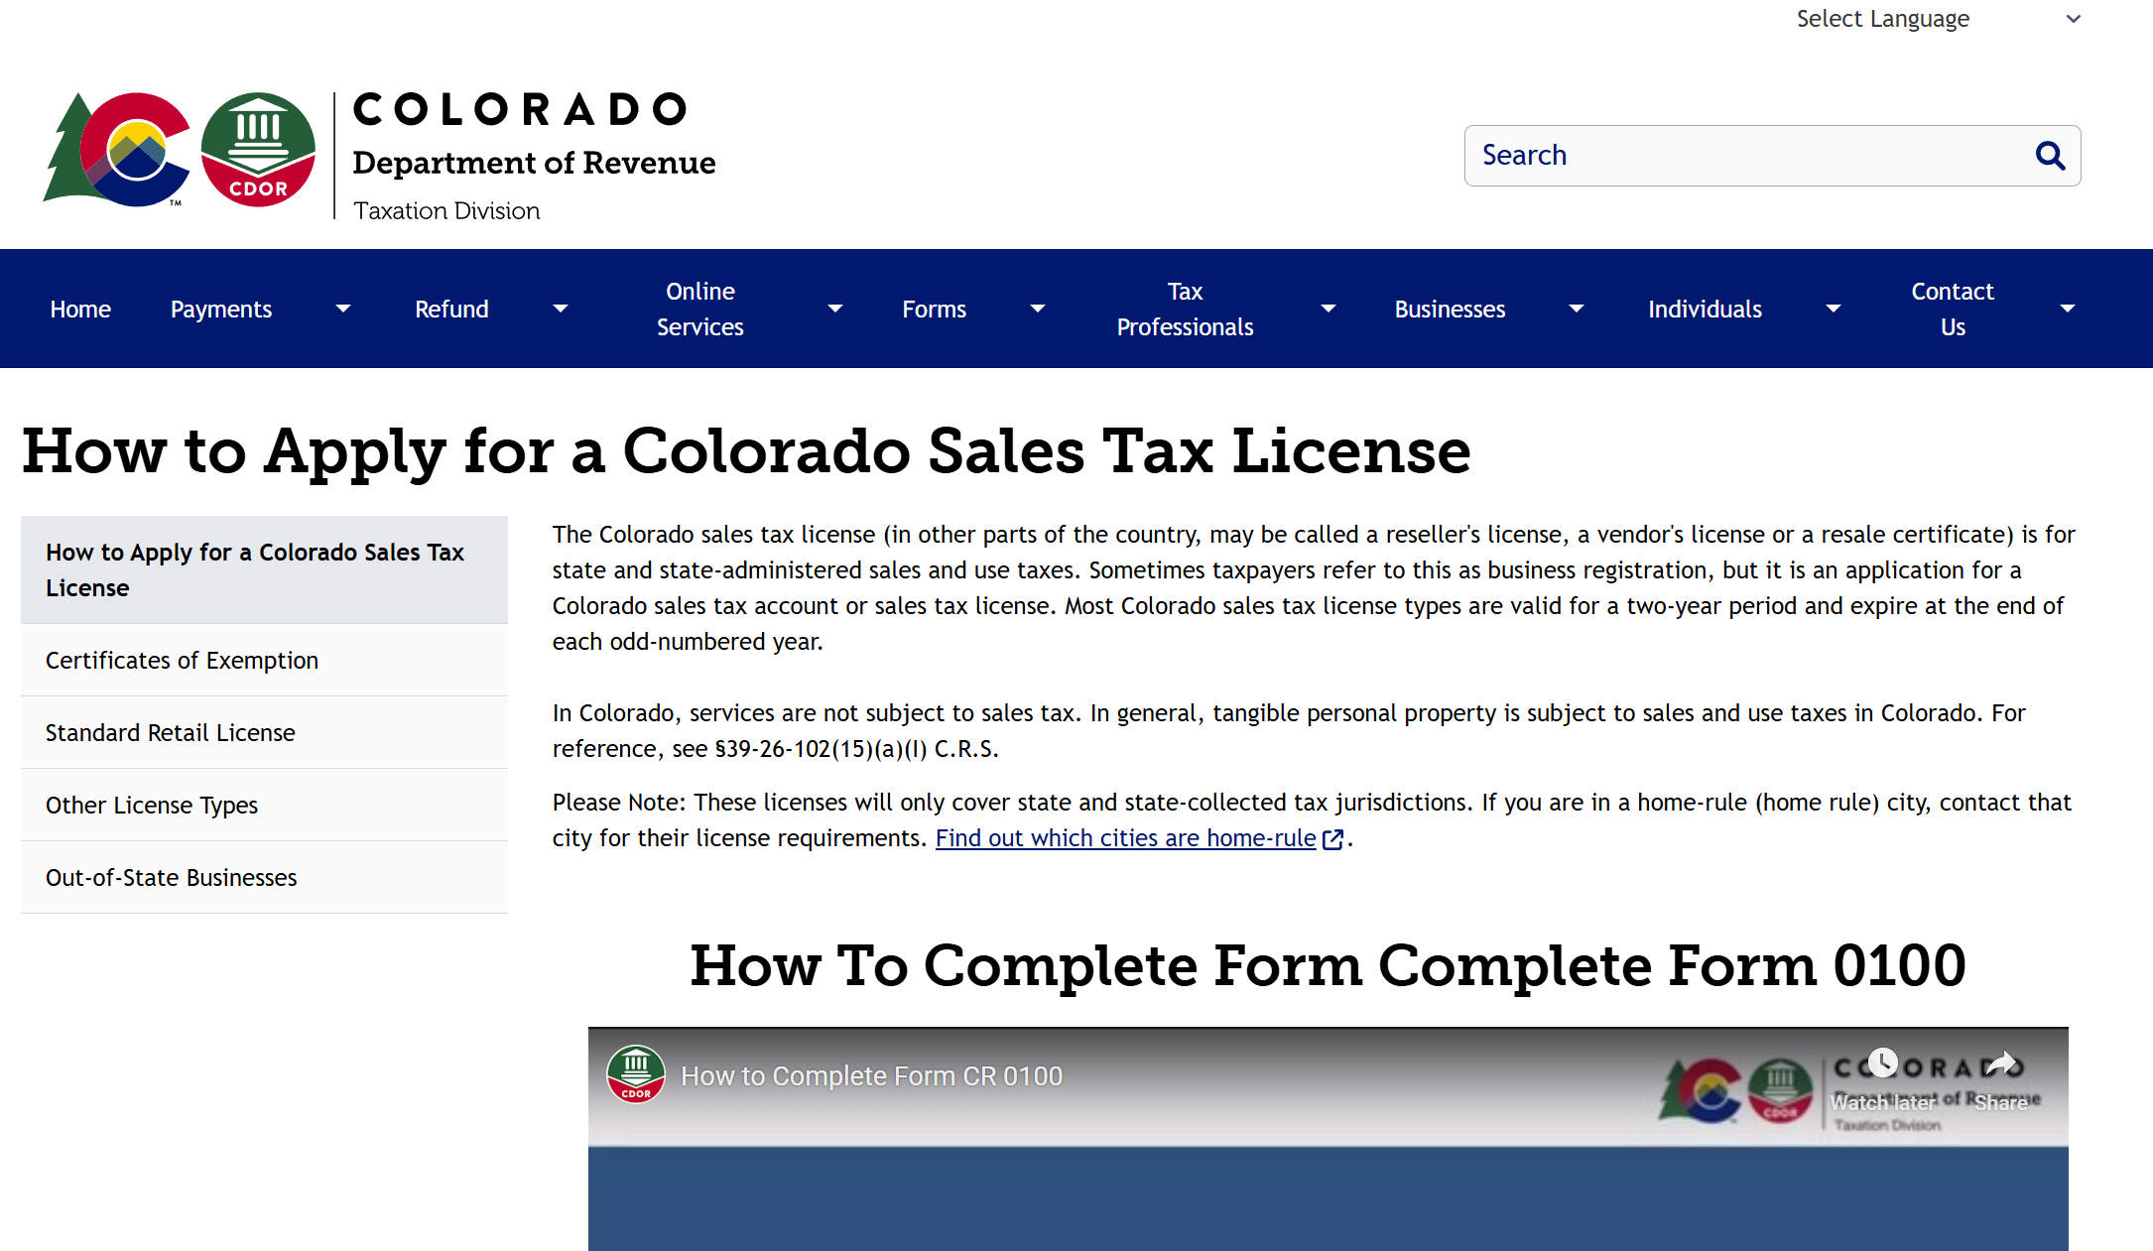
Colorado Dept of Revenue: Sales Tax

Slide 7
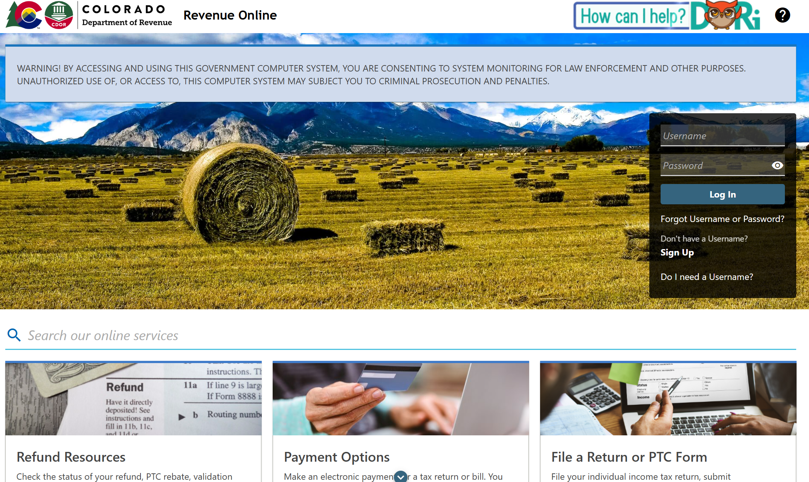
Dept of Rev: Pay Your Taxes

Slide 8
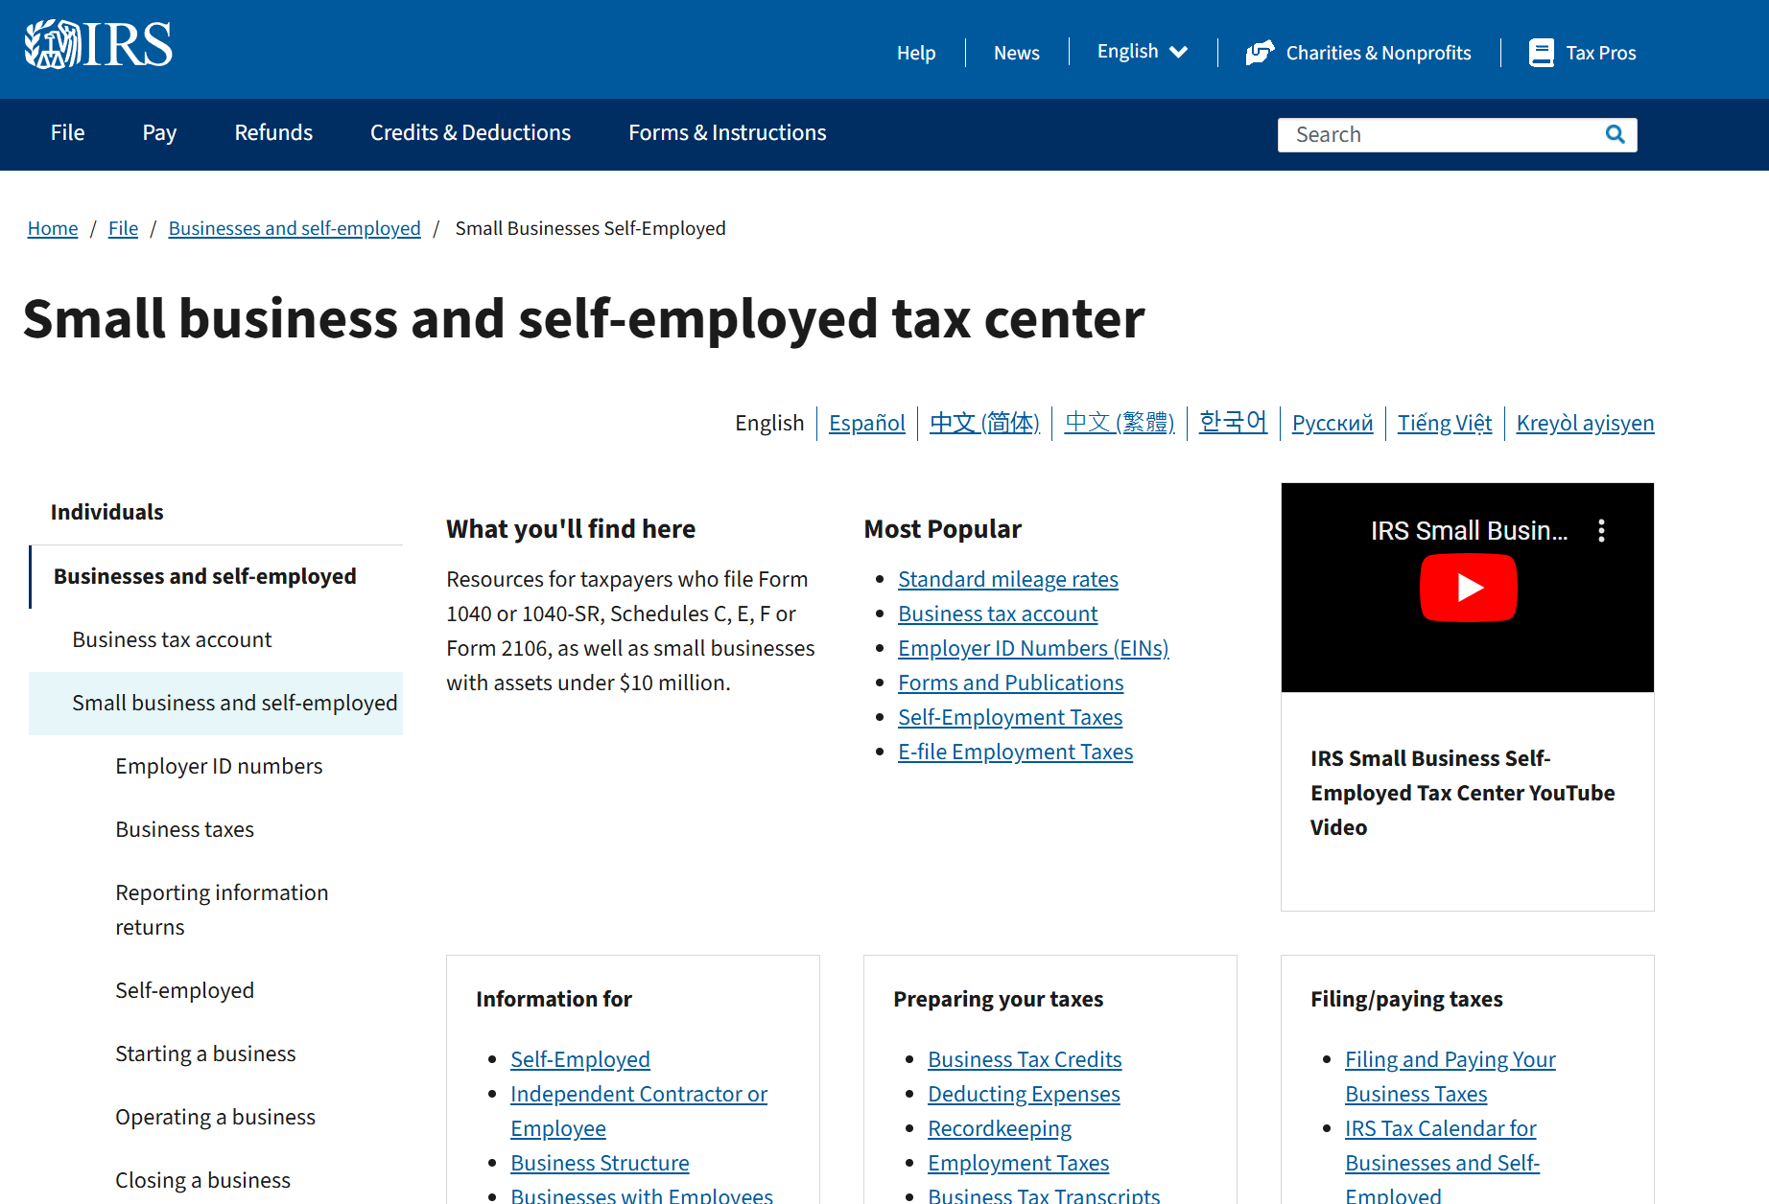
Business Resources from the IRS

