Slide 1
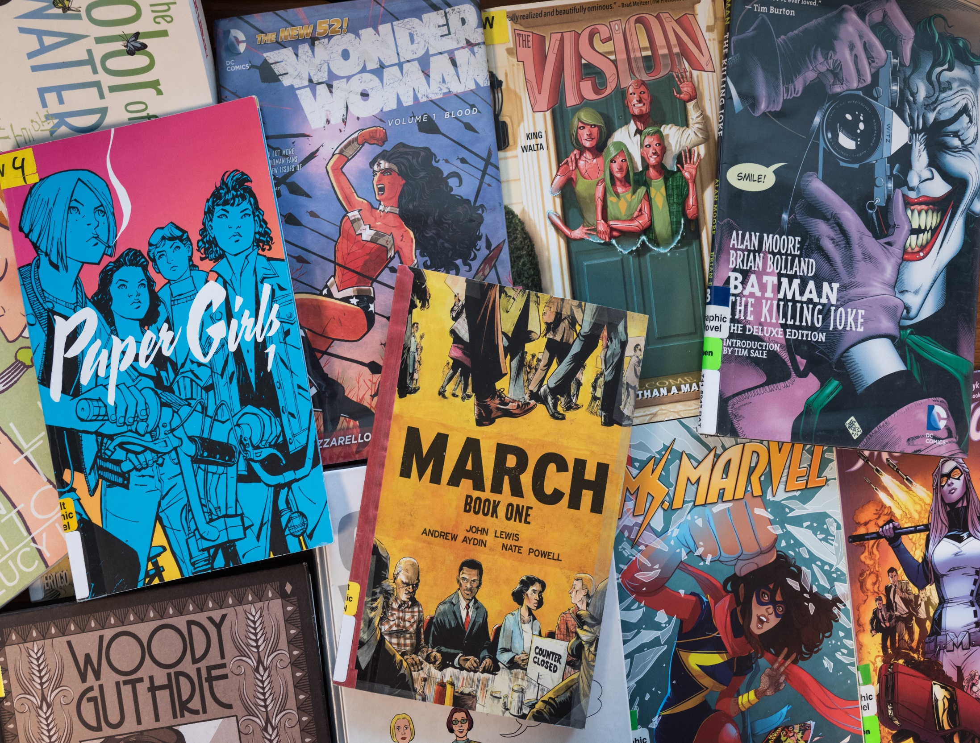

GRAPPLING GRAPHIC NOVELS
…for writers
Rod Martinez

Slide 2
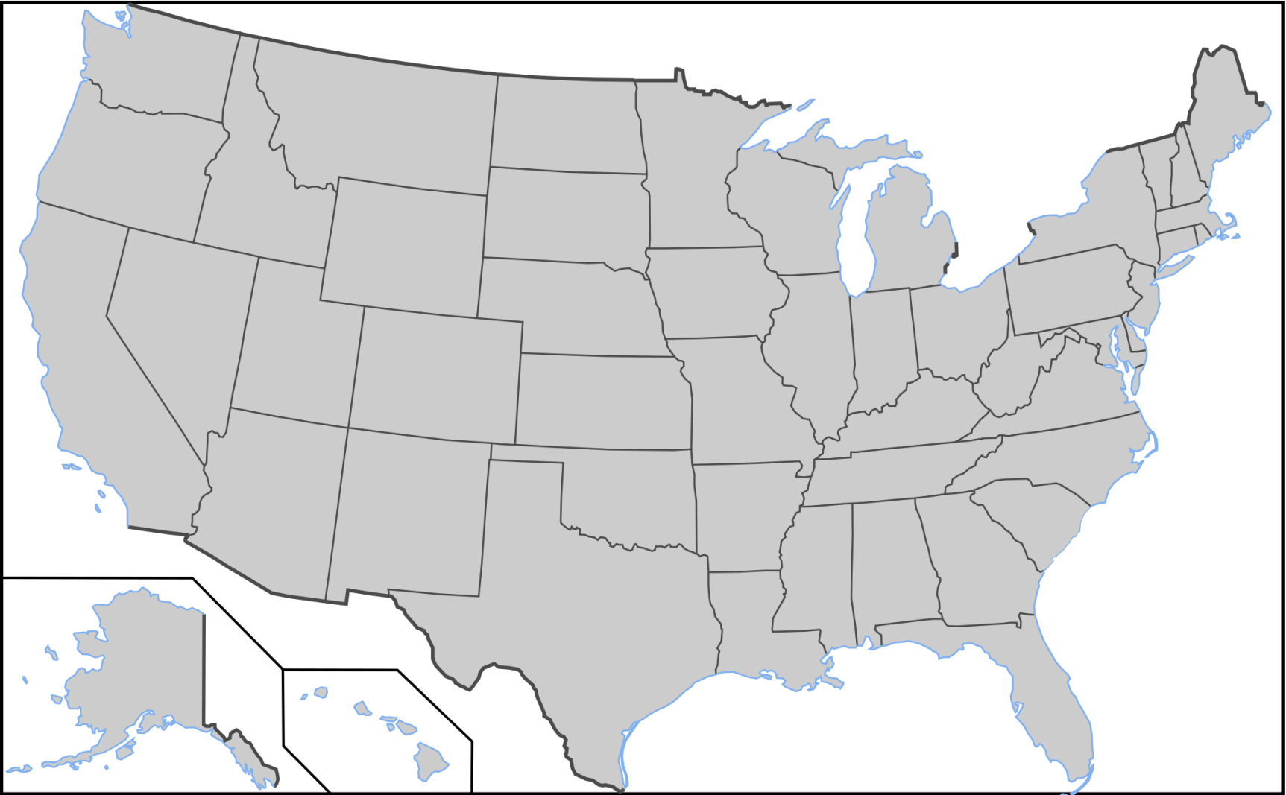

Introduction:
Born and raised in Tampa, Florida
Created my 1st “comic book” in grade school

Slide 3

Introduction:
Not me
Born and raised in Tampa, Florida
Created my 1st “comic book” in grade school
Took Creative Writing in high school
Got serious about writing after a challenge by my son

Slide 4

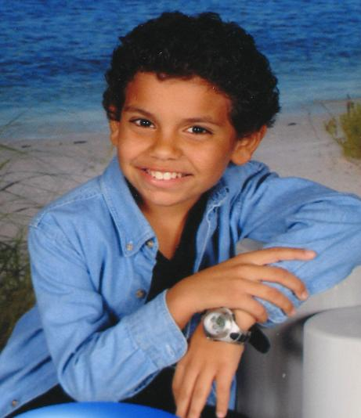

THE CHALLENGE…

Slide 5

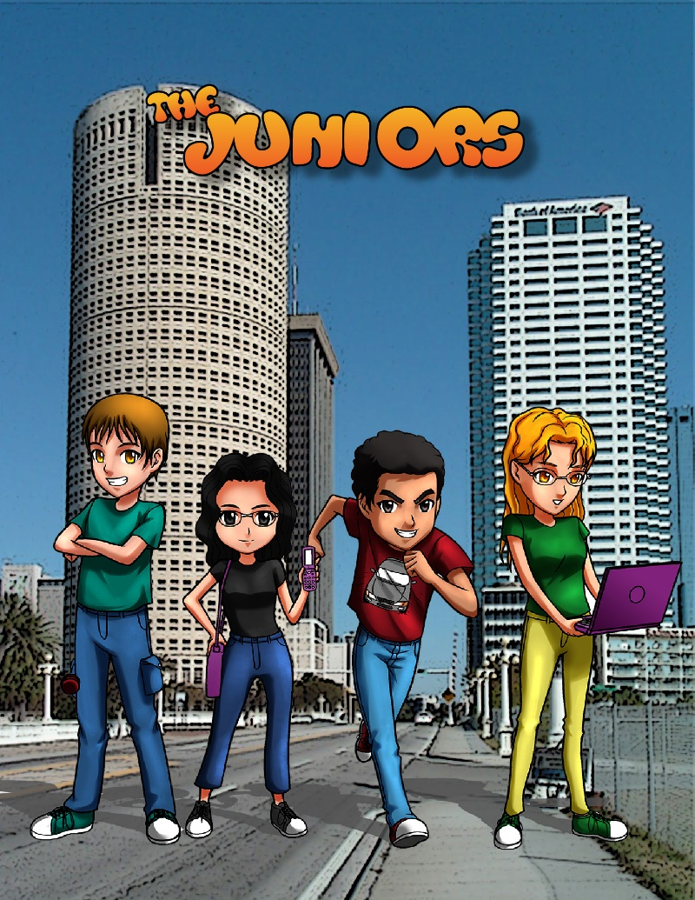

Middle Grade “Tween” detectives based off real kids.
Cover art: Robert Gustilo

Slide 6
That’s what brought me from

Slide 7



DISCLAIMER:
Ok, maybe not an actual
disclaimer, but this presentation
will serve you if you are in one of
these roles:
Writer who is hoping to create a
script for a comic book or
graphic novel – or
You are an artist/writer (more artist)
looking to figure out how to make
this thing work.
OR…

Slide 8
DISCLAIMER:
Ok, maybe not an actual
disclaimer, but this presentation
will serve you if you are in one of
these roles:
Writer who is hoping to create a
script for a comic book or
graphic novel – or
You are an artist/writer (more artist)
looking to figure out how to make
this thing work.
OR…
You plan on doing everything
from start to finish, from plotting
the book all the way to
self-publication – in that case,
My hat’s off you

Slide 9

DISCLAIMER:
WHAT THIS PRESENTATION
IS NOT:
A tutorial on how to write,
because if you’re here…
But: we WILL talk about
the process of script writing,
so don’t just up and leave

Slide 10

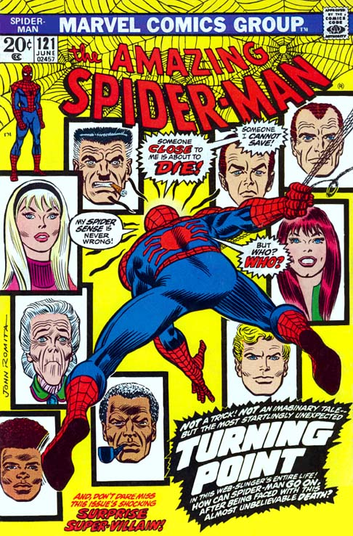
My Intro to Graphic Novels

Slide 11

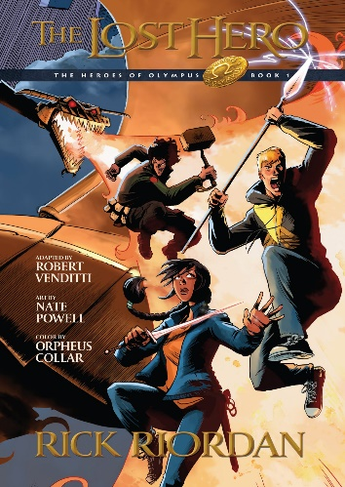
My Intro to Graphic Novels

Slide 12

My Intro to Graphic Novels
This Photo by Unknown Author is licensed under CC BY-NC-ND

Slide 13

WHAT IS A GRAPHIC NOVEL?
A graphic novel is essentially a book-length comic book
This Photo by Unknown Author is licensed under CC BY-SA

Slide 14
WHAT IS A GRAPHIC NOVEL?
Doesn’t necessarily have to be fiction…
This Photo by Unknown Author is licensed under CC BY-SA

Slide 15

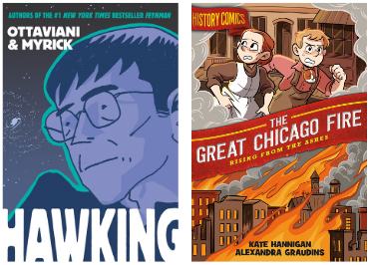
GRAPHIC “NOVELS” CAN BE ABOUT ANYTHING

Slide 16

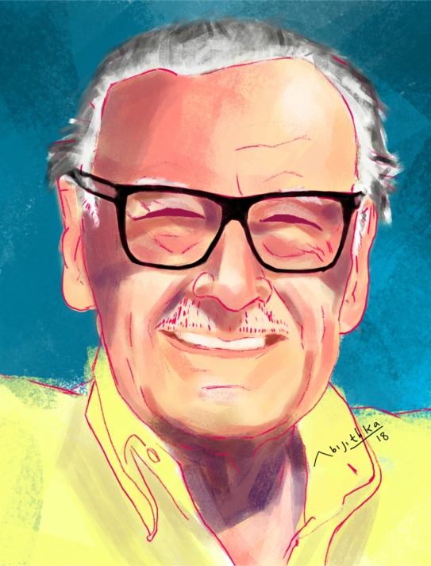
WRITING METHOD
The normally accepted method in writing a graphic novel script is first the writing is done, then the artwork is added based on that writing
But before we go there, we have to revisit that revered icon of comic-dom…

Slide 17
WRITING METHOD
Stan invented the highly successful Marvel Method of writing comic books and we’ll discuss that in a later slide…
But before we go there, we have to revisit that revered icon of comic-dom…

Slide 18



WRITING METHOD
Method of ‘script writing’ versus prose.
Raise your hand if…

Slide 19

FACT
The ‘art’ of writing a graphic novel script is in how well you, a prose writer can adapt to writing a script.
Not a TV sitcom or play script, the graphic novel uses the approach of bringing the artist into your vision of
the story.
How do we do that?

Slide 20





SCRIPT WRITING
There are rules:
Keep your artist in mind.
Stay humble.
While we pour our souls into our stories, expect changes from the artist you’re working with.
Don’t be too proud to accept ideas from the artist, it’s not about you. It’s about putting the best out there.
Leonardo Ramirez
https://leonardoverse.com/

Slide 21
SCRIPT WRITING
SAMPLE:
Panel 1.
It is night and Haven (the protagonist) stands poised for war on the rooftop of a building across the street from a majestic cathedral…
… She has one foot propped on the ledge while the other is secure on the rooftop and stares at the stained-glassed image of the crucifixion…
Can you picture this panel?
https://leonardoverse.com/

Slide 22
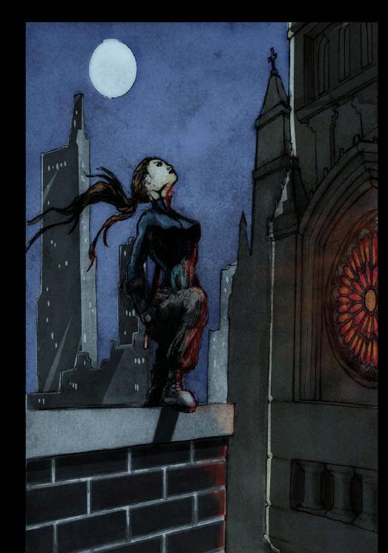
Artwork credit: Davy Fisher
https://leonardoverse.com/

Slide 23
SCRIPT WRITING
Scripts rely heavily on description
https://leonardoverse.com/

Slide 24
ANOTHER SAMPLE FOR COMPARISON
(Places a helmet on her head)

Slide 25
ANOTHER SAMPLE FOR COMPARISON
https://www.bigredhair.com/about/teaching-comic-books/sample-scripts/

Slide 26
TERMINOLOGY
Panel – A panel refers to one of the boxes on a comic book page.
Word Balloon/Speech bubble – A word balloon surrounds the dialogue
that a specific character is saying.
Splash Page – A splash page refers to a page that only has one panel.
Double Page Spread – In the same way that a Splash Page takes up
one whole page, a double page spread does the same but
across two pages.
Caption - Words appear in a box separated from the rest of the
panel or page, usually to give voice to a narrator

Slide 27
MORE TERMINOLOGY
SFX = sound effect
OP or OFF = off panel
CAP = captions
Character Caption: The inner thoughts of a character
Time/Place: Example – Westchester, NY
Narration: Example – Now Professor Charles Xavier sits, somberly studying
his colorfully-costumed house-guests —
Voice Over: Character is speaking, but is not in the current panel
WH = whisper
B = burst
W = weak
TH= thought balloon
Underlined text = Bold text
Italic text = Italic text

Slide 28



DESCRIPTION, DUHH
Location, location, location: Space? Underwater? Chicago in 2074? Alabama 1952? A fictional place(Planet Vulcan)? real place (Denver)?
Character description: how they dress, culture, speech patterns, age, etc.
Visual points of view (camera angle): bird’s eye, worm’s eye, close-up, panoramic, over the shoulder, silhouette, long shot (most used), etc
Thinking Visual: assume you must explain everything to the artist. Although they may have a great ‘view’ of the story, you may lose valuable scenes unless the artist sees what you see.

Slide 29
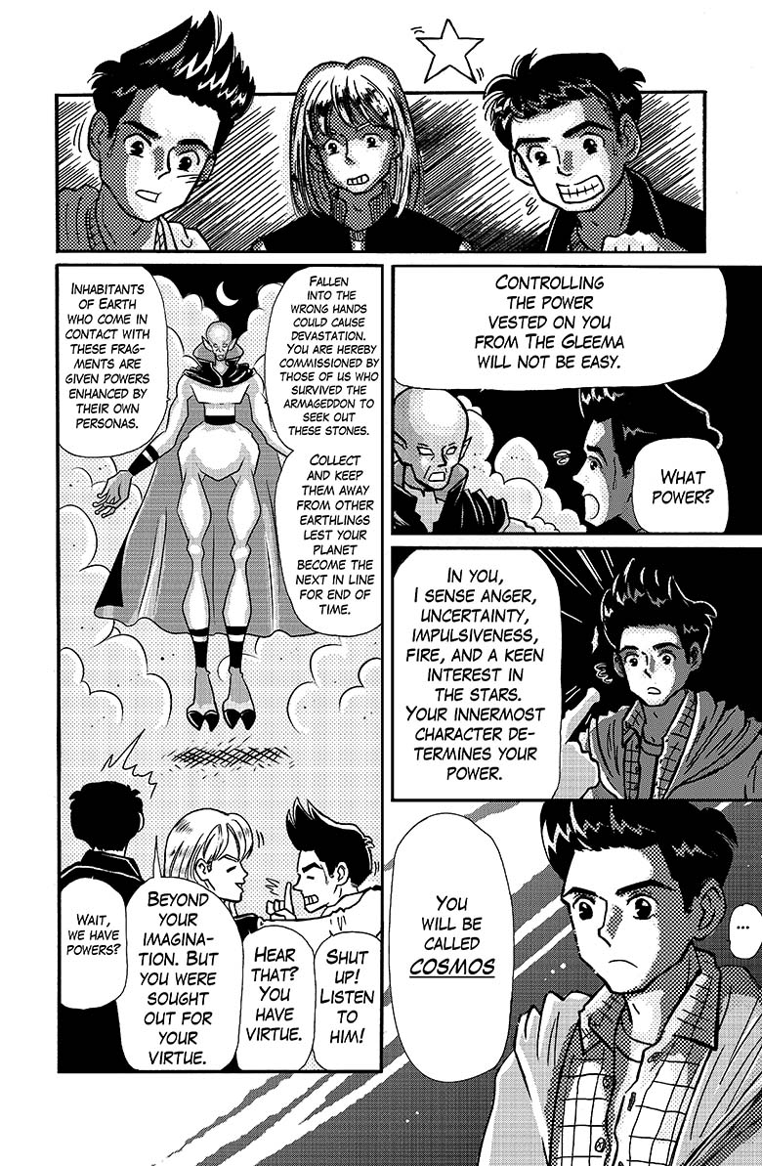
Thought process differences:
Thinking visual
Think in pictures – like a movie
director
Images are as important as the
dialogue & plot
Some panels can be without
any text and tell the story
Pace the story in a visual process

Slide 30
Thought process differences:
Thinking visual
Follow the flow of reading
to make it easier on
the reader

Slide 31
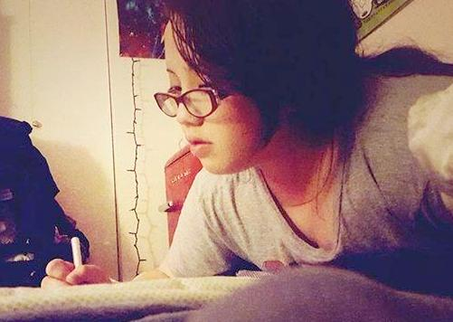
Thought process differences:
Thinking visual
Allow the artist
some creative input on panels. They “see” the story better than you do
Artist Briana Wu
https://leminslicedesigns.home.blog/

Slide 32

PROCESS
The process of the script is different from our normal way of thinking when working on novels, short stories and the like…

Slide 33
PROCESS
Before diving into writing a script, you really should write an outline first.
List each idea as a bullet point, then revise it to find a logical flow for the story.
Once that’s done, you’ll be able to approximate the number of panels needed to pull off each bullet point.
What’s my problem with this?
I FOUND THIS ONLINE
BUT I HAVE ONE
ISSUE WITH IT
https://www.makingcomics.com/2014/03/08/write-script-comic/

Slide 34
PROCESS
THE FAMOUS PLOTTER OR PANTSER ARGUMENT
If you are a pantser, how do you plan
or outline a comic book script?
I FOUND THIS ONLINE
BUT I HAVE ONE
ISSUE WITH IT
https://www.makingcomics.com/2014/03/08/write-script-comic/

Slide 35
PROCESS
Another show of hands - how many plotters…
Pantsers?

Slide 36
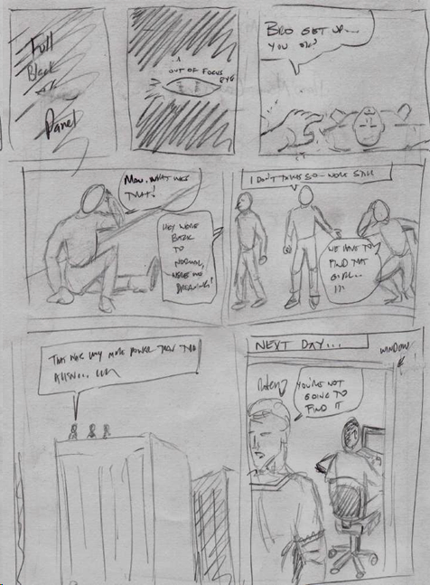
PROCESS
THE PROCESS FOR MY GRAPHIC
NOVEL “GLEEMA 3”
I knew how many pages I wanted
I wrote the script
I gathered that many pages
I thumbnail sketched every page
to fit the page count

Slide 37
PROCESS
Some artists call this the “thumbnail
breakdown system” and prefer it
to the full script or “Marvel Method”
because it gives them a clear view
of what the writer ‘sees’, including
camera angles, lighting, etc…
BUT…..

Slide 38
PROCESS
Not everyone can follow that method
Soooo…
How do you the prose writer, switch to
script style? Let’s start with dialogue…
But wait… let’s see the before and
after comparison of this particular
page

Slide 39
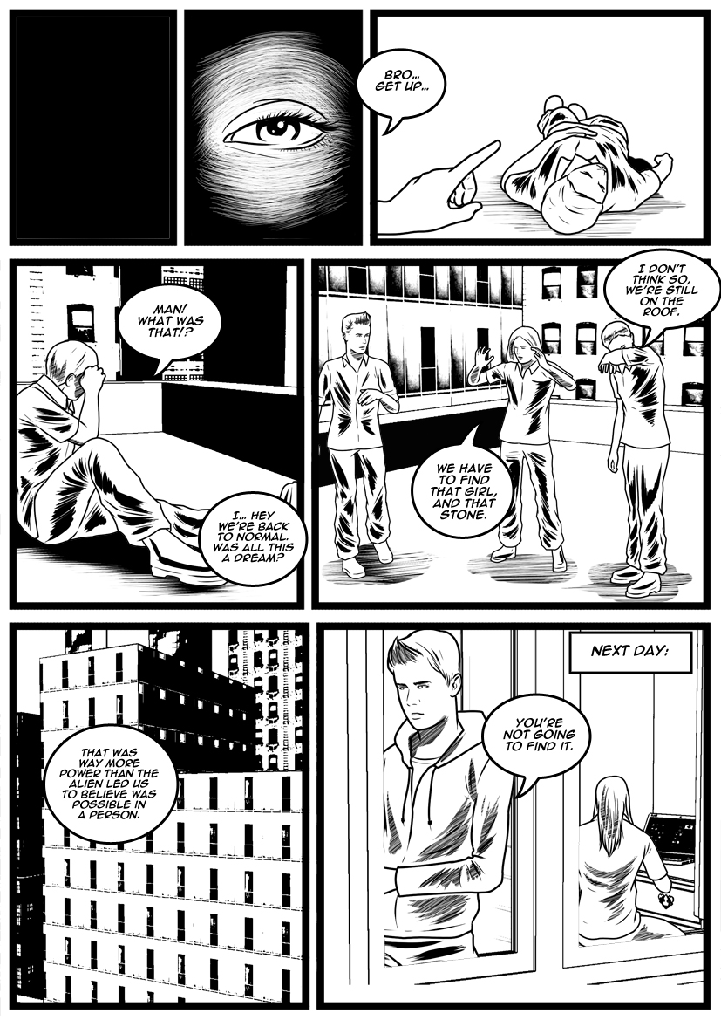

Slide 40
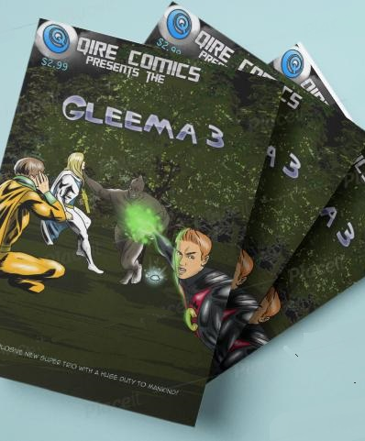

PROSE TO SCRIPT…
Ok, back to
dialogue
sample…
http://tinyurl.com/qirecomics

Slide 41
PROSE TO SCRIPT…
PROSE VERSION
The three friends convened in the living room of the massive townhome apartment. Ruben, steadily glaring out his prized telescope, gasped at the sight in the viewfinder.
“Aha, see? It was a meteorite! We need to drive down there. I have to see this!”
Mark backed away, holding a half sandwich in hand, “Here we go again. Rube, by the time it hits earth it’ll be dust.”
“Not always bro, this one looked promising”
Ruben led the two out the door after grabbing his keys.
“Well Mark, you know my brother. Looking through that telescope is his thing, just like the computer is with you.” Hector smirked.
“Yeah, and you with your magic stuff and kung fu stuff.” he replied.
When the Jeep screeched to a halt in the field miles away…

Slide 42
PROSE TO SCRIPT…
SCRIPT VERSION
Splash: Scenic Florida panoramic setting with meteorite crashing to earth.
(panel 1)Telescope peering out window. Ruben is staring through the eyepiece.
Ruben: Aha!
(panel 2) Ruben: See? It was a meteorite! We need to drive down there.
I have to see this!
(panel 3)Mark: Here we go again. Rube, by the time it hits earth it’ll be dust.
(panel 4)Ruben: Not always bro. This one looked promising.
(panel 5)Hector: Well Mark, you know my brother. Looking through that
telescope is his thing, just like the computer is with you.
Mark: Yeah, and you with your magic stuff and kung fu stuff.
(panel 6)
Ruben: There! There it is!

Slide 43
PROSE TO SCRIPT…
ANOTHER TRY AT IT
Nicole slept heavy on the bed, earbuds on. The cracked open window
allowed a mysterious fog to enter her room unannounced and it slowly took
form into human shape.
Her miniature Terrier took note and the barking ensued, waking the
teenager from her deep slumber – just as the lips that formed on the foggy
form approached her dribble.
Nicole hopped up, wiping her eyes as the fog slowly rolled back out of the
window, her small protector stood erect at the edge of the bed barking until the
last of the visitor rolled away out of view outside.
“Max? What’s wrong?”
The dog hopped up to her face and greeted her with multiple licks to her face.
“Oh Max, I had the weirdest dream. David came back and wanted to kiss me.”
The pet stared at her as if he understood.
“Maxie, do you think I’ll ever see David again?
She pulled off her covers to get up while the dog stared out the window.

Slide 44
PROSE TO SCRIPT…
ANOTHER TRY AT IT
Splash: Bedroom, birds eye view, teenage girl snoring in bed, headphones on.
Window is cracked open and fog is rolling in.
PAGE 1
(panel 1) Fog forms into human shape near her
(panel 2) Miniature terrier hops on the bed and is barking at the fog.
(panel 3)Closeup of fog’s lips almost on hers, dribble showing.
(panel 4)Dog barking closer, she opens her eyes.
(panel 5)Fog begins rolling out of window, dog follows on the bed (bird’s eye)
(panel 6) Nicole
Max? What’s wrong?
PAGE 2
(panel 1) dog runs into her embrace
(panel 2) Nicole (silhouette view from outside window looking in)
Oh Max, I had the weirdest dream. David came back and wanted to kiss me
(panel 3) Max stared at her as if he understood, head cocked (close-up)
(panel 4) Nicole
Maxie, do you think I’ll ever see David again?
(panel 5) Nicole moves to get up from the bed. (view from door)
(panel 6) Max is at the edge of the bed staring out window(view from outside)

Slide 45
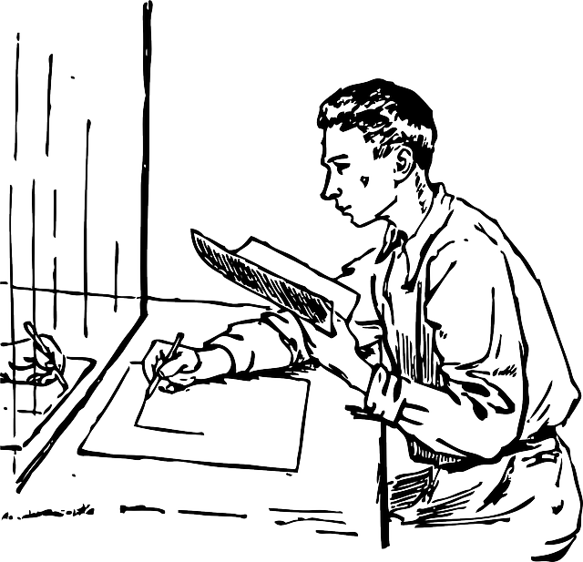

Prose to script was simple enough, how do you get the artist to see your vision once it is in script format?
Description,
description, description…

Slide 46
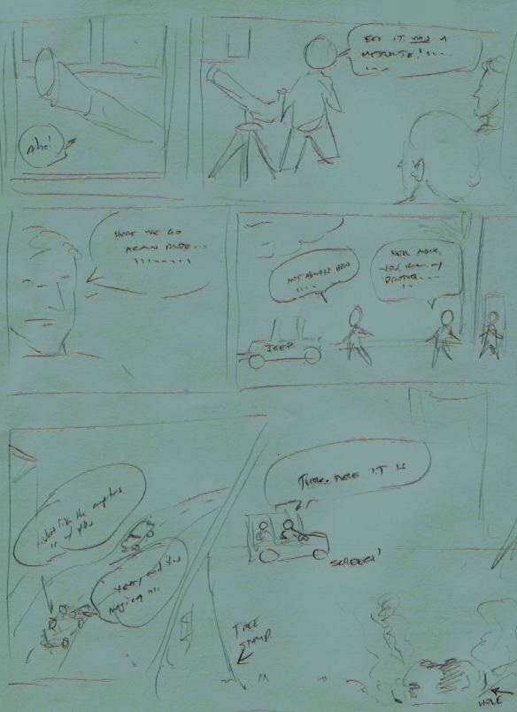
My original sketch sample
for the artist for
page 1.
From this, he produced this…

Slide 47
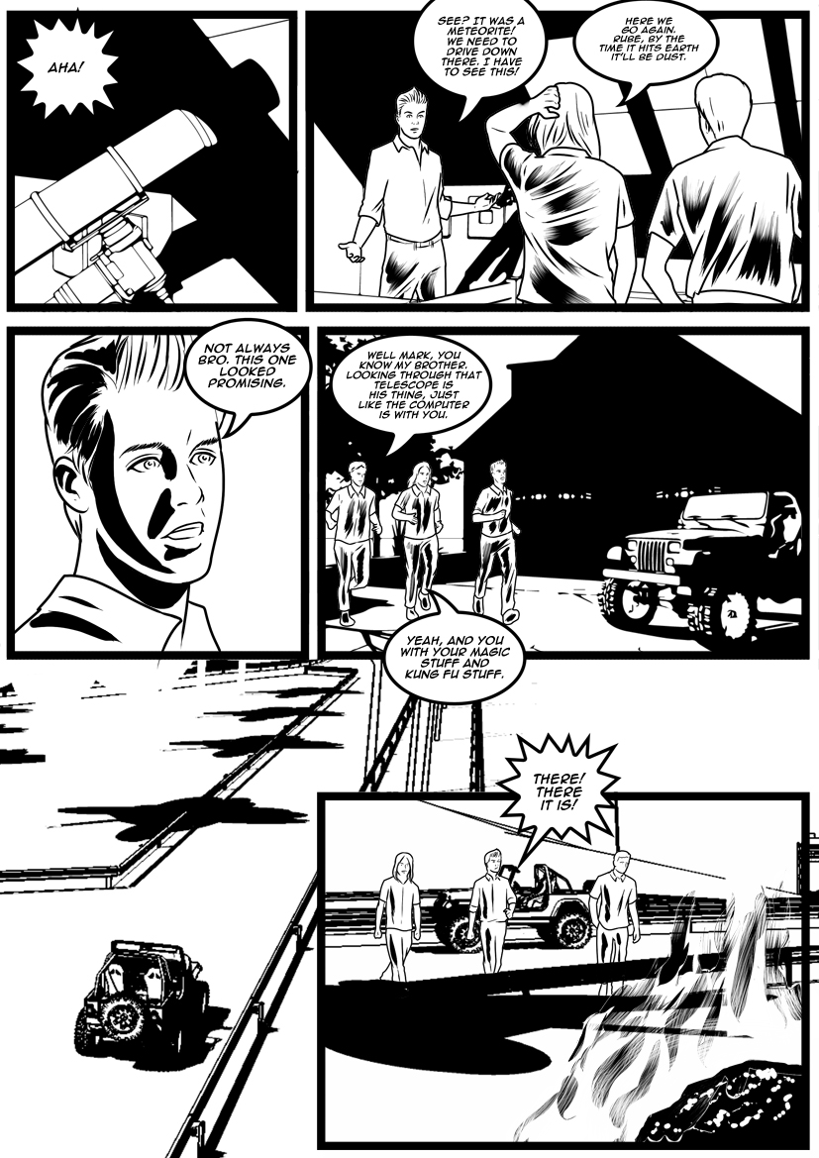

Slide 48
But wait…. remember what we said earlier about allowing the artist creative freedom?

Slide 49
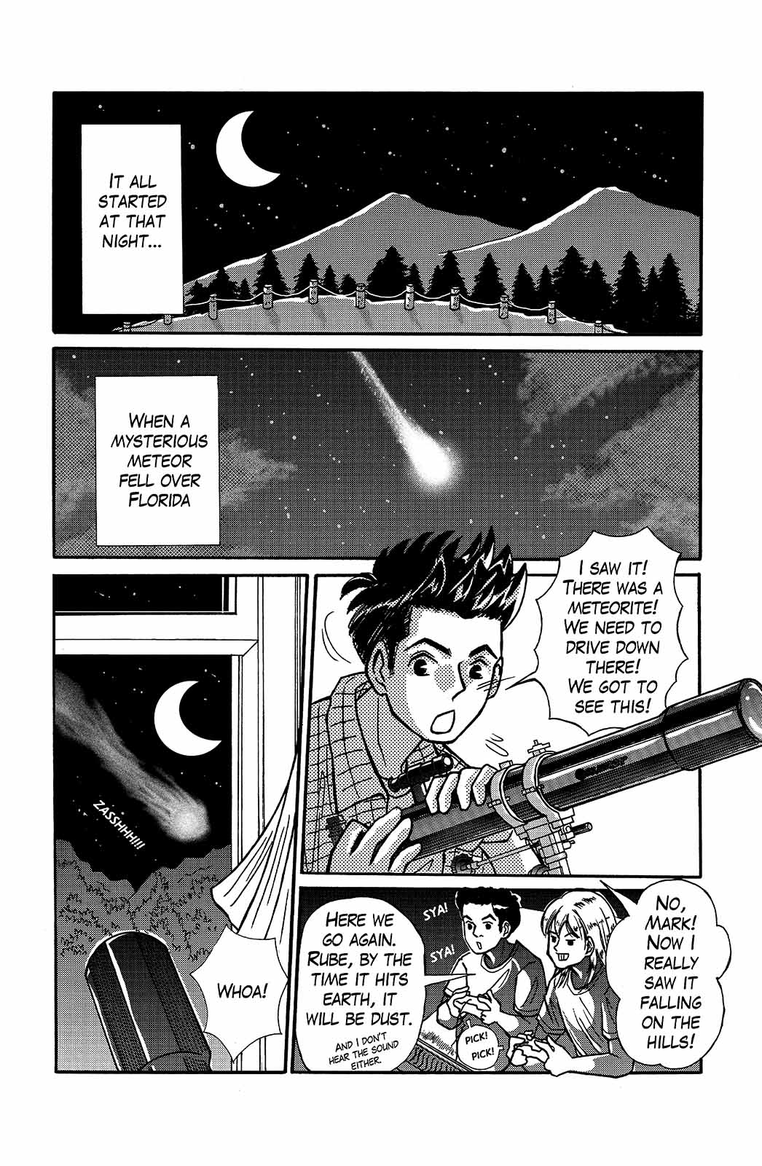
Notice differences in panels and viewpoints of both artists for same page?
Description issue

Slide 50
Script Styles: Per Wikipedia
“There are no prescribed forms of comic scripts, but there are two
dominant styles in the mainstream comics industry;
the full script (commonly known as "DC style") and
the plot script (or "Marvel style").”
Full script:
In this style, the writer breaks the story down in sequence,
page-by-page and panel-by-panel, describing the action,
characters, and sometimes backgrounds and "camera" points-of-view
of each panel, as well as all captions and dialogue balloons.
Plot script
In a plot script the artist works from a story synopsis from the writer
rather than a full script. The artist creates page-by-page plot details
on his or her own, after which the work is returned to the writer for the
insertion of dialogue.
This approach became commonly known as the Marvel Method
https://en.wikipedia.org/wiki/Script_(comics)

Slide 51

Script Styles: Per Wikipedia
Stan Lee “invented” the highly successful Marvel Method of writing comic books
This Photo by Unknown Author is licensed under CC BY-NC

Slide 52
My simple “full script” style for Gleema 3
PAGE 3
(panel 1) Alien: Fallen into the wrong hands, the Gleema stone could cause devastation. You are hereby
commissioned by those of us who survived our Armageddon to seek out these stones,
collect them and keep them away from other earthlings lest your planet become the next in line for end of times.
(panel 2) Hector: Wait – we have powers?
Alien: Beyond your imagination, but you were sought out for your virtue.
(panel 3) Mark: Ruben, hear that? You have virtue.
Ruben: Shut up bro.
(panel 4) Alien: Controlling the power vested on you from the Gleema will not be easy.
Ruben: Power?
(panel 5) Alien: In you I sense anger, uncertainty, impulsiveness, fire, and a keen interest in the stars.
Your innermost character determines your power…
(panel 6) … you will be called Cosmos.
PAGE 4
(PANEL 1) You (pointing to Hector), you are carefree, have interest in supernatural, plus a knack in martial arts…
You will be called Pardo the Mystic.
(PANEL 2) You (pointing to Mark) are of a truly virtuous nature…
(PANEL 3) Ruben: His dad’s a preacher
Alien: optimist, humorist… virgin
(PANEL 4)
Hector: That’s messed up
Alien: you will be called St. Mark

Slide 53
My simple “full script” style for Gleema 3
(Captions)
PAGE 3
(panel 1) Alien: Fallen into the wrong hands, the Gleema stone could cause devastation. You are hereby
commissioned by those of us who survived our Armageddon to seek out these stones,
collect them and keep them away from other earthlings lest your planet become the next in line for end of times.
(panel 2) Hector: Wait – we have powers?
Alien: Beyond your imagination, but you were sought out for your virtue.
(panel 3) Mark: Ruben, hear that? You have virtue.
Ruben: Shut up bro.
(panel 4) Alien: Controlling the power vested on you from the Gleema will not be easy.
Ruben: Power?
(panel 5) Alien: In you I sense anger, uncertainty, impulsiveness, fire, and a keen interest in the stars.
Your innermost character determines your power…
(panel 6) … you will be called Cosmos.
PAGE 4
(PANEL 1) You (pointing to Hector), you are carefree, have interest in supernatural, plus a knack in martial arts…
You will be called Pardo the Mystic.
(PANEL 2) You (pointing to Mark) are of a truly virtuous nature…
(PANEL 3) Ruben: His dad’s a preacher
Alien: optimist, humorist… virgin
(PANEL 4)
Hector: That’s messed up
Alien: you will be called St. Mark

Slide 54
‘RULES’
The strictest rule tends to be page length. Comics tend to be 24-32 pages long, graphic novels around 80-120 pages.
Dialogue must fit inside speech bubbles.
Think in panels, if you’re working on a 22-page comic you might end up with
around 132 panels
Be meticulous in the details with the artist to assure that what you want is included.
Add screenplay terminology in your script. Use keywords like Exterior or Interior,
Day or Night, and reference the scene’s location
https://www.makingcomics.com/2014/03/08/write-script-comic/

Slide 55
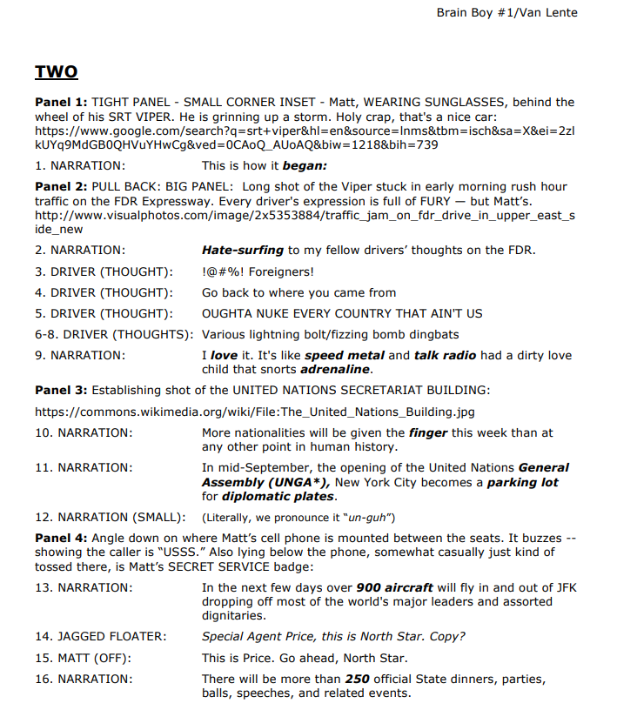
Another great sample
BRAIN BOY #1 Script / Copyright 2013 Dark Horse Comics
Fred Vanlente http://fredvanlente.com/comix.html

Slide 56

Another great sample
BRAIN BOY #1 Script / Copyright 2013 Dark Horse Comics
Fred Vanlente http://fredvanlente.com/comix.html

Slide 57
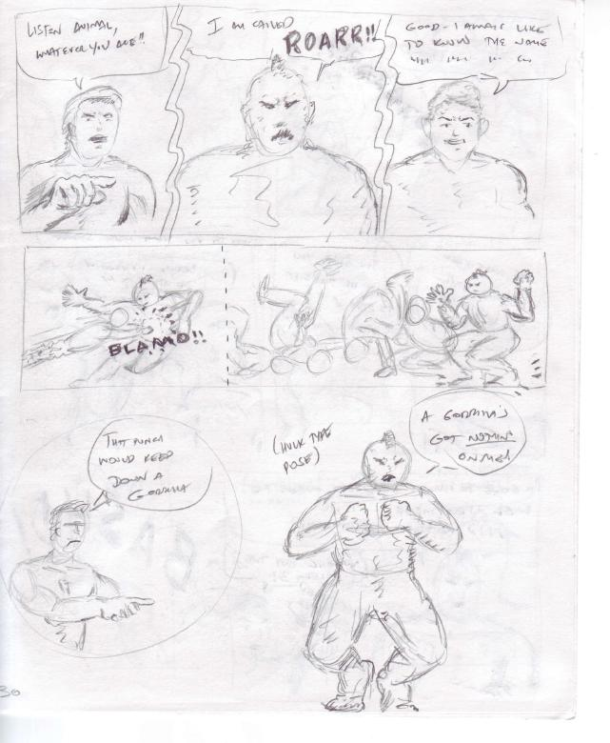
Remember, different artist – different feel
This is a sketch from Gleema 3
I did and had two artists draw it

Slide 58
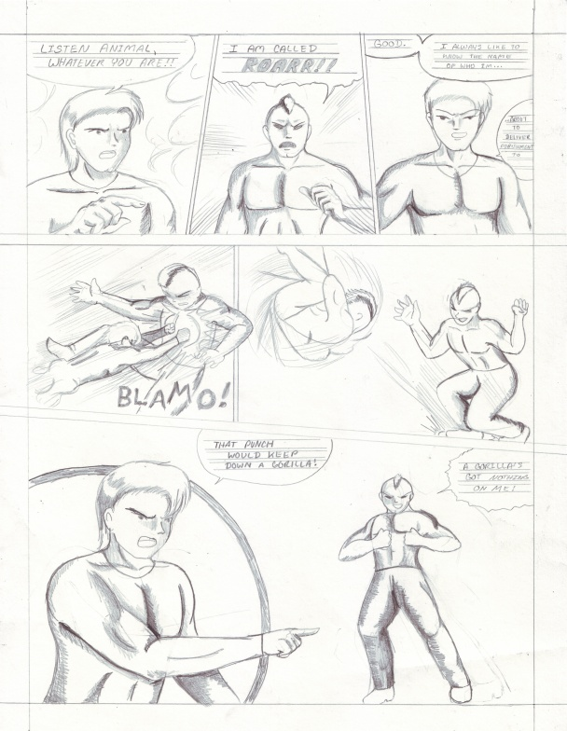
Remember, different artist – different feel
This is a sketch from Gleema 3
I did and had two artists draw it
Here’s one depiction from my sketch… here’s the other

Slide 59
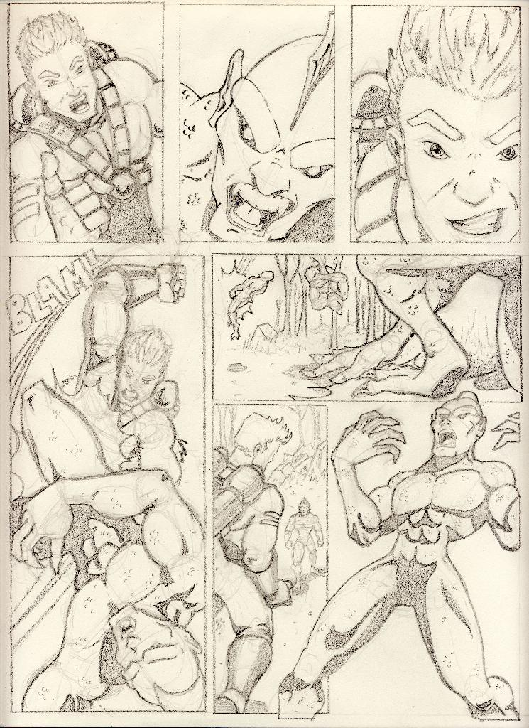
Remember, different artist – different feel
Know what I loved about this page?
This is a sketch from Gleema 3
I did and had two artists draw it
Here’s one depiction from my sketch… here’s the other

Slide 60
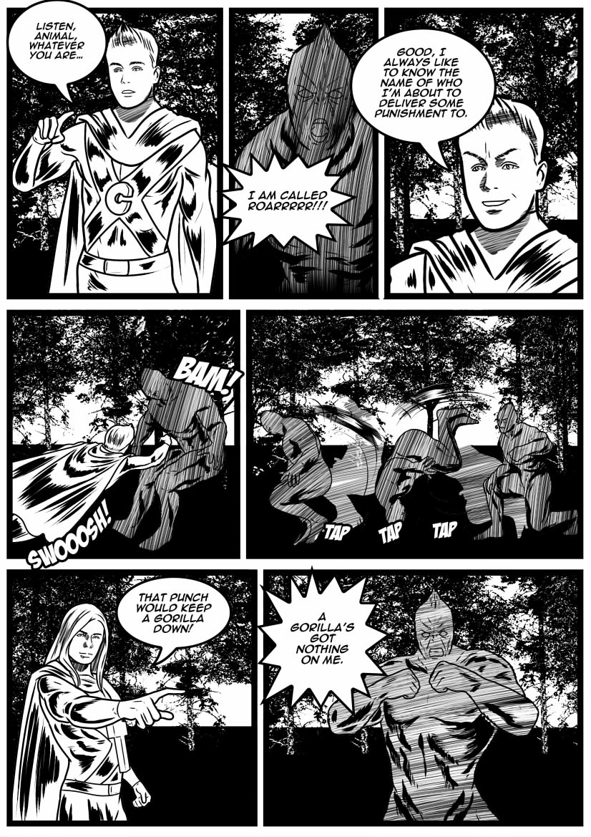
Remember, different artist – different feel
This is a sketch from Gleema 3
I did and had two artists draw it
Here’s one depiction from my sketch… here’s the other
Remember that slide about
description?

Slide 61


Three Minute Exercise
Bennie is ten years old. His next-door neighbor asked him to babysit her ferret while she’s shopping. While napping in his room with the ferret on the bed, his sister Kelsey opened the door to borrow his laptop, she left the door open – the ferret’s gone.
Car door slam outside awakens him, he realizes his predicament and has five minutes before Mrs. Marie comes knocking on the door for her Ruby.
Write a scene in three minutes in script style, depicting Bennie and how he handles this.

Slide 62
Three Minute Exercise
Remember simple format style:
(SAMPLE)
CAP (caption/narration) Jamie hops out of bed…
BENNY: Hey.. Wait a minute, where’s the…
KELSEY: Whaaaaat?
You can title it WTF (Where’s The Ferret?)
Clock will start with next slide, ready?

Slide 63

3-minute sand timer
Bennie is ten years old. His next-door neighbor asked him to babysit her ferret, Ruby.
His sister Kelsey opened the door to his room – the ferret’s gone.
Mrs. Marie comes knocking on the door for her Ruby 5 minutes later. Write a scene in script style,
depicting Bennie and how he handles this.
3 minutes
End
Bennie, Kelsey, Mrs. Marie
Notes:
This ‘sand timer’ will start on a mouse click anywhere on the slide. The ‘sand’ will drain from the top section to the lower section and when completed will show the word ‘End’.
To change the timings of this timer, you need to enter the animation settings, and change the timings for the Isosceles Triangles. There will be 2 that need changing (to the same amount) – one animates the top triangle emptying, whilst the other animates the bottom triangle filling.
When you change the timings these have to entered as a number of seconds.

Slide 64

DID YOU KNOW
Back in the heyday of creating comics there were several roles involved in the making of just one title?
Artists
Penciller & inker
Colorist
Writer
Letterer

Slide 65




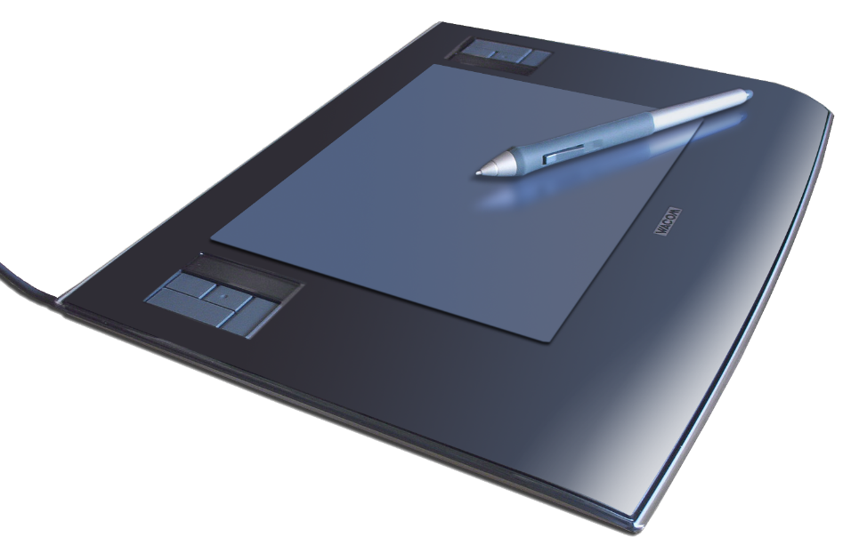
But these days…
This Photo by Unknown Author is licensed under CC BY-NC

Slide 66
But these days…
This Photo by Unknown Author is licensed under CC BY-NC

Slide 67



Slide 68

Script
Writer
Trophy
But lastly…

Slide 69

Anyone want to share??
Script
Writer
Trophy

Slide 70
Where’d that critter go??
Script
Writer
Trophy

Slide 71



GRAPPLING GRAPHIC NOVELS
by Rod Martinez…BIBLIOGRAPHY
WEBSITES
* https://skokielibrary.info/blog/180/graphic-novels/
* http://one-shotstructure.blogspot.com/p/48-page-graphic-novel-worksheet.html
* http://www.victoriaying.com/blog/2019/11/5/scripting-a-graphic-novel
* https://timstout.wordpress.com/2010/06/21/graphic-novel-script-format/
* https://www.writersdigest.com/write-better-fiction/publishing-writing-graphic-novels-growing
* https://www.bigredhair.com/about/teaching-comic-books/writing-guide/
* https://www.merakicomic.com/writing-a-graphic-novel-script/
* https://leminslicedesigns.home.blog/
* https://www.makingcomics.com/2014/03/08/write-script-comic/
BOOKS
The DC Comics Guide to Writing Comics – Watson-Guptill Publications, 2013 ISBN 9780770434557
The Everything Guide to Writing Graphic Novels by Mark Ellis Adams Media, 2008 ISBN 9781598694512
The Complete Idiot's Guide to Creating A Graphic Novel by Nat Gertler Alpha Books, 2009 ISBN 9781592579426
Write your Own Graphic Novel by Natalie Rosinsky Compass Point Books, 2009 ISBN 9780756538569
and of course
The Gleema 3 by Rod Martinez ISBN 9798590145072 http://tinyurl.com/qirecomics
wtf
Rodmartinez.us - facebook.com/authorrodmartinez/

Slide 72
GRAPPLING GRAPHIC NOVELS
Facebook.com/authorrodmartinez
rodmartinez.us

