Slide 1
Build Your Foundation with Facebook Ads
Andre Gonzalez

Slide 2
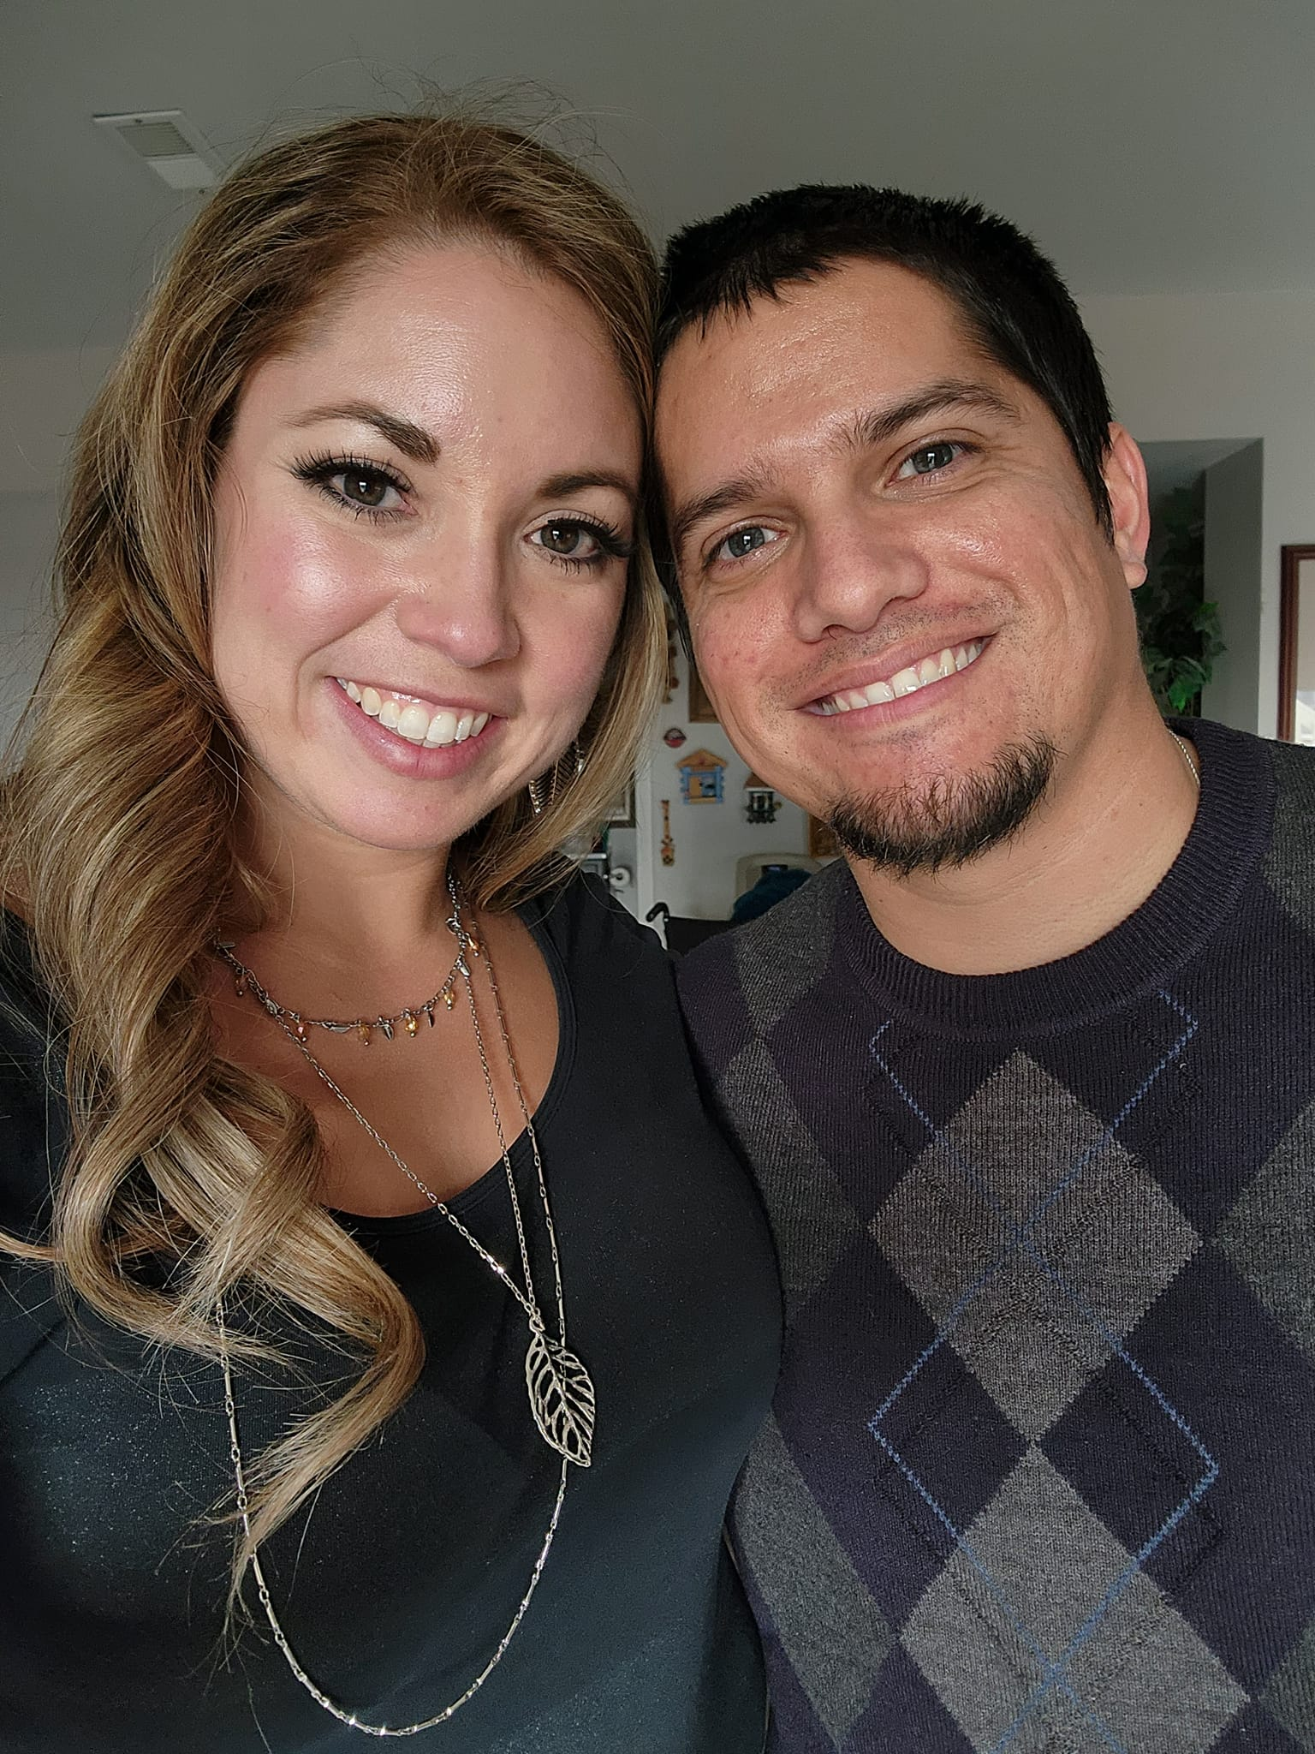
About Me
Co-Owner of M4L Publishing
20 books of my own
2021 RMFW Indie Writer of the Year
Seven years experience

Slide 3
What We’ll Cover
Book Sales Funnel
Sales vs. Subscribers
Targeting
Ad Creative
Bookbrush
Facebook Ads Platform
Testing & Tracking
Scaling

Slide 4
Book Sales Funnel
Book
Book Package (cover + blurb)
Ad/Marketing
Landing Page
All four must be in sync!

Slide 5

Sales vs. Subscribers
What is your objective?
Expectations will vary

Slide 6
Grow newsletter subscribers
Can be “back burner” advertising
Slow and steady
Low-cost ads
Patience
Have automation sequence for new subs

Slide 7
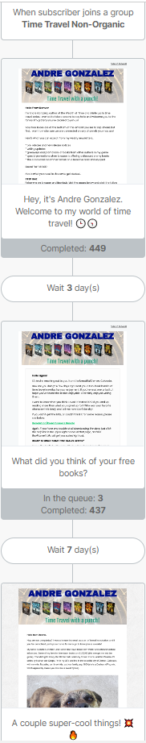
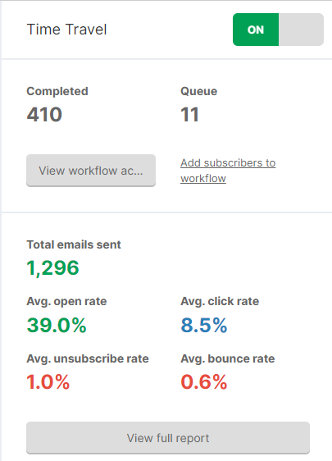

Slide 8
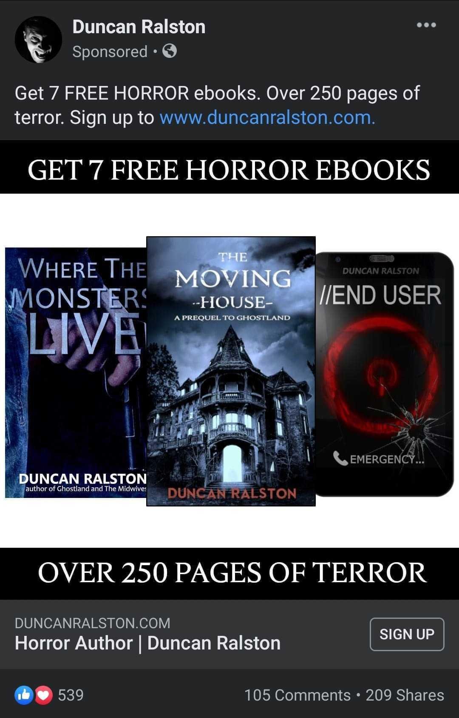
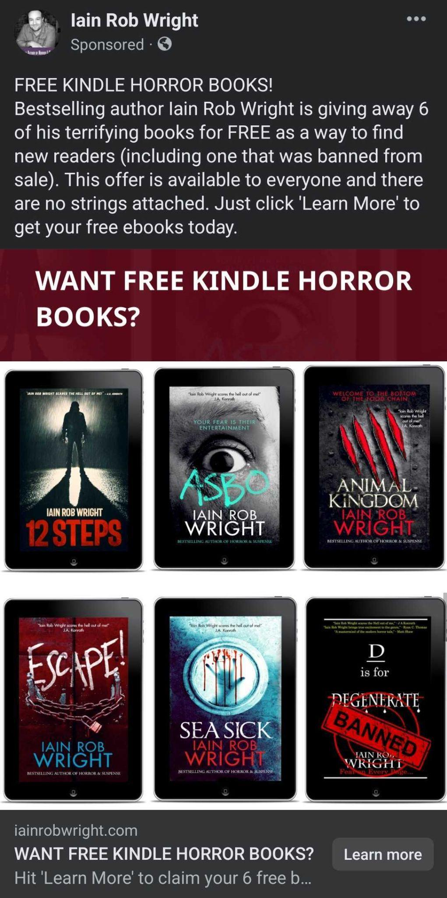
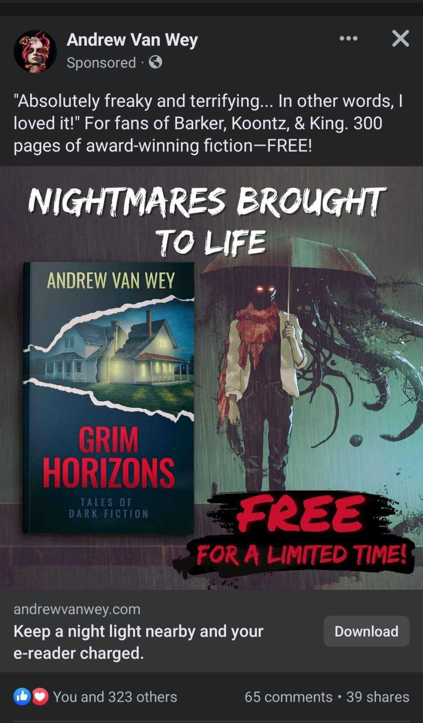

Slide 9

Ads for Book Sales
Requires more attention and money
Be ready to pivot
Test, test, test!
Track everything
Aggressive - may be time sensitive for special deals
Everything else in sales funnel needs to be in sync

Slide 10
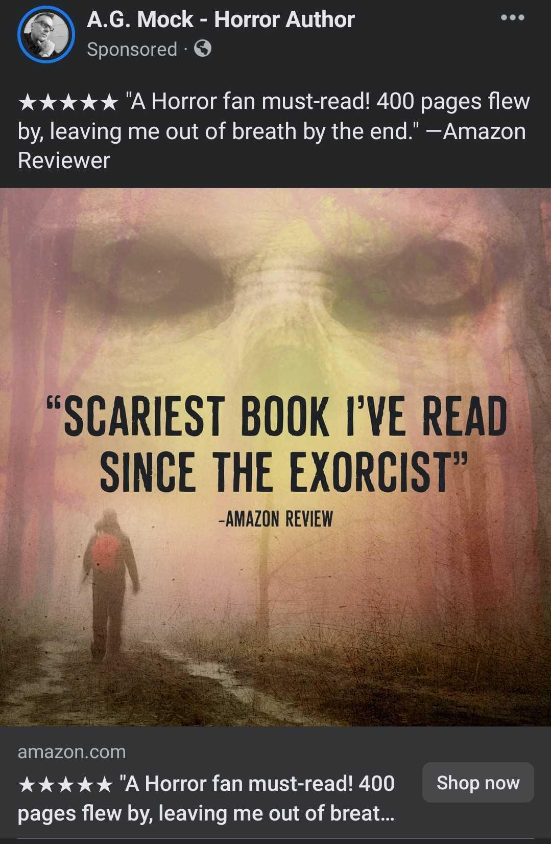
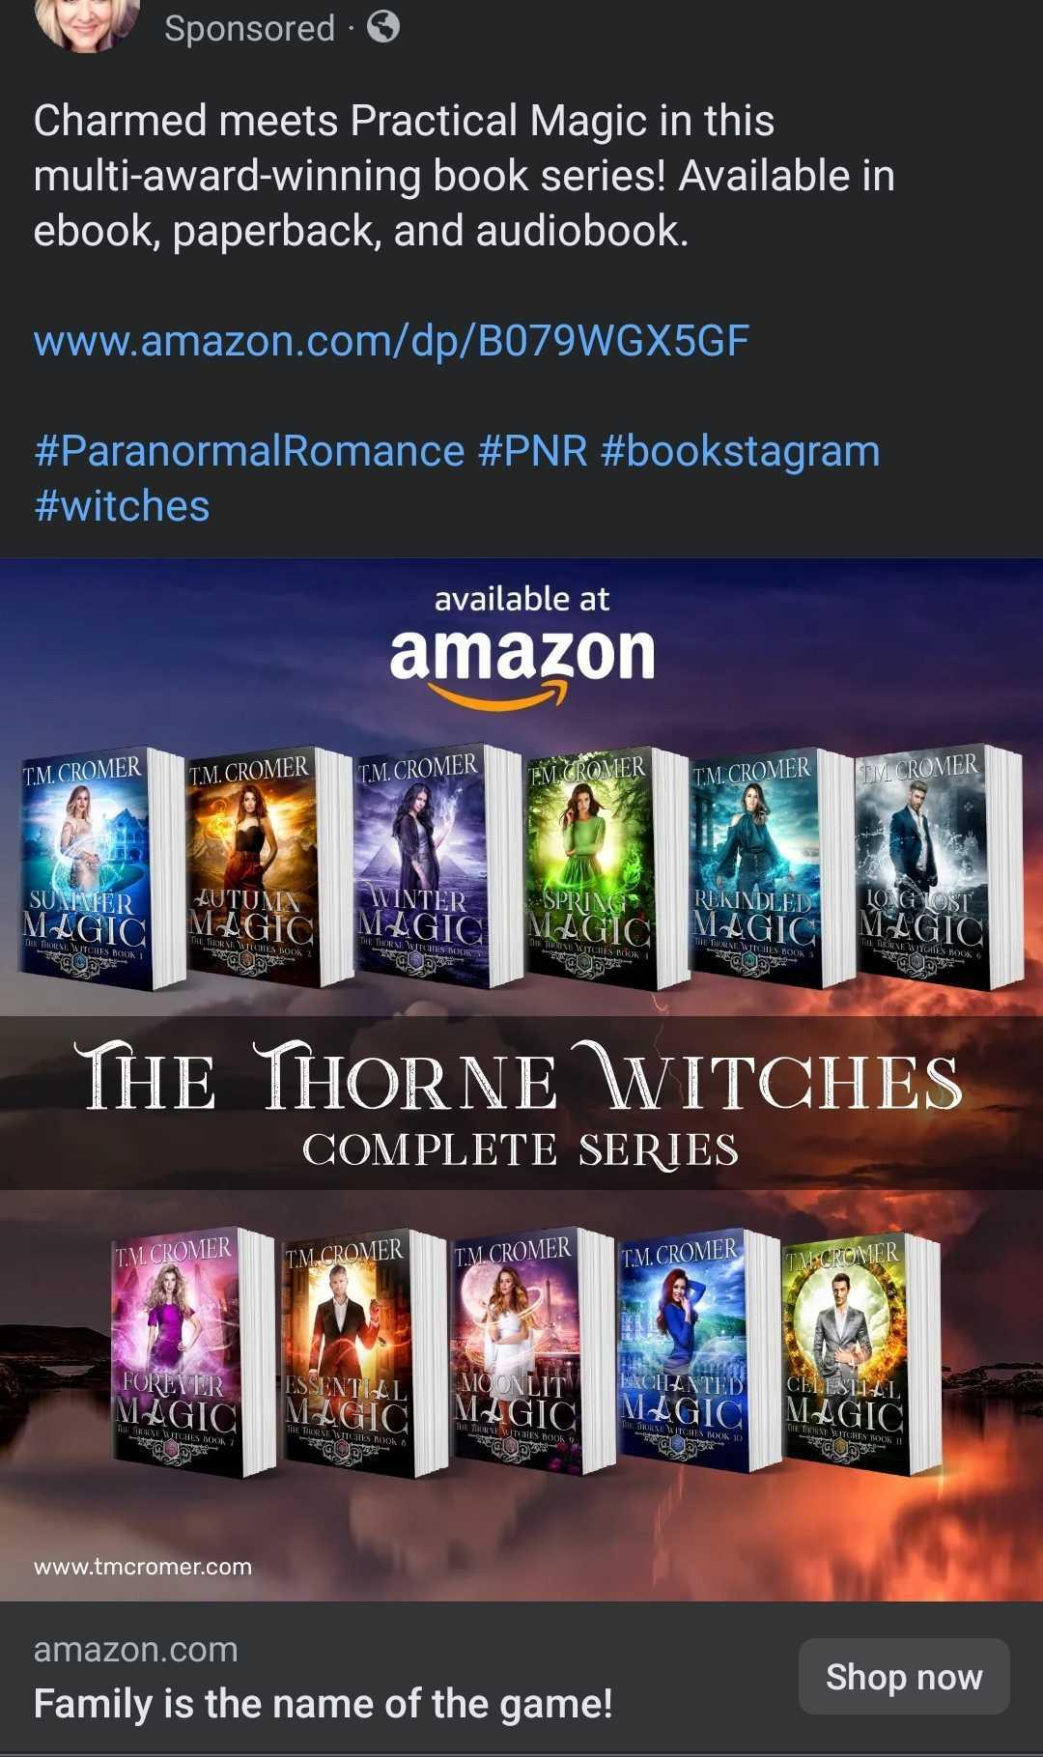
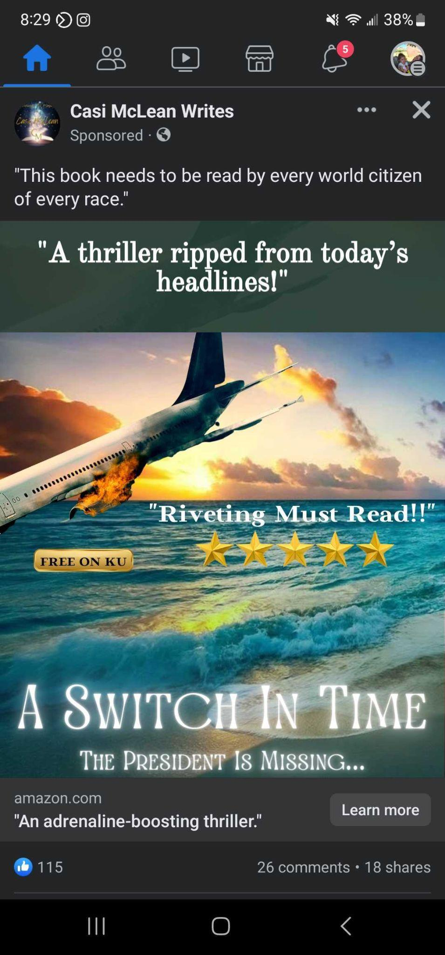

Slide 11

Targeting
Know your genre!
Similar authors/books/movies/video games
Demographics
Readers - which platforms
Audio listeners

Slide 12
Creative
Dynamic Ads = automatic testing
Test individually, one aspect at a time
What are others doing?
Canva or Bookbrush

Slide 13
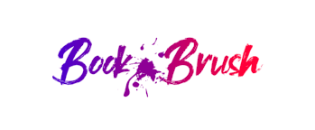
Bookbrush
Dozens of images in seconds! - Instant Mockups
Custom images
Boxset images
Movie trailers
A+ Content

Slide 14
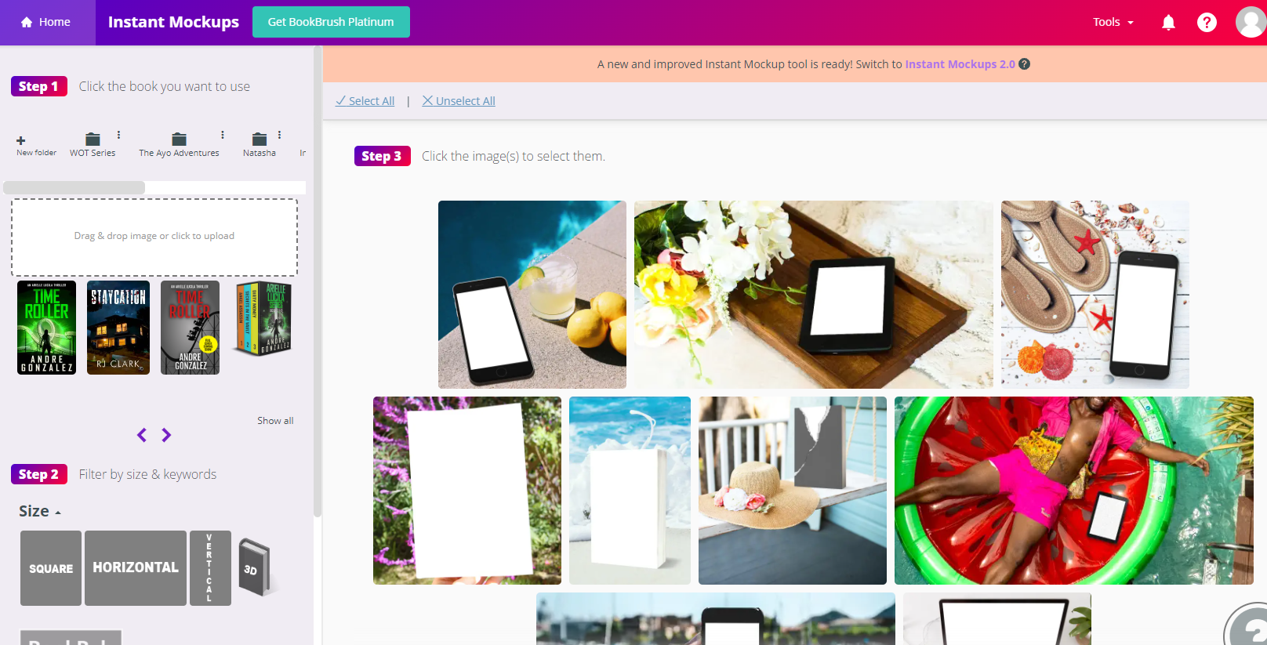

Slide 15
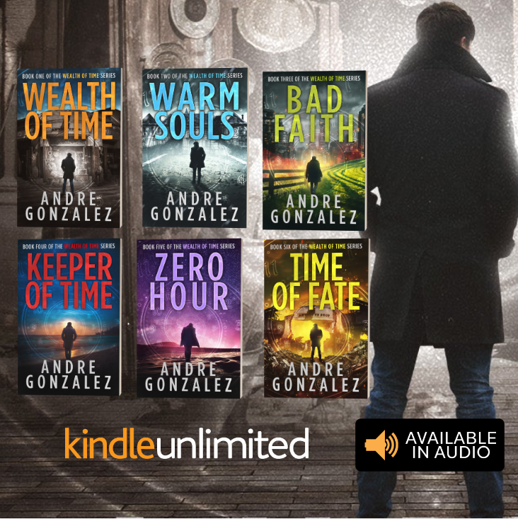

Slide 16
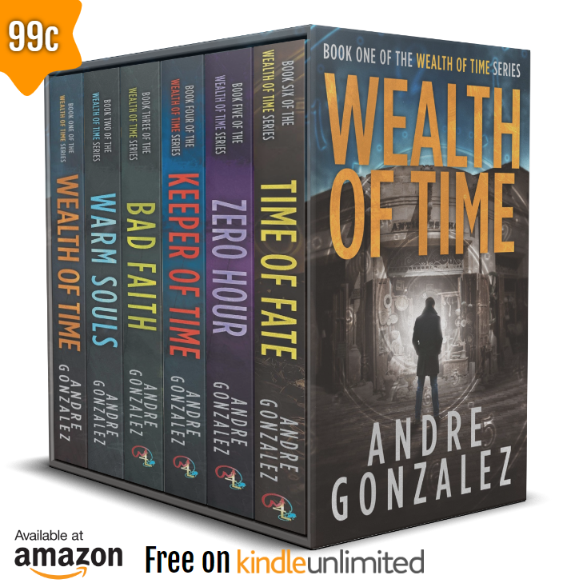

Slide 17
Facebook Ads Platform
Campaign - back end details
Ad Set - back end details
Ad - reader-facing
Will need to upload a credit card - plan for $5 charges when you start
www.adsmanager.facebook.com

Slide 18
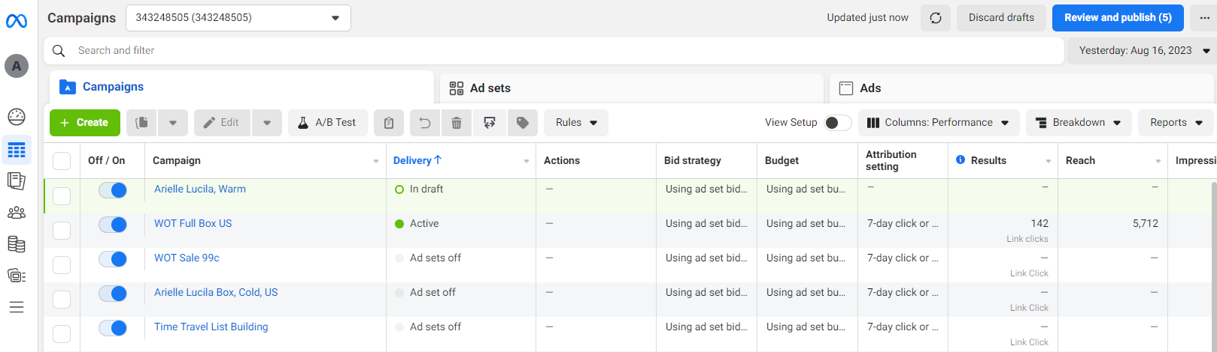

Slide 19
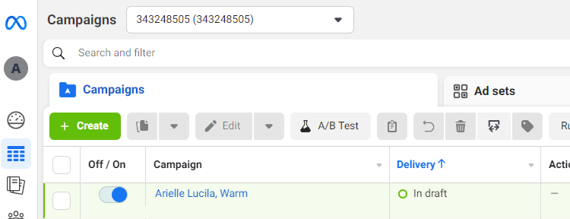
Campaigns
Top Level
Hosts Ad Sets and Ads
Naming Strategies

Slide 20
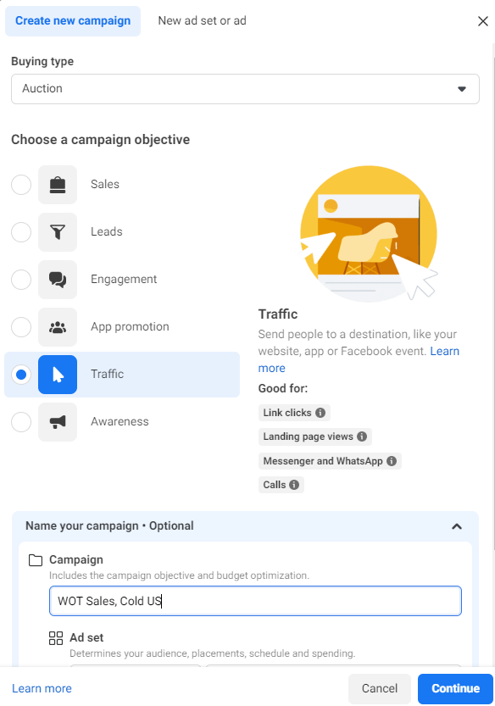
Traffic
Leads

Slide 21
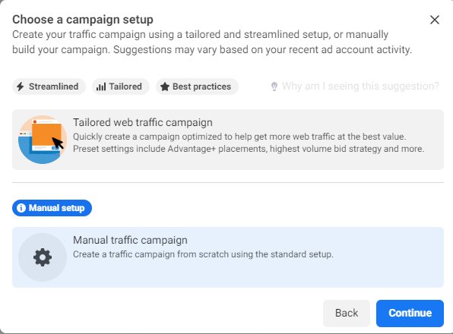

Slide 22
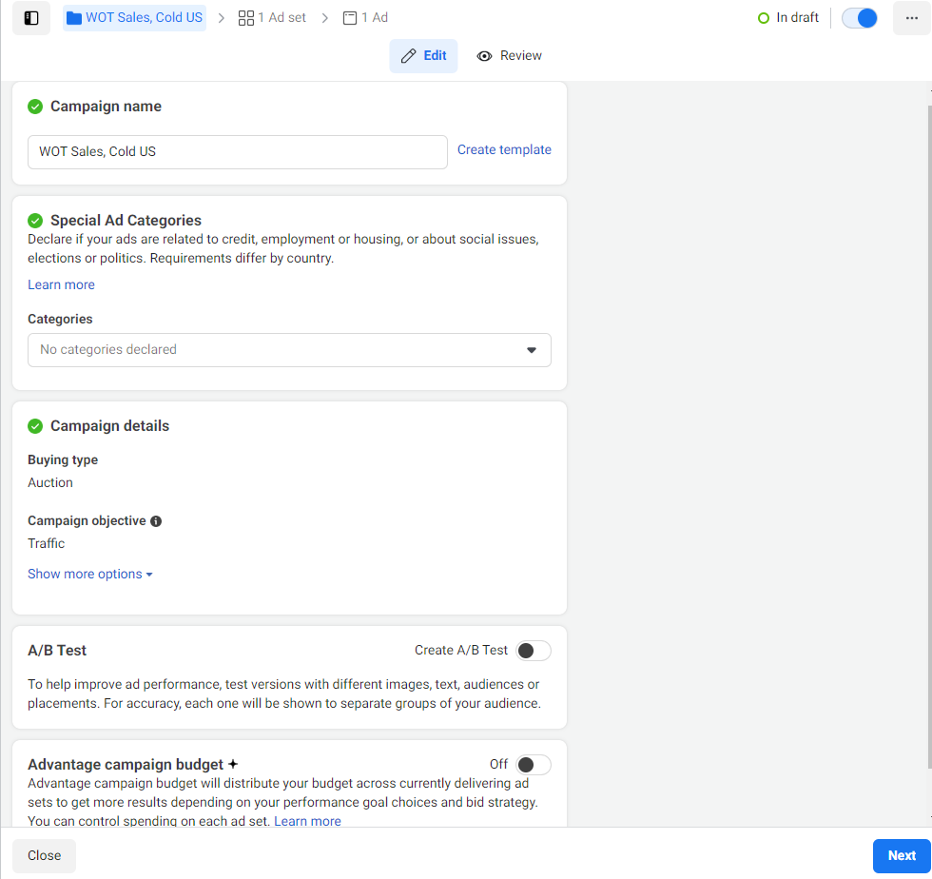

Slide 23
Ad Sets
Targeting/Audience
Budget
Advertising Placements
Dynamic Creative
Naming Strategies

Slide 24
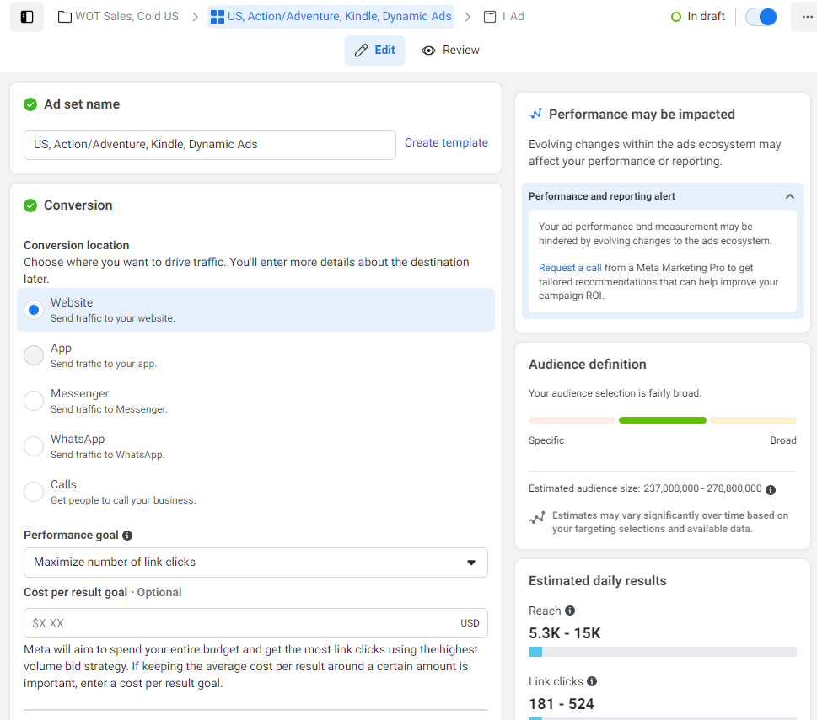
Ad Set Name should highlight audience
Estimated performance on right updates as you go

Slide 25
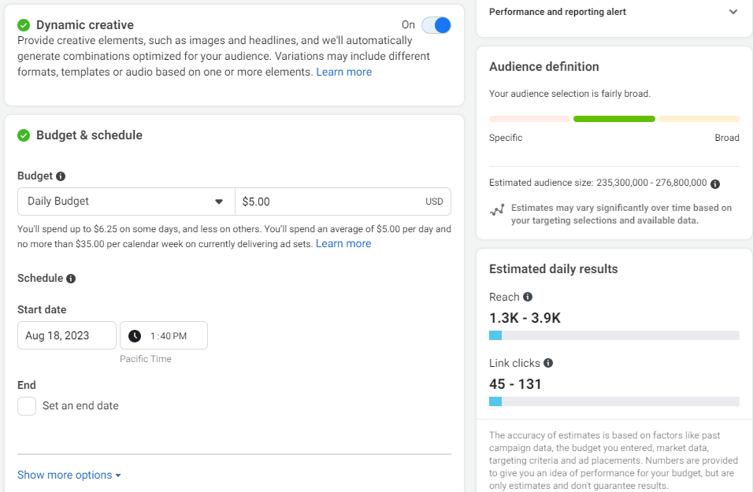
Do NOT start ads after 3pm!

Slide 26
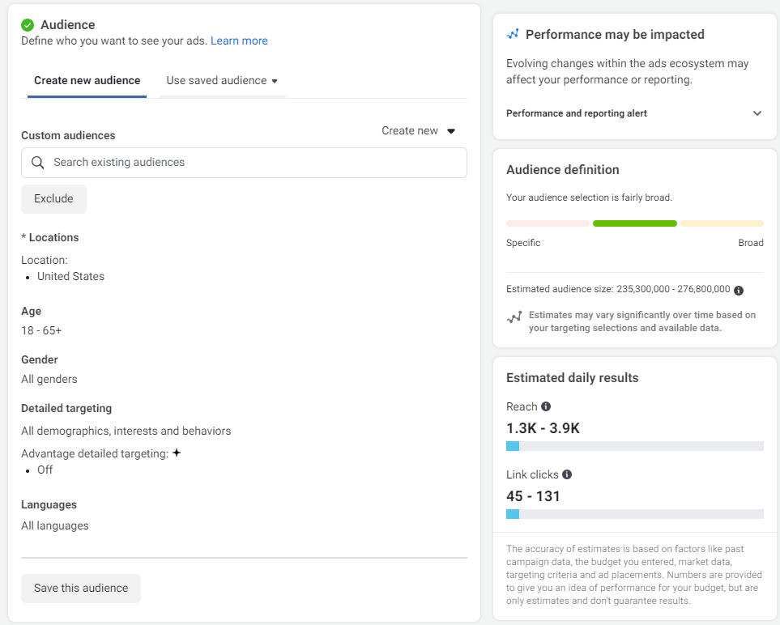
Custom Audiences (Lookalike)
Location
Age
Gender
Detailed Targeting

Slide 27
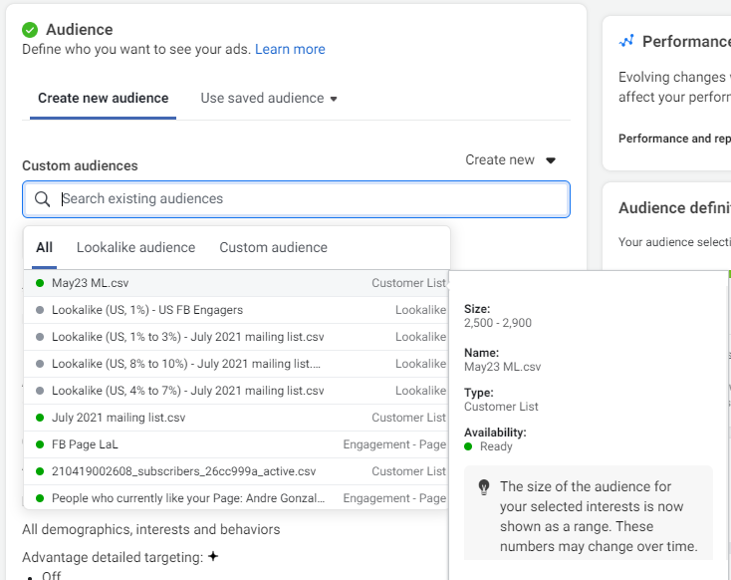
Facebook followers
Mailing List subscribers
Lookalike (1,000 followers)

Slide 28
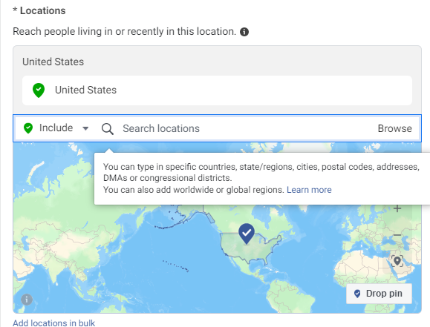

Slide 29
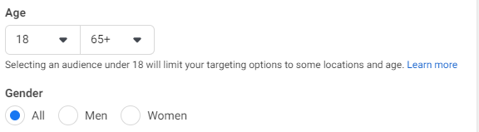

Slide 30
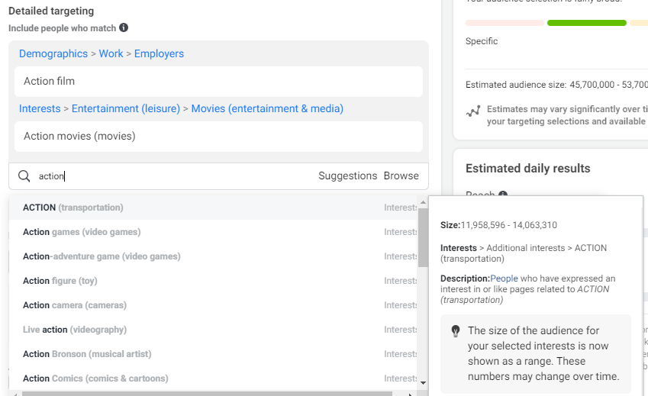

Slide 31
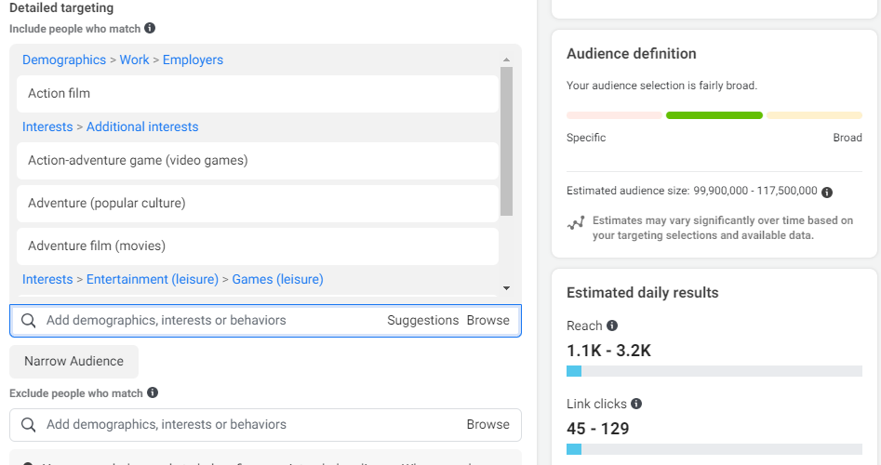

Slide 32
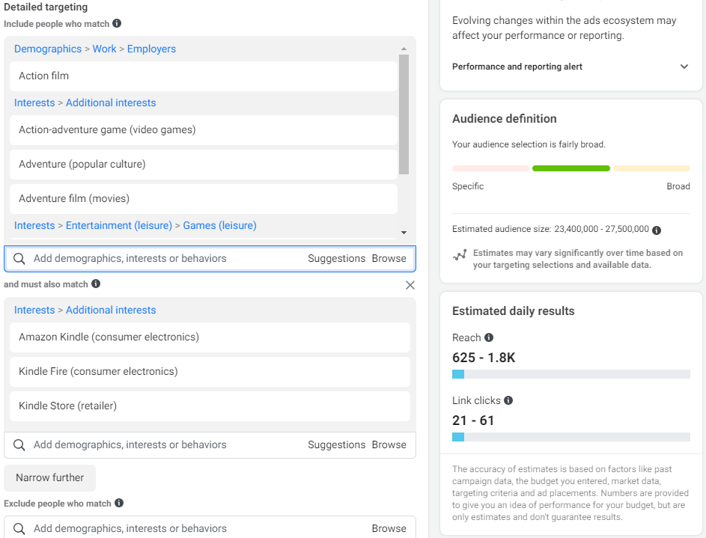

Slide 33
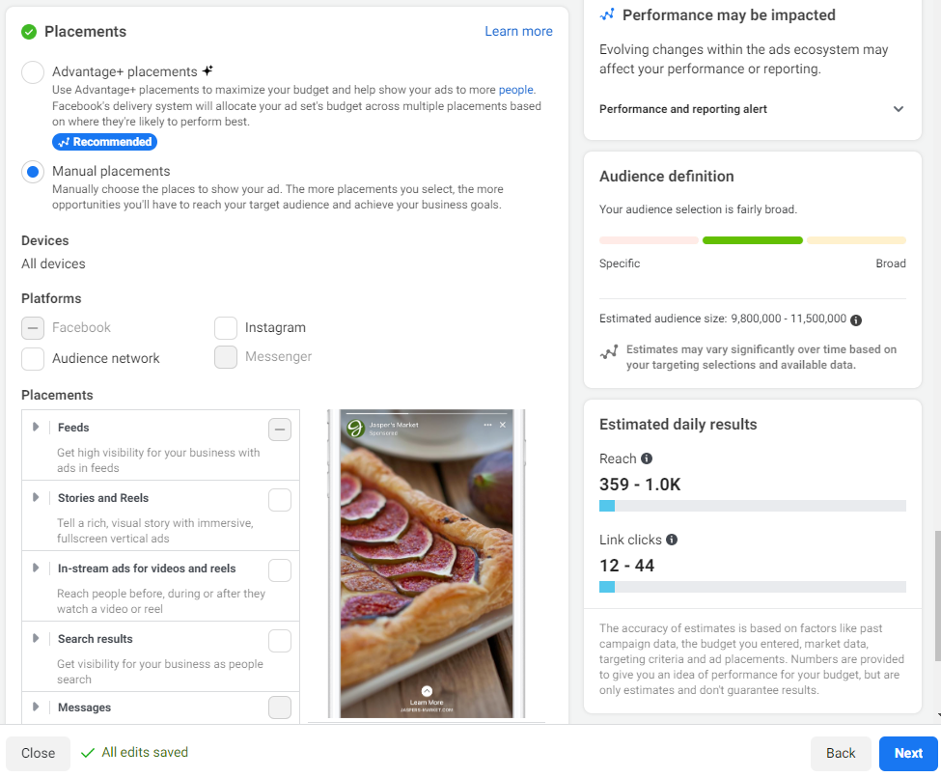
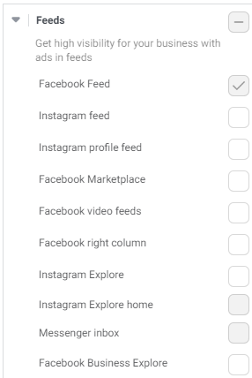
FB Feed only!
Instagram can be experimented

Slide 34
Ad
Creative
Dynamic
Images/Text
Link to Landing Page
Preview

Slide 35
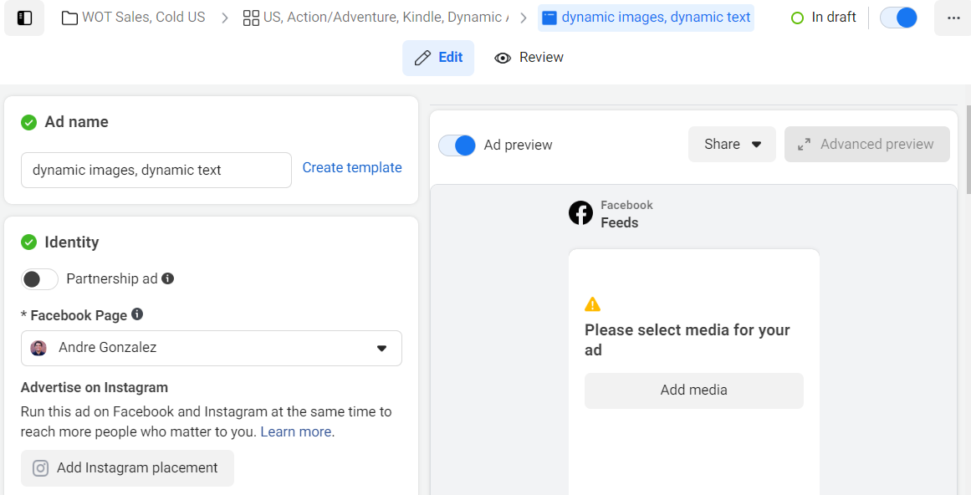

Slide 36
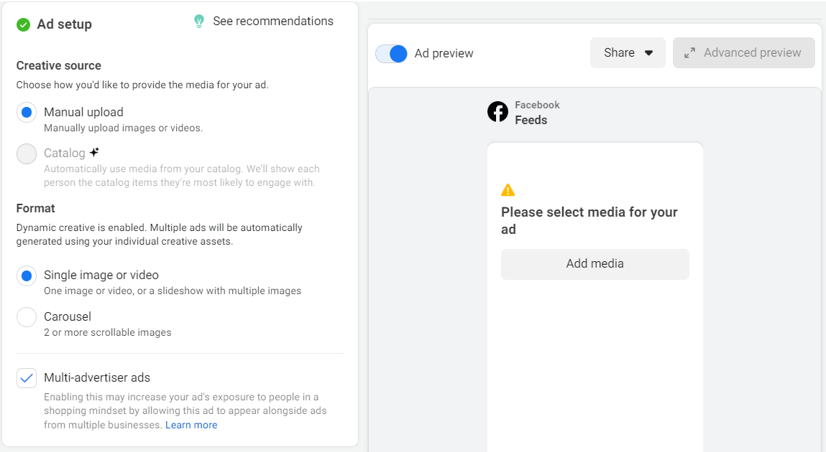

Slide 37
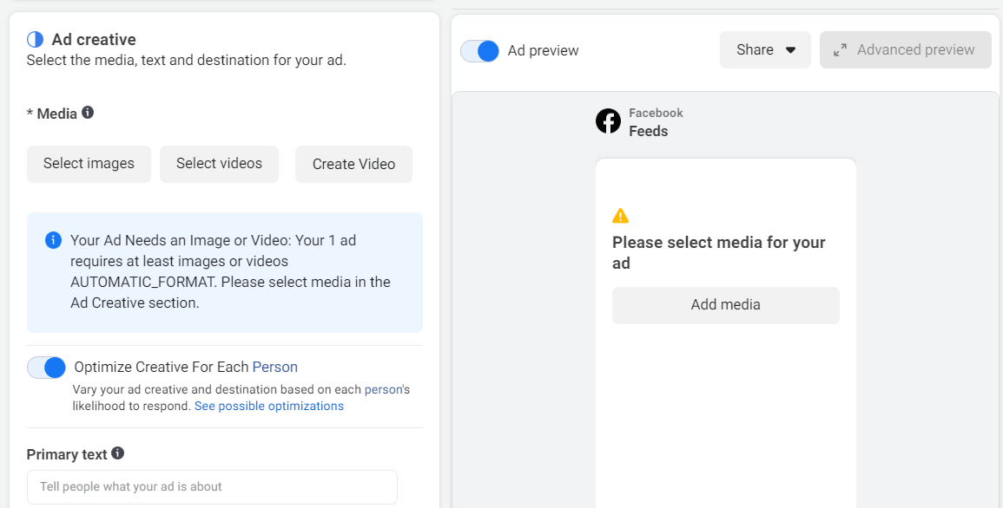

Slide 38
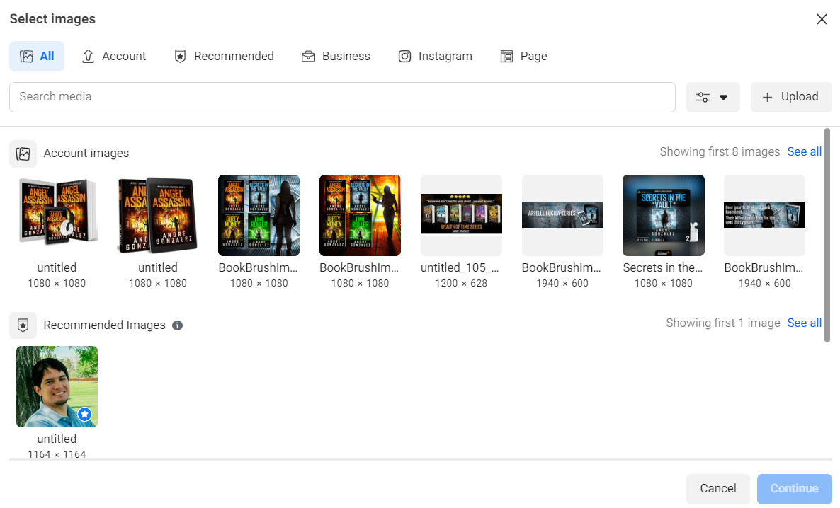

Slide 39
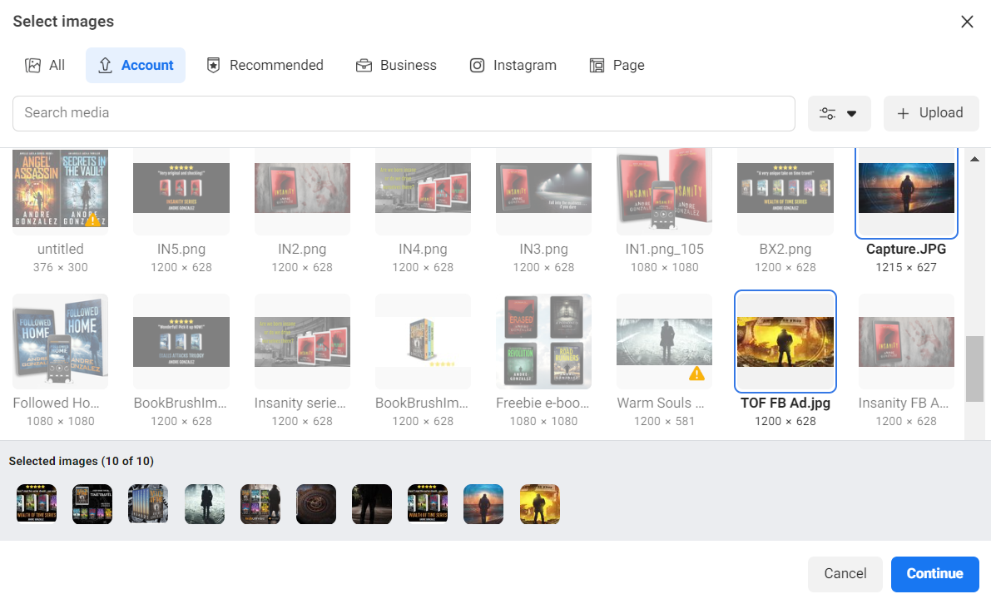

Slide 40
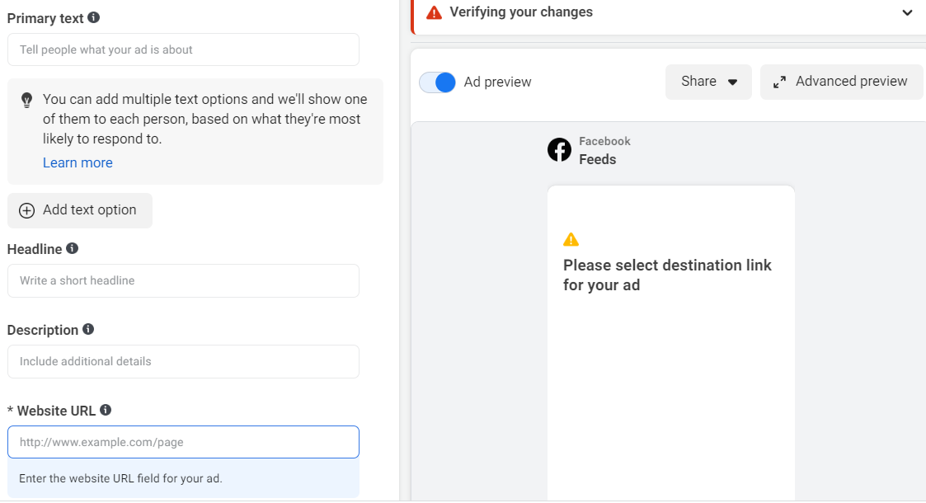

Slide 41
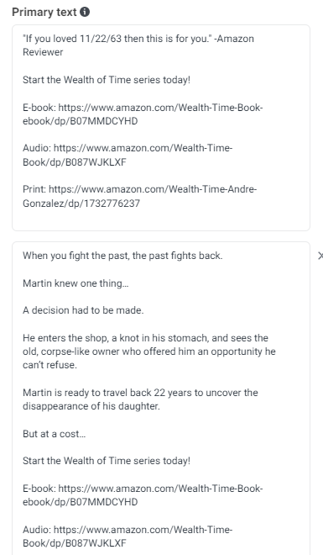

Slide 42
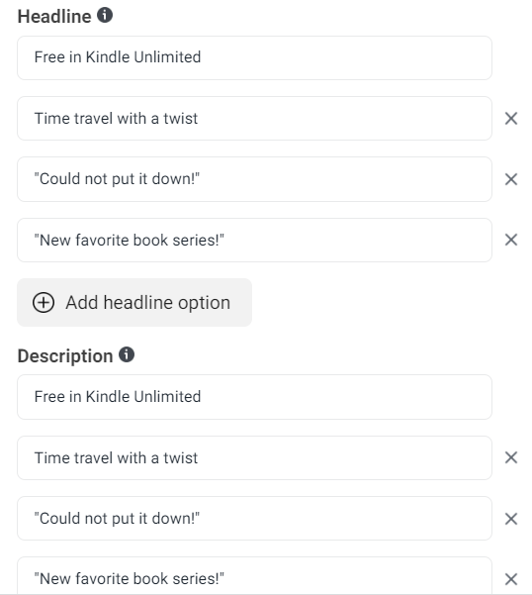

Slide 43
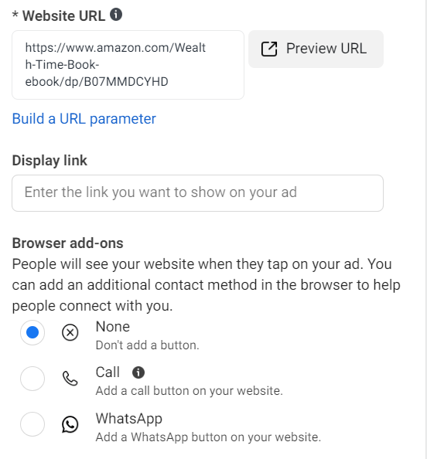
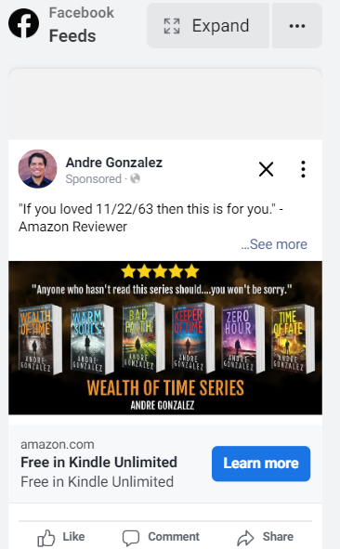

Slide 44
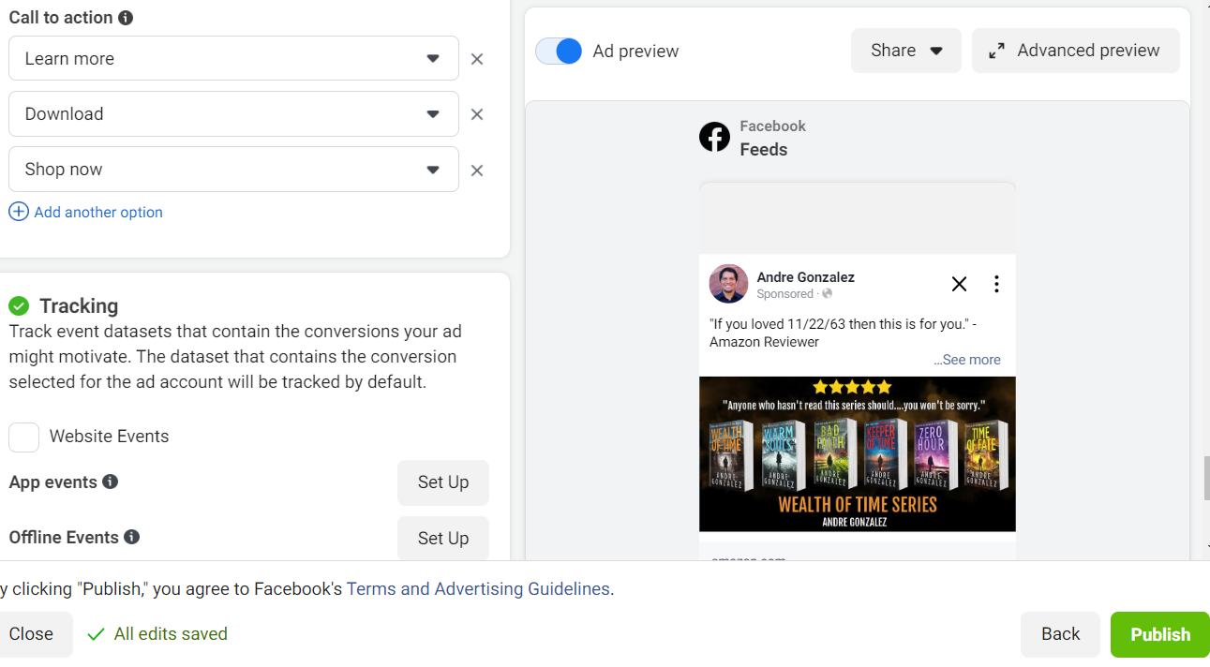

Slide 45
Common rejections from Facebook
Image quality too low
Curse words in text
Too much text on image
Inappropriate images

Slide 46
Testing & Tracking
Know your baseline numbers
Amazon Attribution Links
Spreadsheets
Expectations
Testing

Slide 47
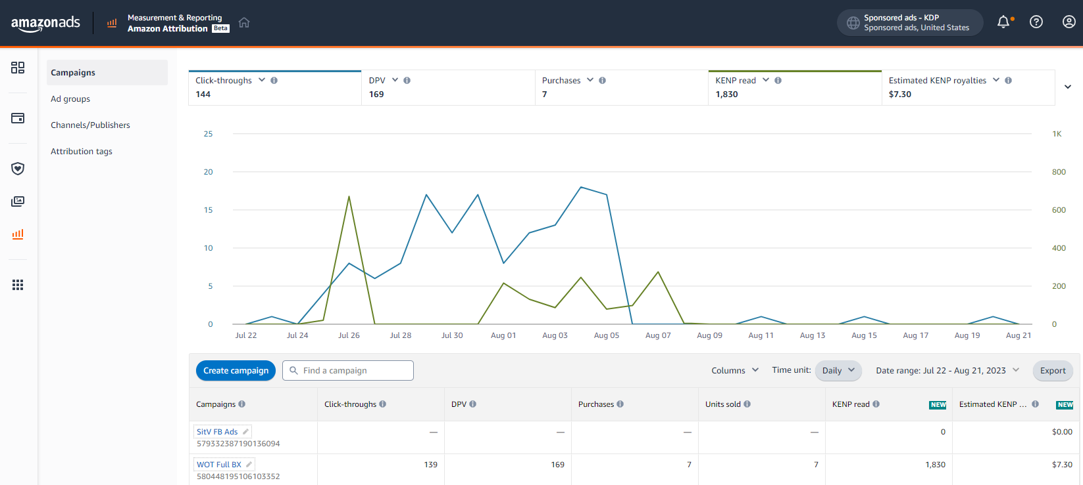

Slide 48
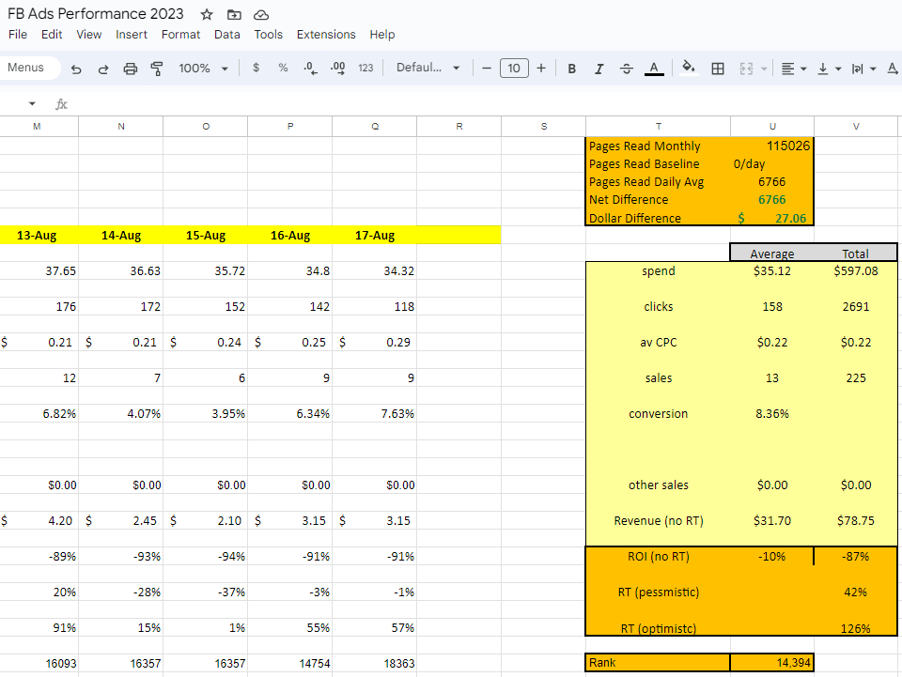

Slide 49
Expectations
First 2-3 days start slow
Sales trickle in
May or may not remain steady
Watch daily and make adjustments
Test, test, test!
Strong ads don’t last forever

Slide 50
Testing
Never make adjustments on a well-performing ad
Duplicate Ad Sets and make changes
Test one thing at a time
Allow the 2-3 day window before making decisions

Slide 51
Scaling
Slow and steady
No more than 20% every other day
Continue to track as you scale
Every ad has a ceiling
Increase spend from Ad Set tab

Slide 52
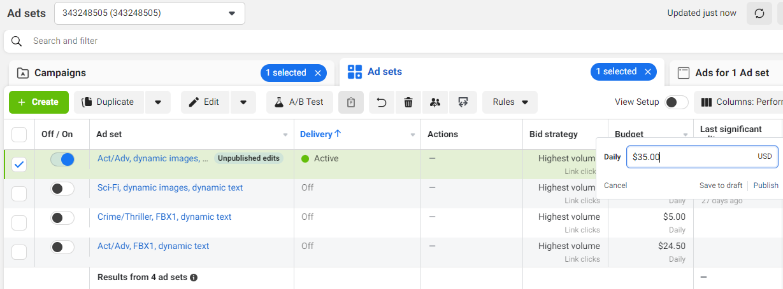

Slide 53
Advanced Facebook Ads
Retargeting
Ask for reviews
Launches
Contests
International success
YOU ARE READY TO START YOUR ADS!!

Slide 54

Questions
andregonzalezauthor@gmail.com
www.M4Lpublishing.com

