Slide 1
Optimize Your Amazon Sales Page
Andre Gonzalez

Slide 2

About Me
Co-Owner of M4L Publishing
20 books of my own
2021 RMFW Indie Writer of the Year
Seven years experience

Slide 3
Sales Funnel
Book
Book Package (cover + blurb)
Ad/Marketing
Landing Page
All four must be in sync!

Slide 4

Landing Page
Amazon Sales Page
Direct Sales
Reader Magnet Landing Pages
Indie and Trad authors can edit with Author Central

Slide 5
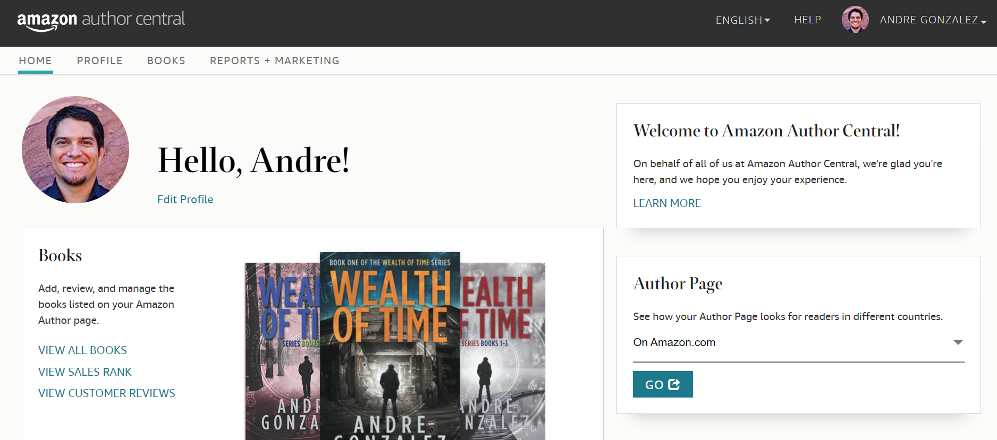
Author Central - author.amazon.com

Slide 6

Profile - Author Bio (multi languages), Headshot, Amazon profile link, view author page in all markets
Books - Claim your titles, Edit book page details
Reports + Marketing - Amazon follower count, sales rank, reviews, book recommendations on author page

Slide 7

What can you control?
Blurb (if self-published)
Editorial Reviews
From the Author
From the Inside Flap
From the Back Cover
More on all of this to come!

Slide 8

Book Package
Book Title
Cover
Blurb
Readers see these three things first!

Slide 9
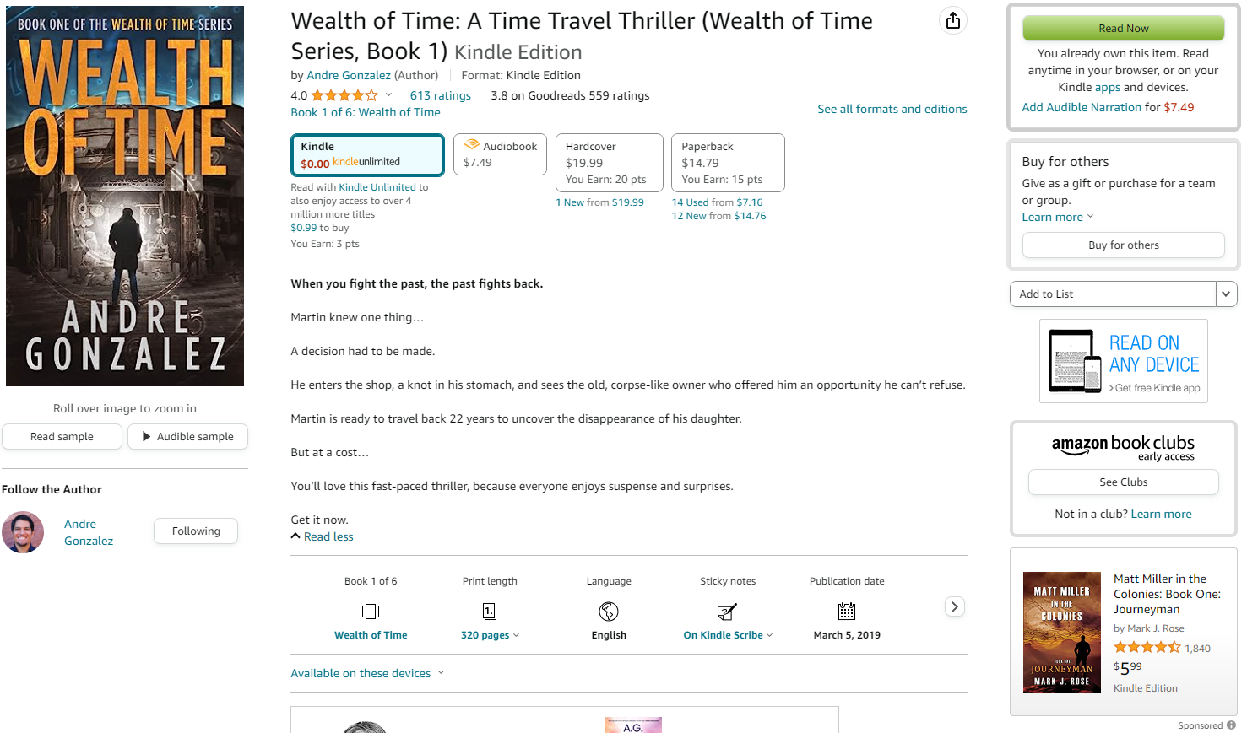

Slide 10
Book Titles
Genre A
Genre B
Genre C
Finding You
Things We Never Got Over
Behind the Net
Heartless
Pucking Around
Never Give Your Heart to a Hookup
Happy Place
Knot So Lucky
That One Night
Right Man, Right Time
Strange Weather
The Fervor
Killing Season
Our Mother in the Lake
Dead End
Emergency Broadcast
Outbreak Chaos
A Dark Breed
The Exorcist’s House
Decaying Haven
King of Battle and Blood
Zodiac Academy
The Modern Girl’s Guide to Magic
Trial of the Sun Queen
Kingdom of Ash
Lady of Darkness
Rule to the Aurora King
The House Witch
A Prince So Cruel
A Deal with the Elf King

Slide 11
Use Subtitles

Slide 12

Covers
Do not stick out!
Blend in…

Slide 13
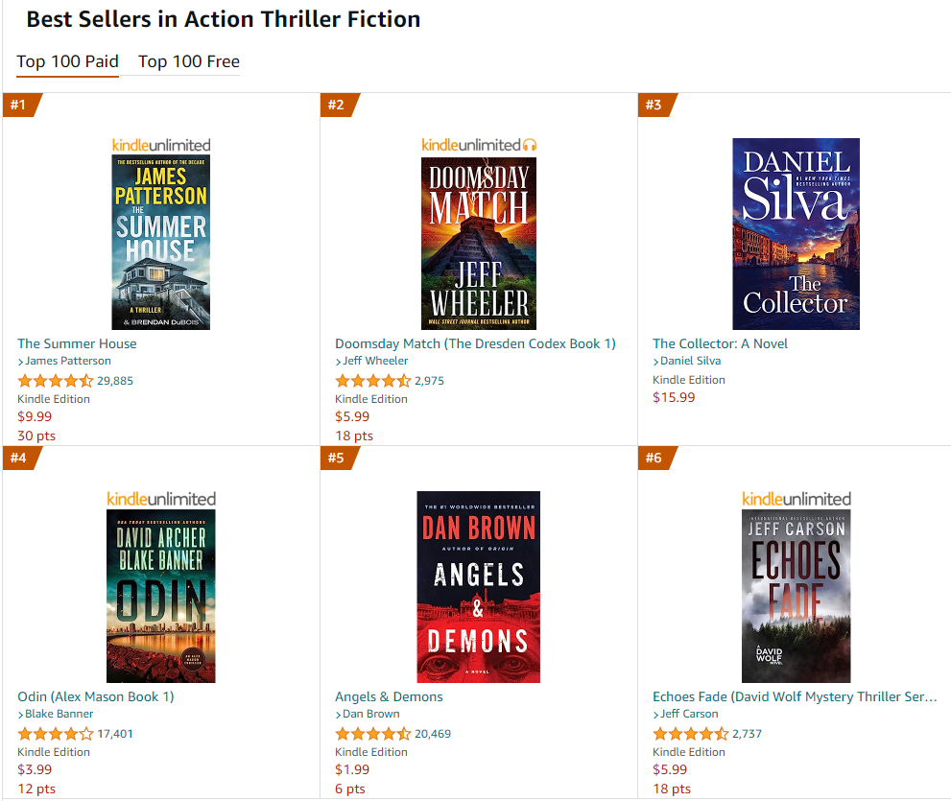

Slide 14
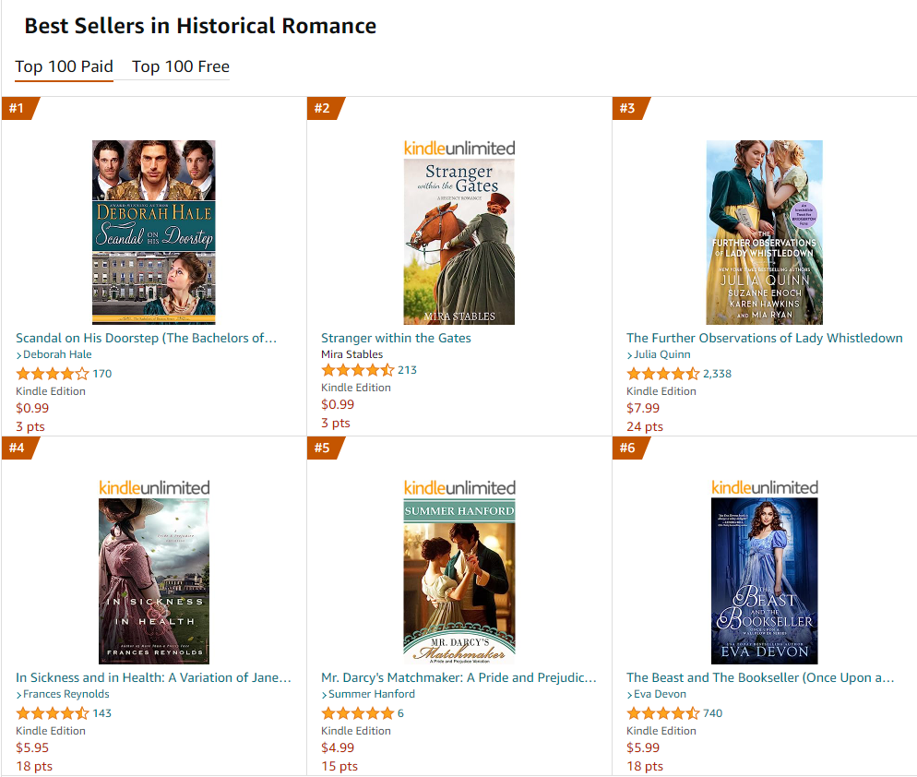

Slide 15
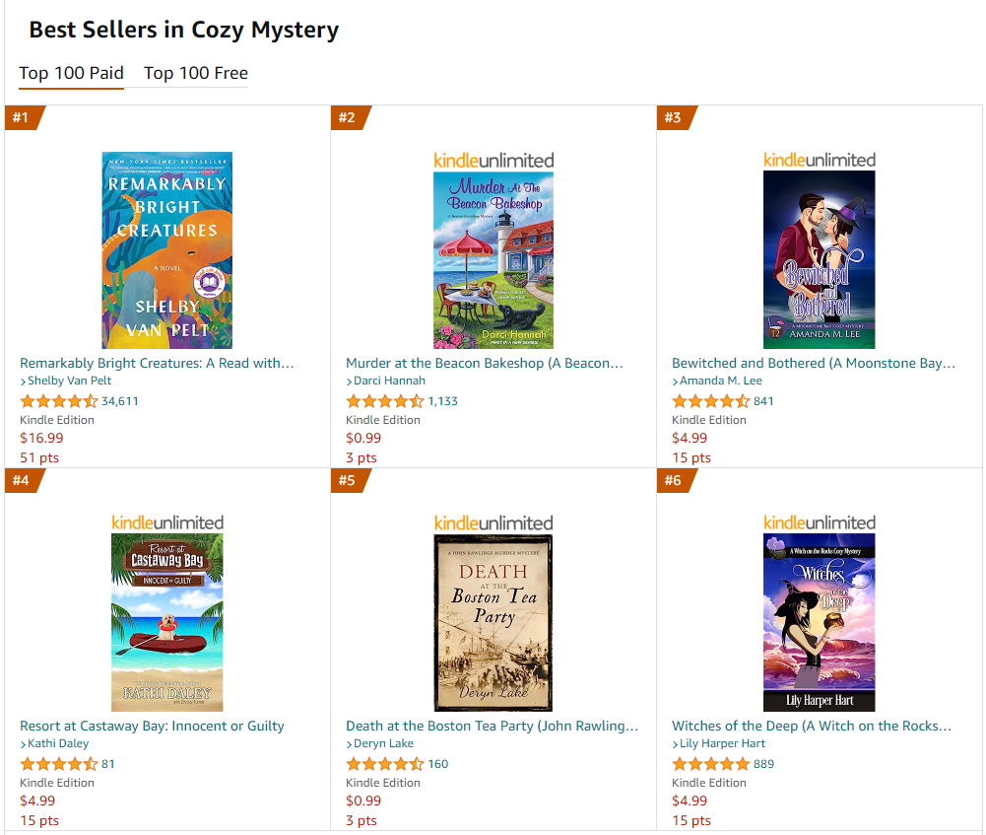

Slide 16

Blurbs
Read as many blurbs as you can…then read 100 more!

Slide 17
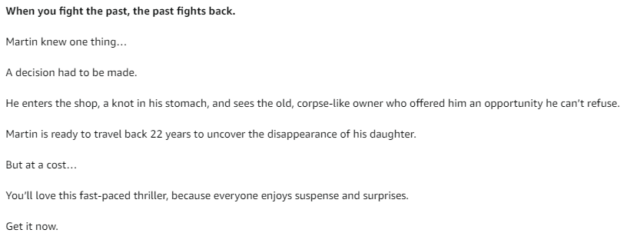
Time Travel

Slide 18
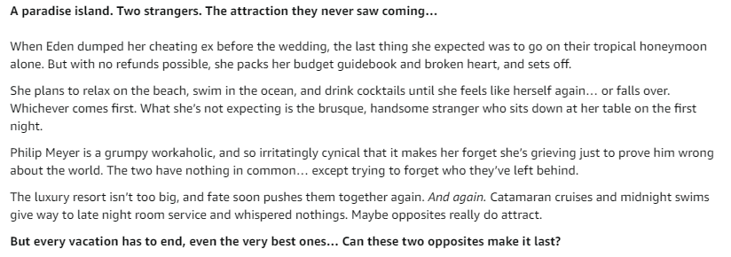
Romance

Slide 19
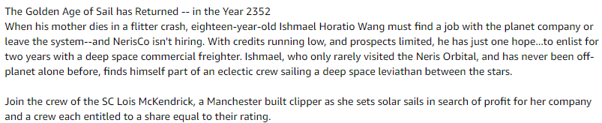
Space Opera

Slide 20

Moving down the Amazon Page

Slide 21
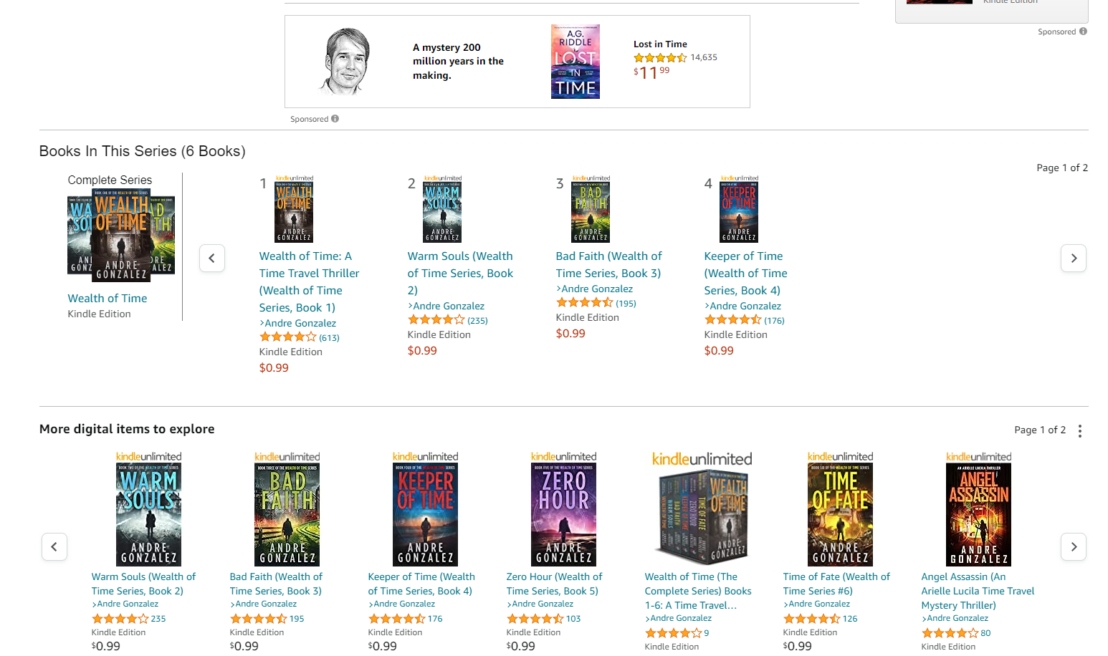

Slide 22


A+ Content
Provide a visual for readers
BookBrush has the templates!
Dozens of images in seconds! - Instant Mockups
Custom images
Boxset images
Movie trailers
A+ Content

Slide 23
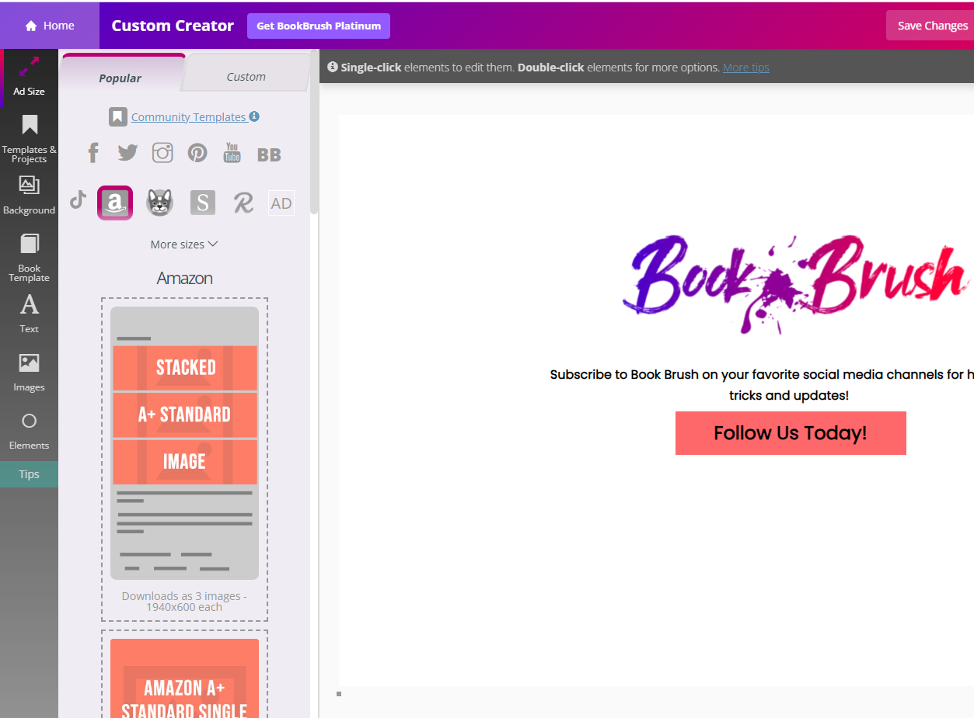

Slide 24


Slide 25


Slide 26


Slide 27
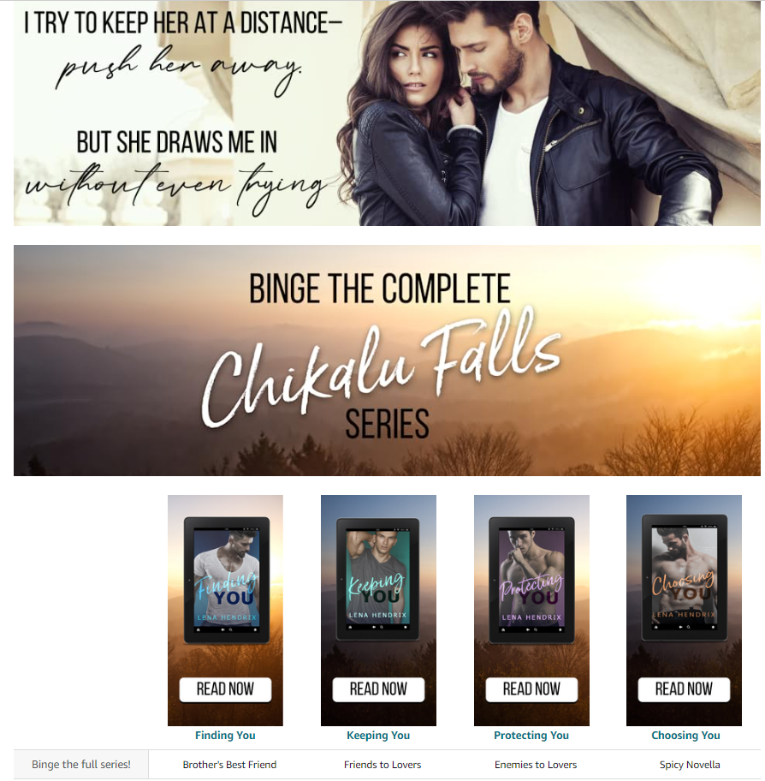

Slide 28
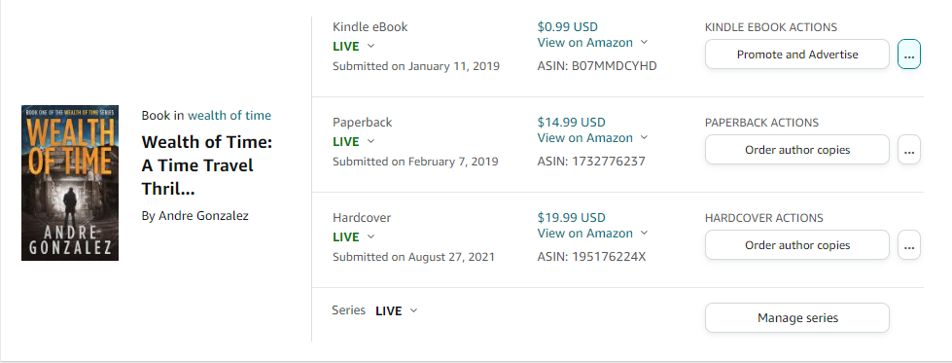
Where to access A+ content

Slide 29
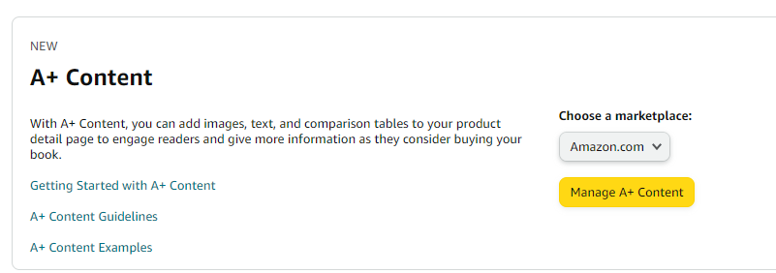

Slide 30
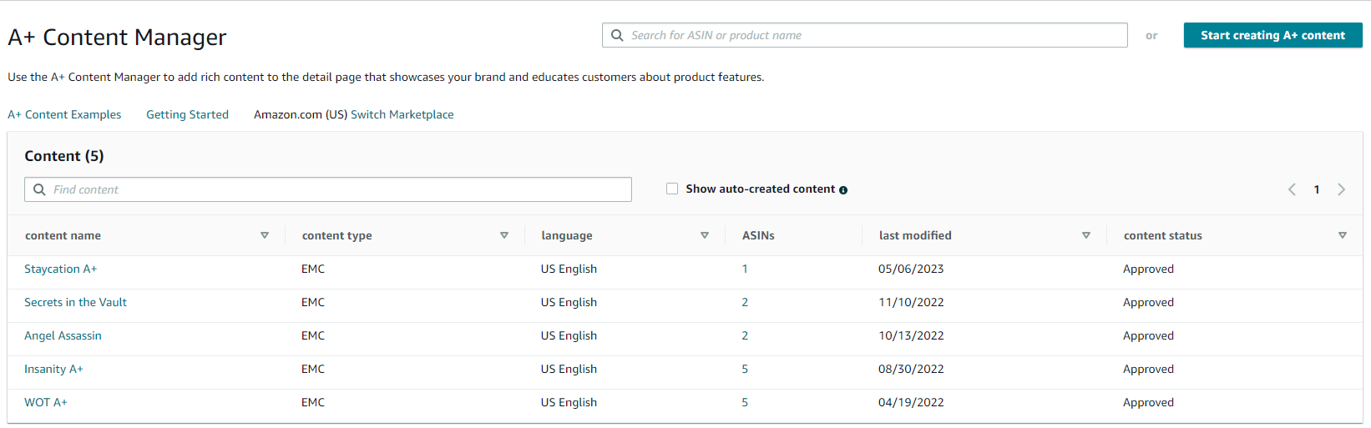

Slide 31
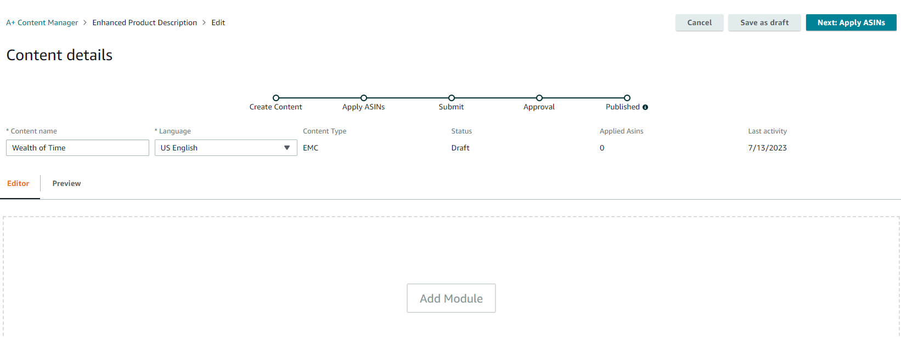

Slide 32
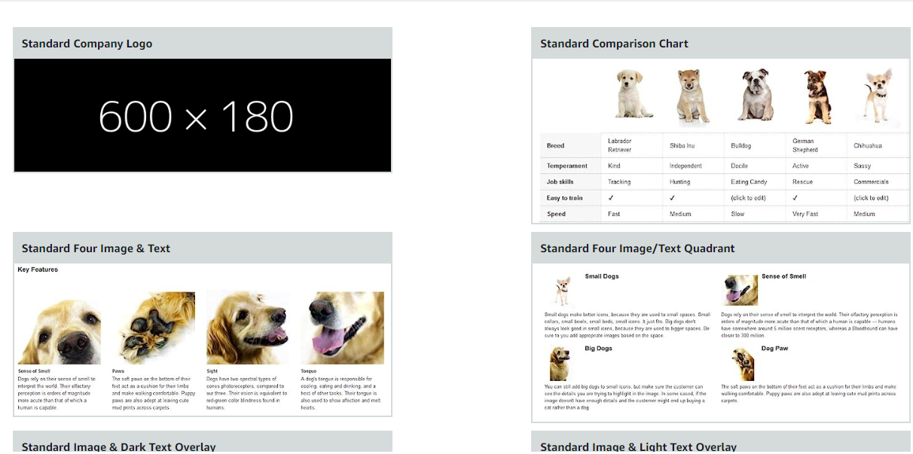

Slide 33
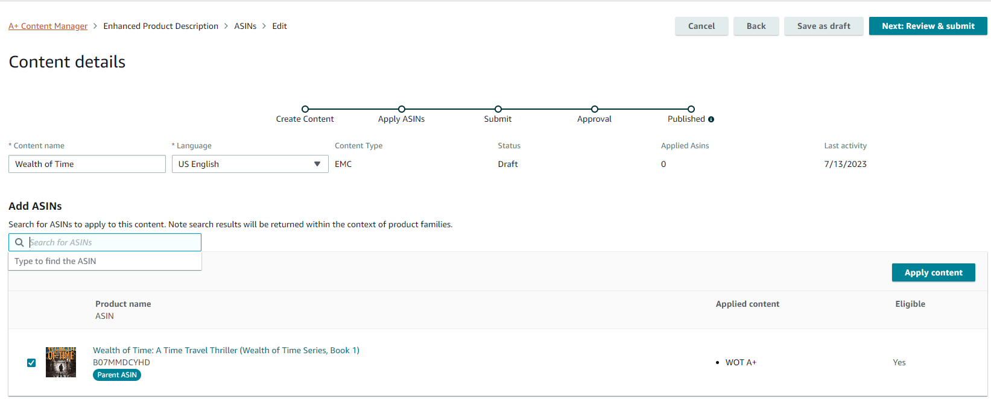

Slide 34
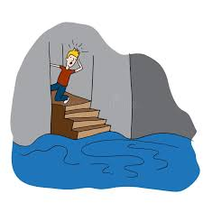
Moving down the Amazon Page

Slide 35
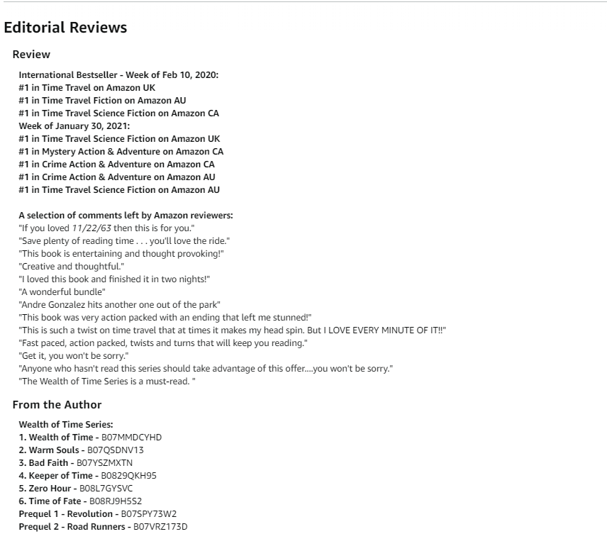

Slide 36
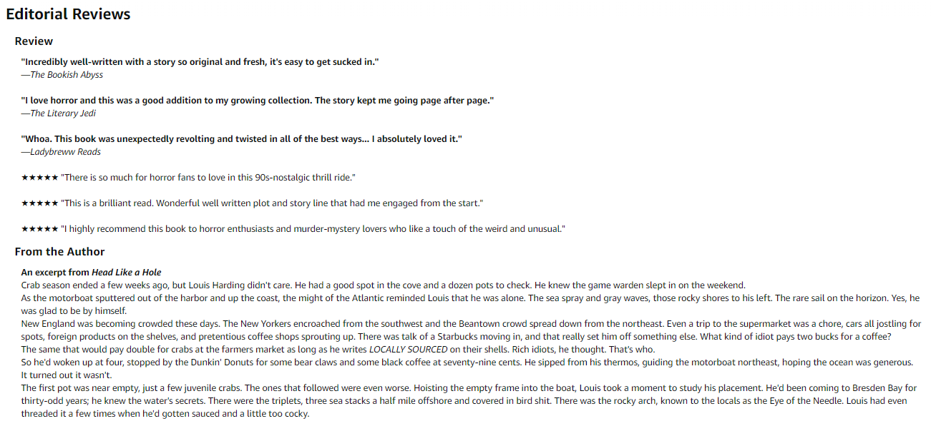

Slide 37
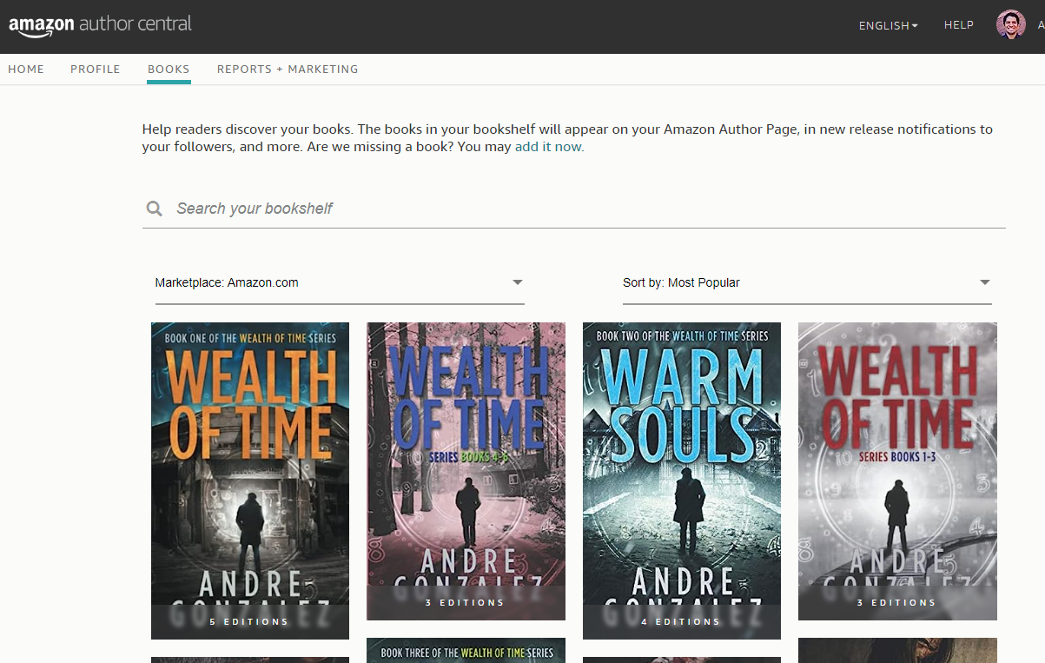
Where to edit?

Slide 38
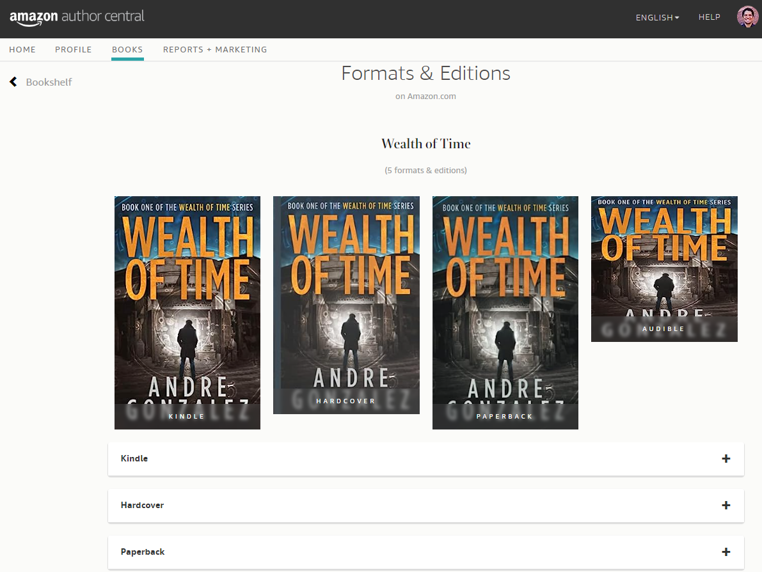

Slide 39
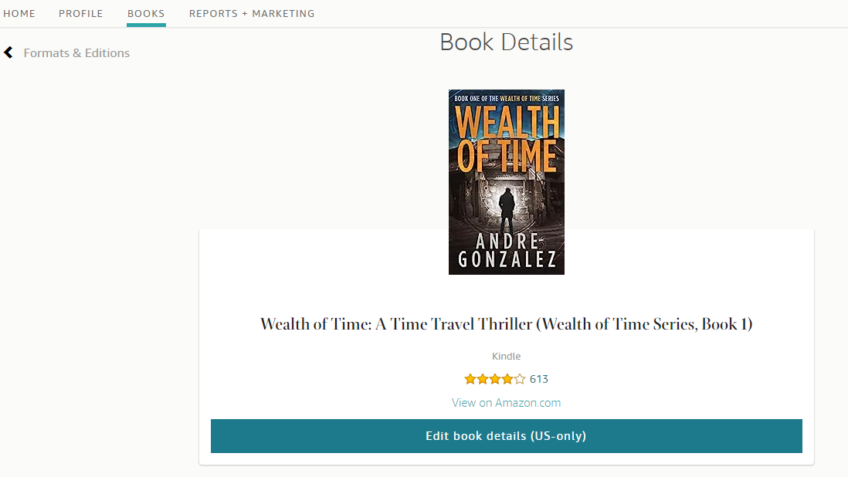

Slide 40
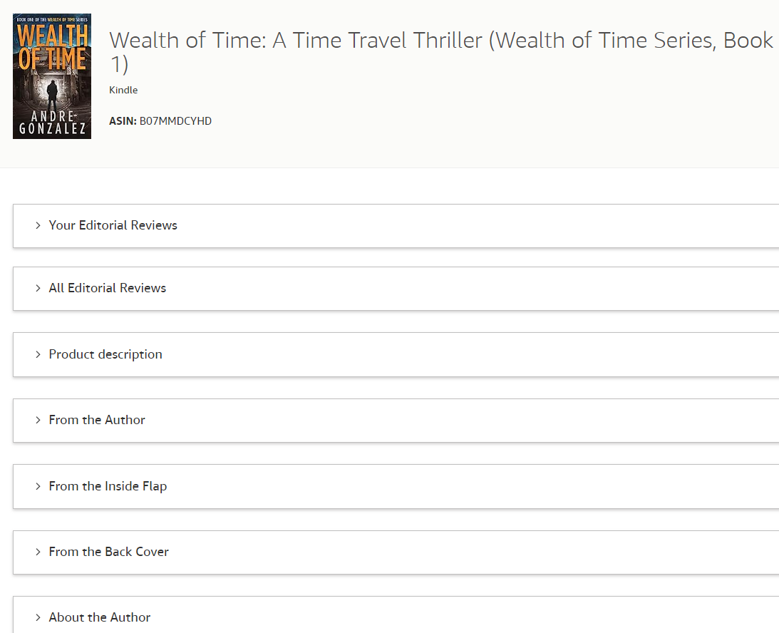

Slide 41
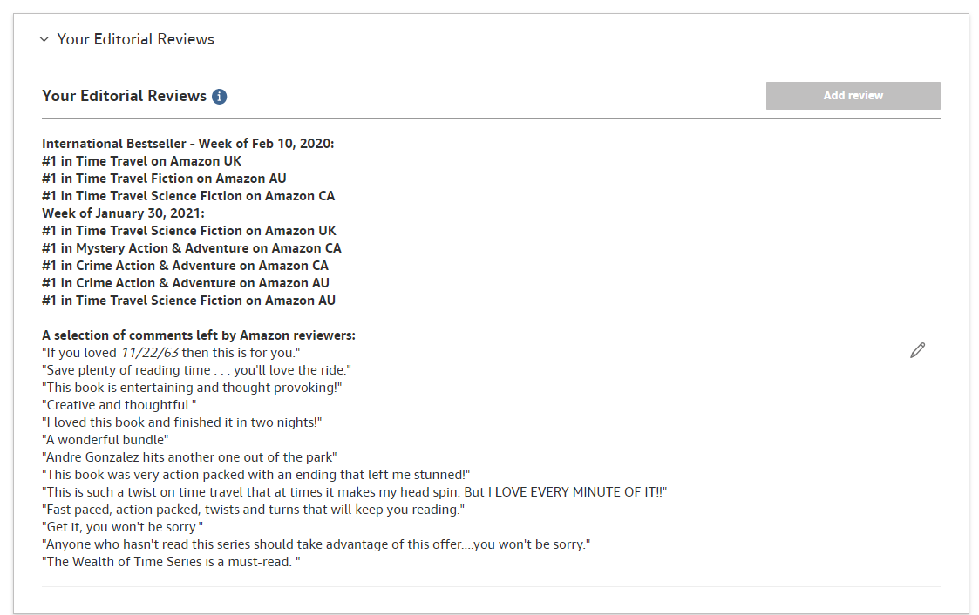

Slide 42
Always double check!
Check back 24 hours later to make sure everything is displaying how you intended

Slide 43
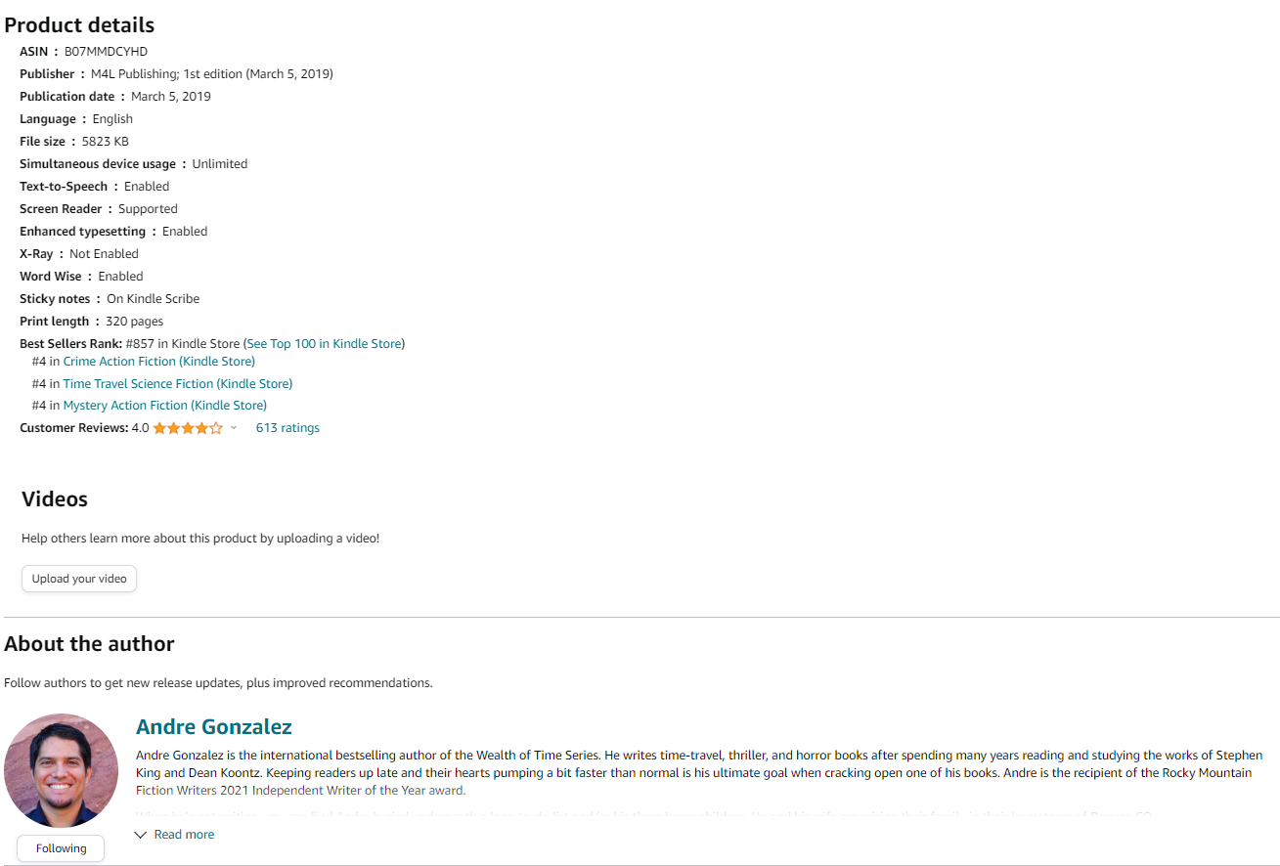

Slide 44

Questions
andregonzalezauthor@gmail.com

